Slide 1
Vulnerable Populations
Why people live in hazardous areas

Slide 2
Objectives - what you should retain...
Differentiating ‘Hazards’ - Behavioural versus Structuralist
Why people live in hazardous regions?
Vulnerability
Risk and risk relationships.

Slide 3
Hazard versus Disaster? (worth repeating!)
Hazard: a perceived natural event that threatens life, property, or both.
Disaster: the realisation of this hazard
Why is the term ‘environmental hazard’ more accurate than ‘natural hazard’?
The term environmental hazard comes about when human populations live in a dangerous environments; therefore, exposing themselves to risk.
It isn’t nature’s fault!

Slide 4
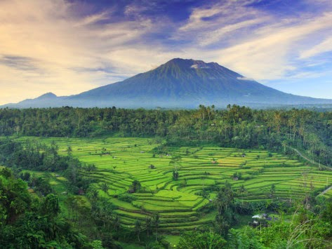
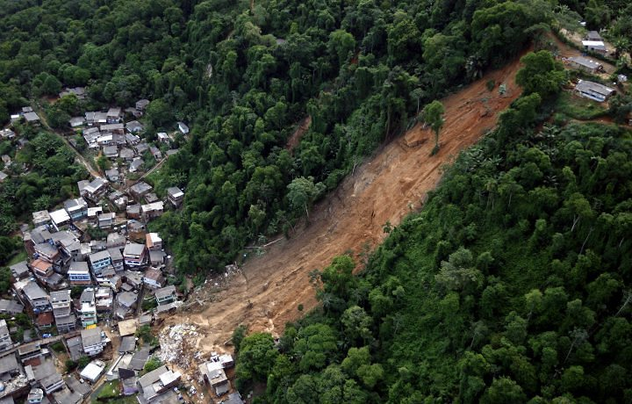
Why do people often live in hazardous environments?
BEHAVIOURAL: people put themselves at risk by living in hazardous areas
STRUCTURALIST: poor people don’t have a choice to live in better areas
Bali Kintamani Volcano, Indonesia.
Bumba Hill Favela, Rio de Janeiro
What is the common link between these two ways of thinking?

Slide 5
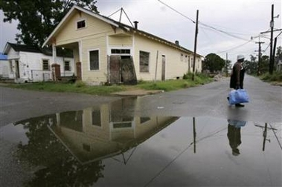
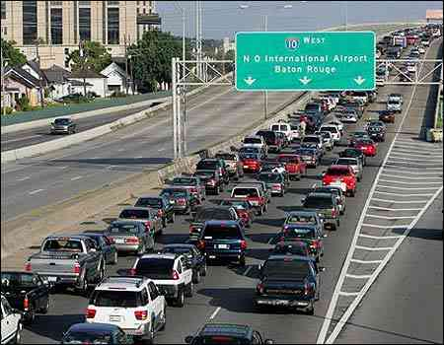
Impacts of hazards often greater for poor populations.
Ninth Ward, New Orleans. Post ‘Katrina

Slide 6
Areas of High Risk: Resource or Hazard?
Free choice?
Locational benefits: climate, coastal region, access to trade and communication, associated recreational activities i.e. alpine environments and skiing
Agriculture: volcanic soil, conducive climate, floodplain soils.
Primary resources such as volcanic minerals, access to fishing grounds, abundant forests etc.
No choice!
Cultural centre or family base
Cannot afford to live elsewhere
Political freedoms
Primary based employment structure i.e. farming.

Slide 7
Vulnerability: how susceptible a population is to a natural hazard (within AND between countries)
Population density:
Growing population of Mt. Merapi pushing them into riskier areas (-)
Understanding of the area:
Living memory and new arrivals - Mt St Helens NO memory of recent eruptions (-)
Public education:
Knowledge of drill protocols and building codes - Japan (+)
Awareness of hazards:
These are now global events e.g. 2004 ‘Boxing Day’ tsunami.
Existence of early warning systems:
USA’s satellite and airborne detection and monitoring systems (+)
Effectiveness of lines of communication:
Japan’s media/text alerts (2011 EQ); China’s ability to mobilise military (2008 Sichuan EQ) (+)

Slide 8
Vulnerability!
Availability and readiness of emergency personnel: Cyclone Nargis (Burma, 2008) not enough (-); China’s military, 2008 and delayed but deployed US National Guard ‘Katrina 2005.
Insurance cover: Low incomes = poor recovery, inability to rebuild and protect for future events (-)
Construction styles and building codes: Compare the outcomes of Japan (2011) 9 on Richter Scale - approx 8,000 deaths. Whereas the Pakistan Kashmir EQ (2005) 7.6 on Richter Scale, approx 87,000 deaths
Political structural support: The failure of the Burmese Government to seek international assistance was a clear precondition to those who starved or died from disease after Cyclone Nargis (+/-)
General cultural factors: i.e. trust in government or scientific expertise, social networks, the control or autonomy a community has; perceptions of threat level (+/-)

Slide 9
Risk and Risk Relationships
Environmental Hazards
25 Million Km², 20% of Earth’s land area is highly exposed to natural hazards.
This equates to approximately 3.4 billion people are exposed to a range of Environmental Hazards
3.8 Million Km² = 790 million exposed to 2 or more hazards
0.5 Million Km² = 105 million exposed to 3 or more hazards
Why can’t we avoid regular events, that claim hundreds of thousands of lives, billions of dollars in revenue and prevent and regress economic development in LEDCs?

Slide 10
Analysis of Risk:
R = H * Pop * Vul
R = risk = number of expected human impacts (casualties) due to special groups at risk
H = Annual hazard occurrence probability
Pop = Population living in a given exposed area
Vul = Vulnerability: depends on socio-economic context

Slide 11
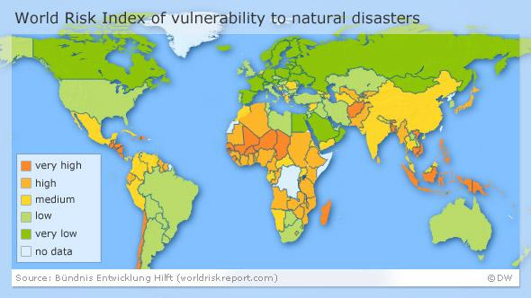
Describe the patterns of vulnerability to environmental disasters [4]

Slide 12
Stages in a disaster - 1
Preconditions
Phase 1 | “Lifestyle” Routine conditions of living, in terms of risk assessment, preparation, social construction of vulnerability.
Phase 2 | “Incubation Period” Erosion of safety measures, complacency of safety measures, signs or problems ignored or overlooked. “It will never happen to us!”

Slide 13
Stages in a disaster - 2
II. The Disaster
Phase 3 | “Triggering Event or Threshold” Impending or onset of crisis. Danger clear or immediate Warnings possible, flight or evacuation a possibility...
Phase 4 | “Impact and collapse” Death, destruction, injury. Political and security system collapse Individual coping mechanisms
Phase 5 | “Secondary and tertiary damage” Exposure of survivors, post-impact hazards, delayed deaths.
Phase 6 | “Outside emergency aid” Rescue and recovery, evacuation, shelter provision, clearing dangerous debris/wreckage. “Organised response” Unilateral, bilateral and multilateral efforts.

Slide 14
Stages in a disaster - 3
III. Recovery and Reconstruction
Phase 7 | “Cleanup and ‘emergency communities’” Relief and refugee camps Emergency housing or relocation Salvage and essential infrastructural work Blame game! Reconstruction debates Commissions of inquiry via official means
Phase 8 | “Reconstruction and restoration” Reintegration of damaged community into wider society Re-establishment of ‘everyday’ life Continuing private and recurring communal grief Disaster related development and mitigation.

