Slide 1
Mini-IA Overview
10: Leisure at an International Scale: Sport
​10d. Mini-IA Assignment: a) Mini-IA Overview & Grading Scheme b) ​A Data Sheet & Spearman's Rank Instructions﻿ c) Spearman's Rank PPT Overview

Slide 2
How would you MEASURE factors that may affect success in sport?
physical/biological makeup (race, age, gender, etc.)
wealth (GDP, government investment, median income, etc.)
culture (mean years of schooling, happiness index, social progress index, number of superstars)
geography (number of mtns, elevation/relief, population density)
politics (government investment, level of democracy, freedom of the press)

Slide 3
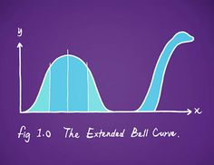
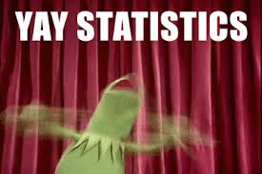
Does One Indicator Affect Success More Than the Other?
How would you find out??
STATISTICS!!!
YAAAAAAAAY!

Slide 4
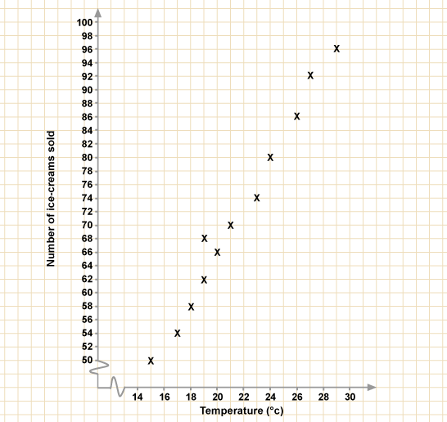
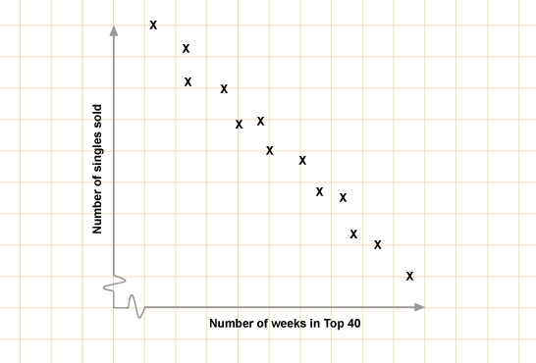
A scatter graph shows us the relationship between two sets of data.
Negative correlation
As one set of data increases, the other decreases
Positive correlation
As one set of data increases,
the other also increases

Slide 5
Open the Student Sheet to begin the journey…..
Top of the spreadsheet you will see variables for different factors potentially influencing sport (Olympics) in countries around the world.
To analyze this data (‘analysis section’) you will choose two variables to graph them to visually show data and describe pattern/trend
THEN we will test, statistically, whether there is indeed a correlation, that can be extrapolated worldwide.

Slide 6
What is the relationship between success in sports and …?
To draw a scatter graph in excel:
1. Highlight the columns of data you are interested in – use Ctrl if the columns are not next to each other
2. Click on the graph buttons – choose XY scatter with no line or curve
3. Add axis labels, the first column is along the X axis
4. Draw the graph, add a trend line by clicking on the data points and right click with the mouse button.
How to use a scatter graph
Does the line of best fit show a negative or positive correlation?
Is the correlation strong or not?
Try to explain the pattern using your knowledge of geographic theory.

Slide 7
How strong is my correlation……….
Spearmans rank is a statistical measure to show the STRENGTH of a relationship between two variables (copy formula below into your notes)
The closer R is to +1 or -1 the stronger the likely correlation

Slide 8
IN YOUR ‘ANALYSIS SECTION’ of IA:
Declare your hypothesis and the null hypothesis
“there is no significant relationship between birth rate and life expectancy”
2) What other factors may influence your data?
You should write these down next
3) RANK the data sets (set up for you in excel)
give the highest values 1 and the lowest a 10 (or whatever number you are working with)
4) Record the d (difference) between the ranked data
5) Square the d for each data point
6) Copy full table into your notes

Slide 9
7) Calculate the r_{s} (rho) using the equation:
( r_{s} )
First; SUM the differences
Then; MULTIPLY the SUM by 6
CUBE the N then minus N
DIVIDE top and bottom
SUBTRACT answer from 1

Slide 10
Remember: The closer to 1 the stronger the positive correlation, the closer to -1 the stronger the negative correlation

Slide 11
HOWEVER: We must be certain this result is accurate and CAN BE REPEATED
8) To be certain of result, we test the significance:
Work out the ‘degrees of freedom’ f = (n-2)
(the number of pairs in your sample minus 2)
And compare with r_{s} on table or graph….
Plot your result on EITHER the 2c) Significance table or the inset graph from website to determine how significant your result is…
(ie: considers your result in relation to how much data you had to test from – sample size)

Slide 12
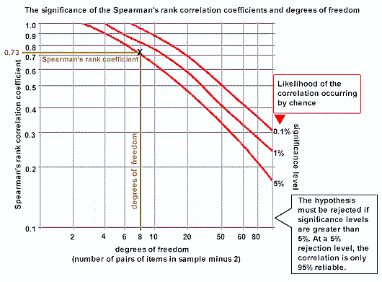
The probability of the relationship you have found being a chance event is ___ in 100

Slide 13
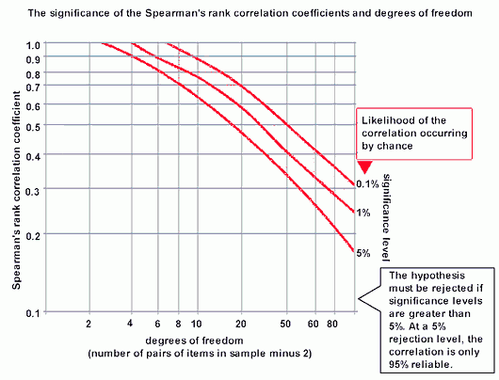
Spearmans rank
Gives you a value of significance

Slide 14
Can we reject the null hypothesis? Is there a strong positive or negative correlation?
Describe your conclusions (answer to your fieldwork question) based on your analysis

