Slide 1
Aim: To evaluate an example of each anti- and pro-natalist policies

Slide 2
Types of policy…
Pro – natalist :
policy to increase the birth rate and increase rate of population growth (needed to balance an aging population)
Anti – natalist:
Policy to reduce birth rate and slow population growth

Slide 3
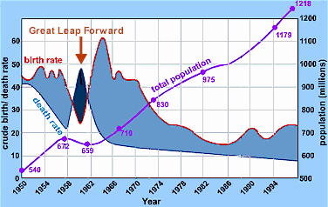
China – demographic transition model
What is the problem here?

Slide 4
What is the one child policy in China?
What do you know??????
Free education, priority housing and pension offered as inducements for first child
Benefits lost after second child is born plus a fine of 15% of family income
Age of marriage set at 22 for men and 20 for women
Couple have to apply to the state to marry and again to have a child
http://www.youtube.com/watch?v=M5TT7KtmFLA&feature=related

Slide 5
Changes in policy in 1987
Farmers in rural areas may try for a boy if their first child is a girl
Minority groups allowed 2 or more children as they live in isolated areas and there are fewer officials to check!

Slide 6
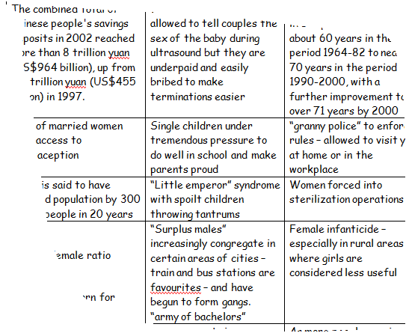
What are the positives and negatives of the policy.
Highlight the positives and negatives on your sheet a different colour

Slide 7
Definition:
Pro Natalist Policy -
A policy which aims to encourage more births through the use of incentives.
In most developed countries, the decline in fertility and the increase in life length has raised three concerns:
A decrease in the supply of labour.
The socioeconomic implications of a population ageing
The long term prospect of population decline and demise
http://www.youtube.com/watch?v=-LkF8bHCqrY

Slide 8
Web inquiry NOTE taking (ie. Key points only)
1. Get the basics on the policy from this website:
http://www.bbc.co.uk/schools/gcsebitesize/geography/population/managing_population_rev5.shtml
2. Use this website to add detail in these areas:
http://news.bbc.co.uk/2/hi/europe/4856992.stm
Tax benefits and tax deductions
carte famille nombreuse
Child care and creches
Incentives to have a third child
3. Is the policy effective?
http://www.washingtonpost.com/wp-dyn/content/article/2006/10/17/AR2006101701652_3.html
YES
How does the French policy allow women to work and raise a large family at the same time?
http://www.bloomberg.com/apps/news?pid=newsarchive&sid=al7FXDMTkeAU
NO
Is the slight increase in fertility rate enough to solve the aging population issue in France?
Final task
You have now looked at two different population policies. Many countries have population policies. Do you think that government attempts to control population can be effective? Would a population policy work here in the Bahamas? Try to explain your answer.

Slide 9
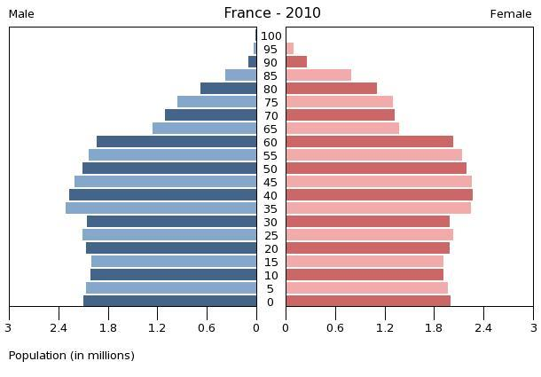
Success?
France’s Birth rate is higher than other EU countries and it is increasing slightly- but is it enough to offset the aging population?

Slide 10
Government attempts to control population are ineffective - Discuss
Split into two groups:
Group 1: attempts to control population are effective
Group 2: attempts to control population are ineffective
Write down 9 ideas or examples that you can use to prove your case.
One per post it note.
Use a different colour note for social and economic reasons.

Slide 11
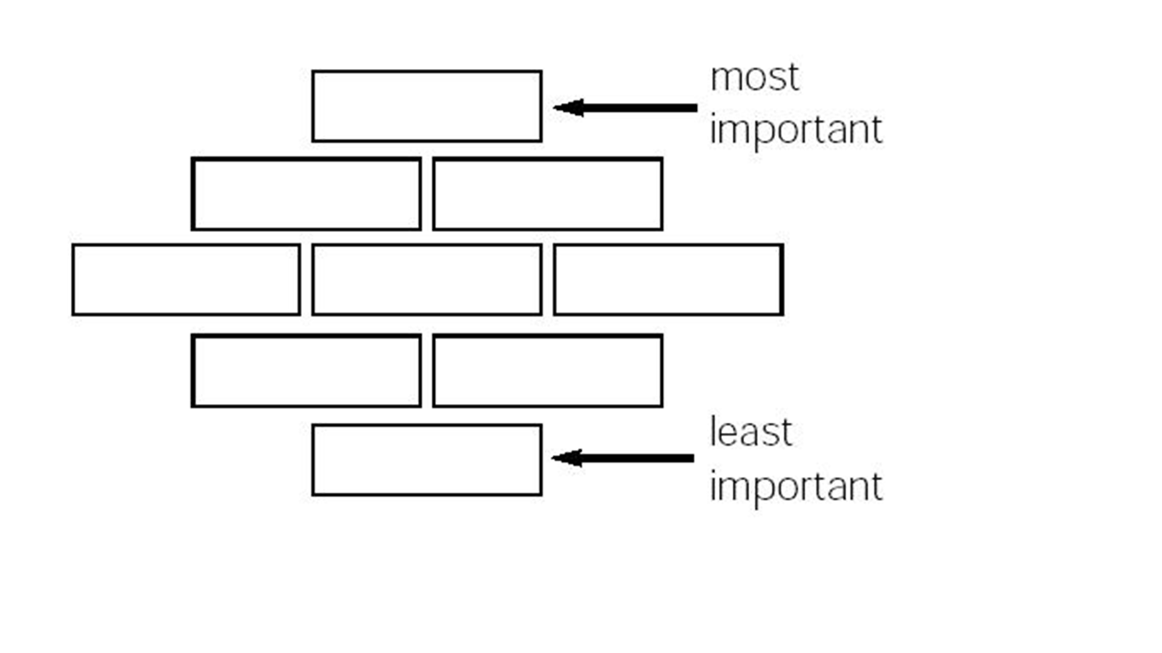
Rank your notes according to the diamond nine formation.

Slide 12
Government attempts to control population are ineffective - Discuss
In pairs, explain the formation to each other. Ask questions can you refute the other view with a act of your own?
Overall – who do you think has the best argument?
Hw - complete a plan for the essay

Slide 13
Assess the successes and failures of a population policy of your choice (10)
To determine the value, significance, or extent of;

