Slide 1
…And Their Coastal margins
Question:
What factors affect coastlines?

Slide 2
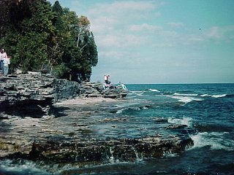
1. What am I?

Slide 3
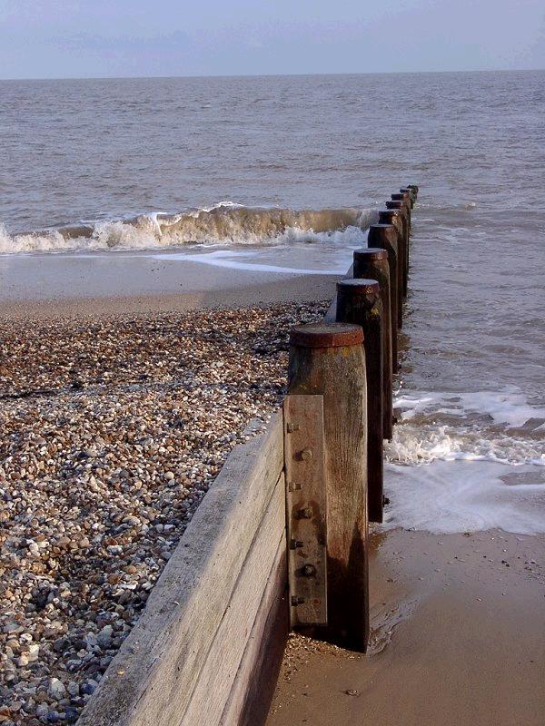
2. What am I?

Slide 4
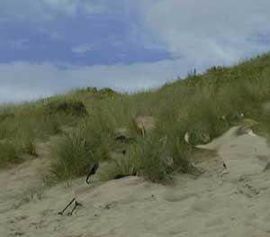
3. What am I?

Slide 5
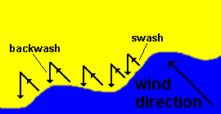
4. What process does the diagram show?

Slide 6
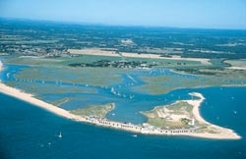
5. What am I?

Slide 7
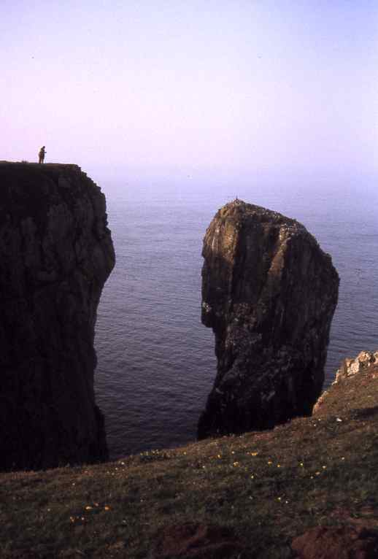
6. What am I?

Slide 8
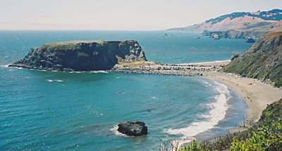
7. What am I?

Slide 9
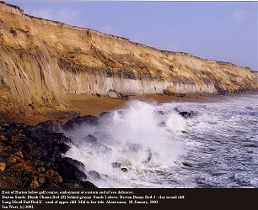
8. What is happening here?

Slide 10
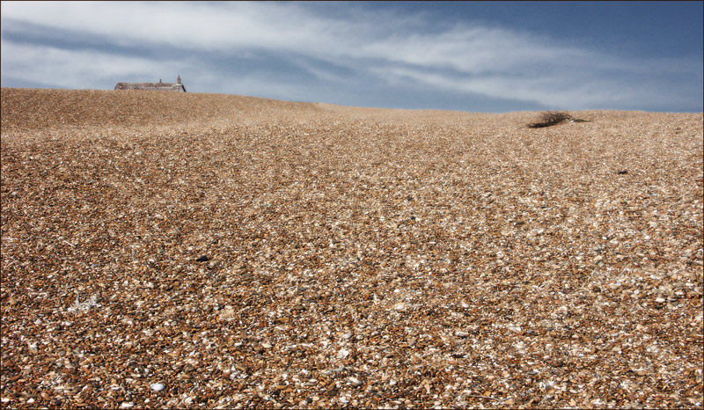
9.How would you describe this?

Slide 11
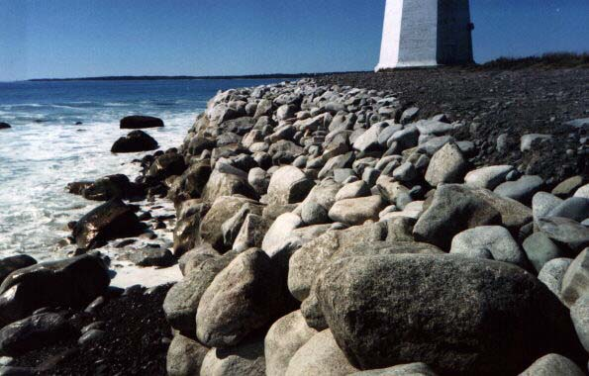
10. What am I?

Slide 12
1. What feature am I?
Wave cut platform

Slide 13
What type of coastal defence am I?
Wooden Groyne

Slide 14
What feature am i?
Sand dune

Slide 15
What process does the diagram show?
Longshore drift

Slide 16
What two features am I?
Spit and saltmarsh

Slide 17
What feature am I?
stack

Slide 18
What feature am I?
tombolo

Slide 19
What processes are shown here?
Processes of erosion
Attrition
Hydraulic
action/pressure
Abrasion
Corrosion

Slide 20
What type of beach is this?
Shingle

Slide 21
What type of coastal defence am I?
Rock armour

Slide 22
Factors affecting the coastline:
The coast is an open system affected by many physical and human processes such as:
Coastal processes – waves, erosion, transport and deposition
Lithology: Geology properties (rock type) and Geological structure – concordant or discordant coastlines
Sea level changes
Human impacts
Ecosystem type

Slide 23
#1 – How does wave type affects the coastline?

Slide 24
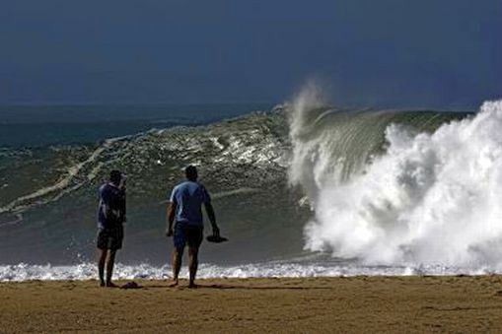
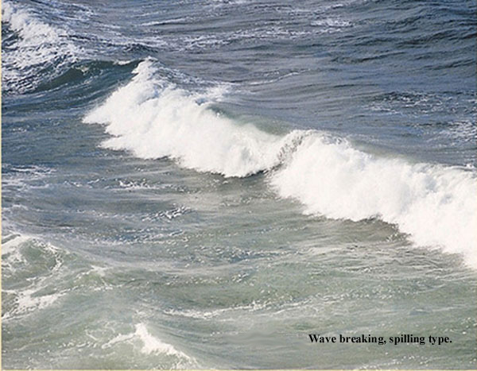
HOW FETCHING!
The size of a wave depends on
Fetch - the distance a wave travels. The greater the fetch, the larger the wave.
Wind - effect on the size of waves. The stronger the wind the larger the wave.

Slide 25
Type of wave…….
http://www.youtube.com/watch?feature=player_embedded&v=EpFykGLsDnM
Constructive or low energy waves
Associated with calm weather.
Are less powerful waves.
Break on the shore and tend to deposit material.
Are responsible for transporting material.
Swash is stronger than the backwash.
http://www.youtube.com/watch?v=FHvAxYrHdDU&feature=player_embedded
Destructive or high energy waves
Associated with storm conditions.
Are created when wave energy is high and there is a large fetch.
Tend to remove material from the coast and are therefore associated with erosion.
Backwash is stronger than the swash

Slide 26
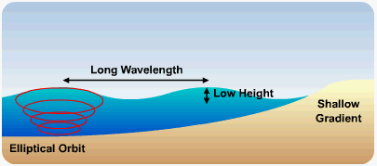
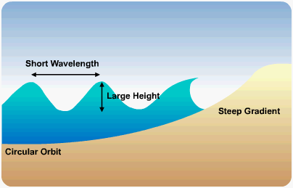
Waves
Type of wave can determine shape of the beach:
Constructive waves produce deposition and therefore shallow beaches
Destructive waves produce erosion and therefore steeper gradients (beaches)

Slide 27
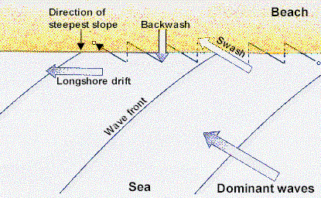
Define & Draw Swash, Backwash and Longshore Drift

Slide 28
Pg. 153-155
Find a diagram and describe a constructive wave (swell wave)
Find a diagram and describe a destructive wave (storm wave)
Define swash and backwash
Define wave refraction and label a diagram to show this process
Define longshore drift
What causes the tides?
How does the tide affect coastal processes?

