Slide 2
Why do earthquakes occur? How do we measure them?
Earthquakes what do you know?

Slide 3
.
The movement of the earths crust causes it to crack, these are called _________. There is _________ where the crust along a fault moves. The crust sometimes _________________ and pressure builds up. When the _____________is high enough the plates move suddenly past each other. The ________ released is the earthquake. The point where the energy is released from is called the _____________. Shock waves called _________________from the earthquake travel across the surface from the ______________, this is the point on the surface above the focus.
Pressure
Shock
Faults
Energy
Seismic waves
Locks together
Focus
Tension
epicentre

Slide 4
How do we measure earthquakes?
Richter magnitude scale
measures the amount of energy released by the earthquake, the strength of the shaking. It is a base-10 logarithmic scale.
The Mercalli Scale
measures the intensity of the earthquake by the effects of an earthquake at different sites.

Slide 5
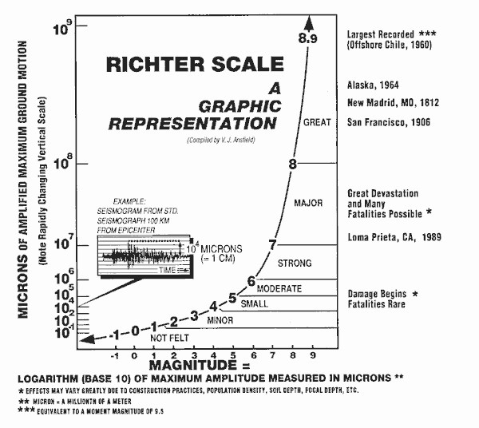

Slide 6
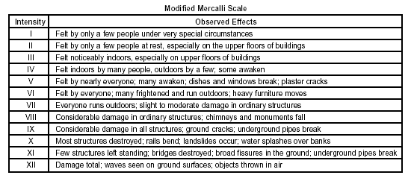

Slide 7
Using the Richter and Mercalli scales
Earthquake | Richter | Mercalli | Reason
Bam Iran 2003
Japan 2011
Kashmir earthquake 2005
Hawaii 2006
Nepal, 2015

Slide 8
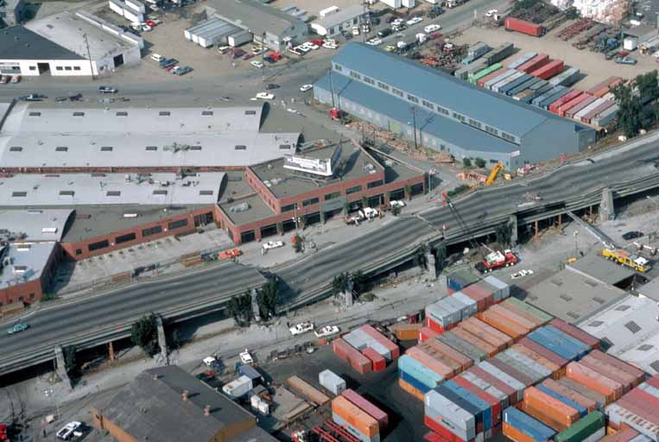
Rate the quake!!
California 2014

Slide 9
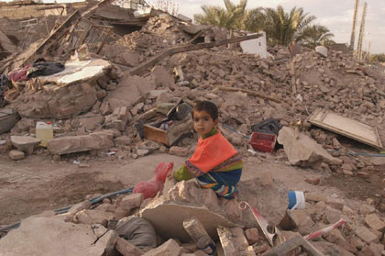
Bam, Iran 2003

Slide 10
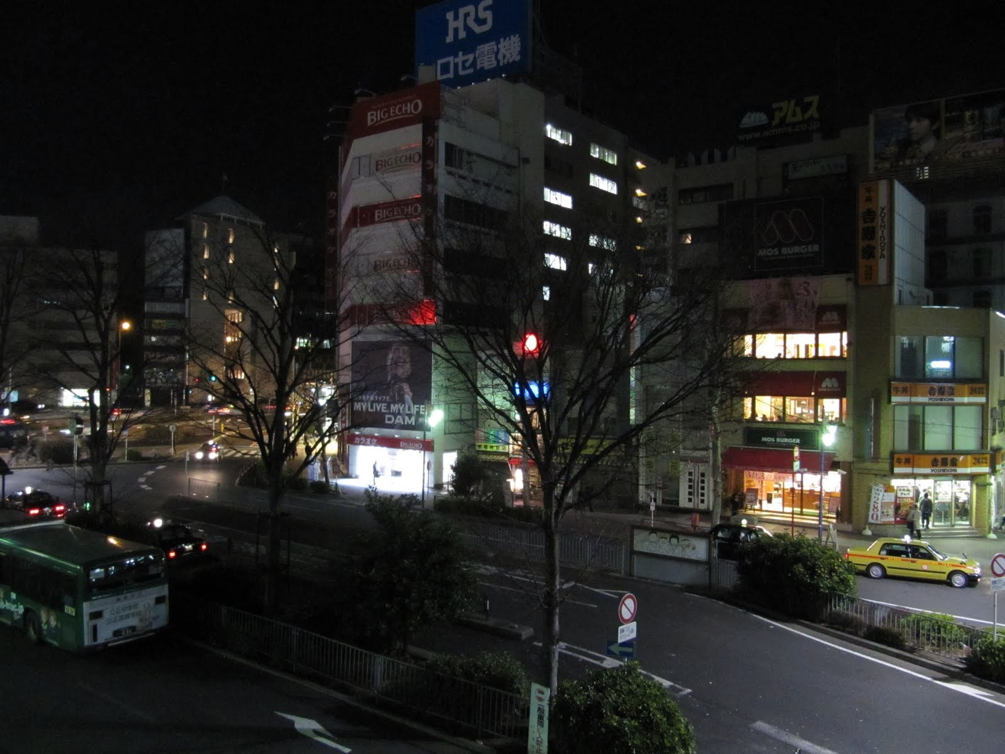
Japan
http://video.google.com/videoplay?docid=-2526322756300486472&q=kobe+japan+video

Slide 11
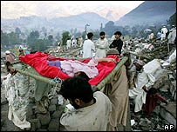
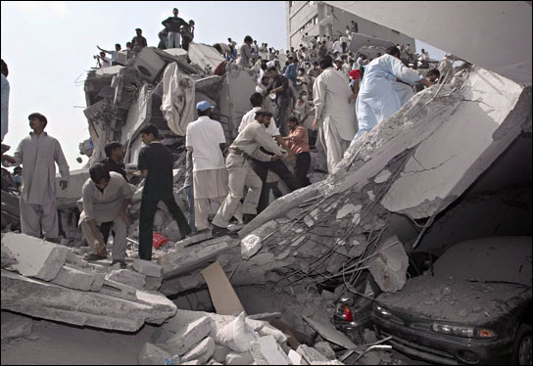
Pakistan Kashmir earthquake
http://news.bbc.co.uk/1/hi/world/south_asia/4321490.stm

Slide 12
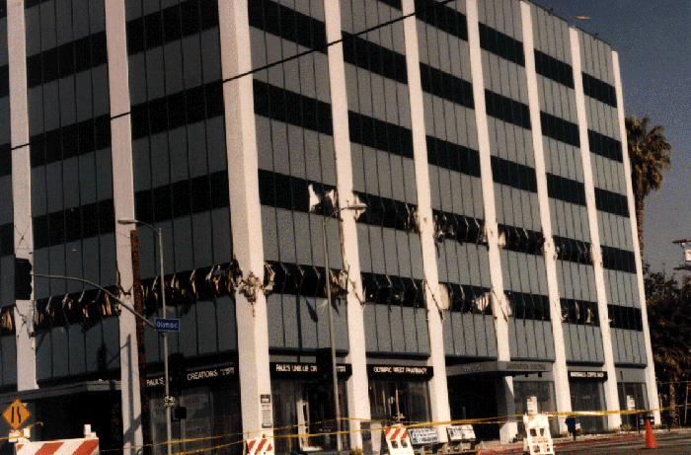
Hawaii 2006

Slide 13
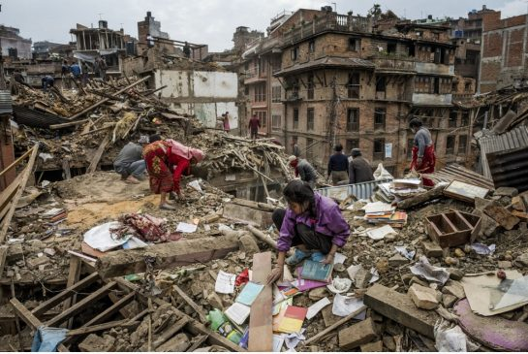
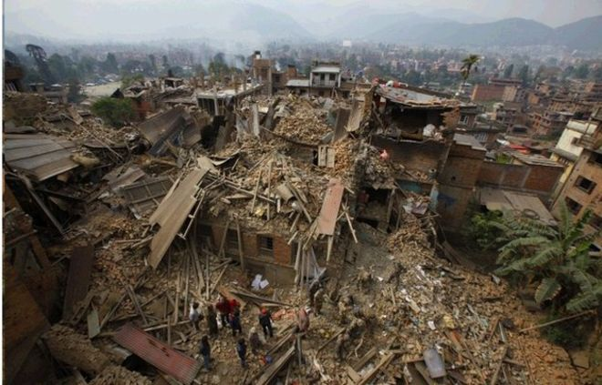
Nepal 2015

Slide 14
Earthquake | Richter | Mercalli
California 2014 | 6.0 | VIII
Bam, Iran 2003 | 6.6 | IX
Japan 2011 | 9.1 | VII
Kashmir earthquake 2005 | 7.6 | VIII
Hawaii 2006 | 6.0 | VIII
Nepal 2015 | 7.8 | IX

Slide 15
Mercalli or Richter Scale?
Task 1
Which measurement do you think is the most useful? Explain your answer.
Task 2
Use the internet – can you find ways that earthquakes can be predicted?

Slide 16
Richter scale

