Slide 1
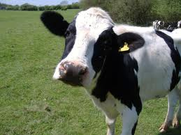
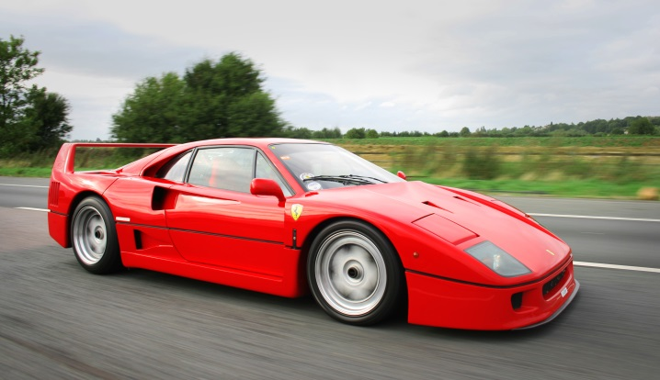
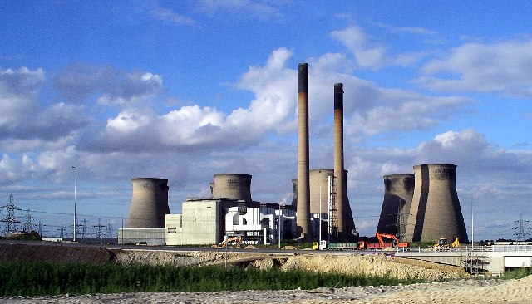
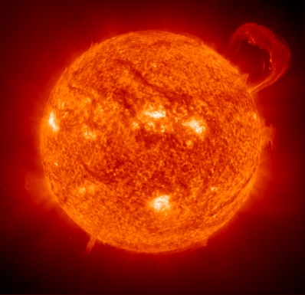
Natural and Human Causes of Climate Change

Slide 2
Alone in a sealed jar, a mouse would die from exhaled CO2. But as scientist Joseph Priestley observed in 1771, adding a mint plant allows the mouse to thrive. In this proof of photosynthesis, the mint absorbed CO2, retained carbon for growth, and released oxygen

Slide 3
Global Warming
Over the past century our Earth’s average temperatures have increased by 1 Celsius
Experts predict another 4.5 increase by the end of this century
A similar - 6degree – temperature increase 250 million years ago resulted in the extinction of 95% of all life on earth

Slide 4
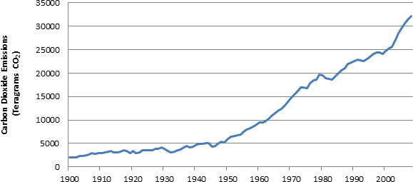
Debate: Natural Or Manmade?
Today, most people feel there is no longer a debate. Too much evidence pointing to human cause

Slide 5
List Top 5 Industries Producing CO2 Emissions In Order (p198)

Slide 6
However some argue this is a natural process: One Example - Sunspots!
Sunspots are solar storms on the suns surface which release more gas and flares…
They have been very active this century meaning the sun is actually brighter by about 0.1% than it was 100 years ago…

Slide 7
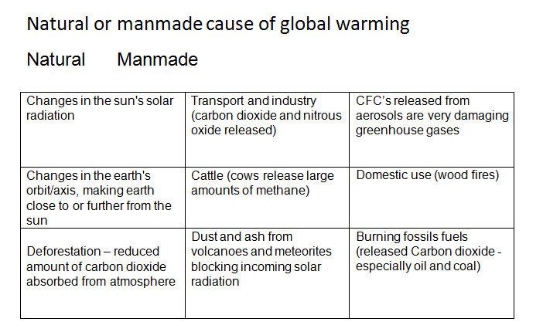
Classify: Natural or Manmade

Slide 8
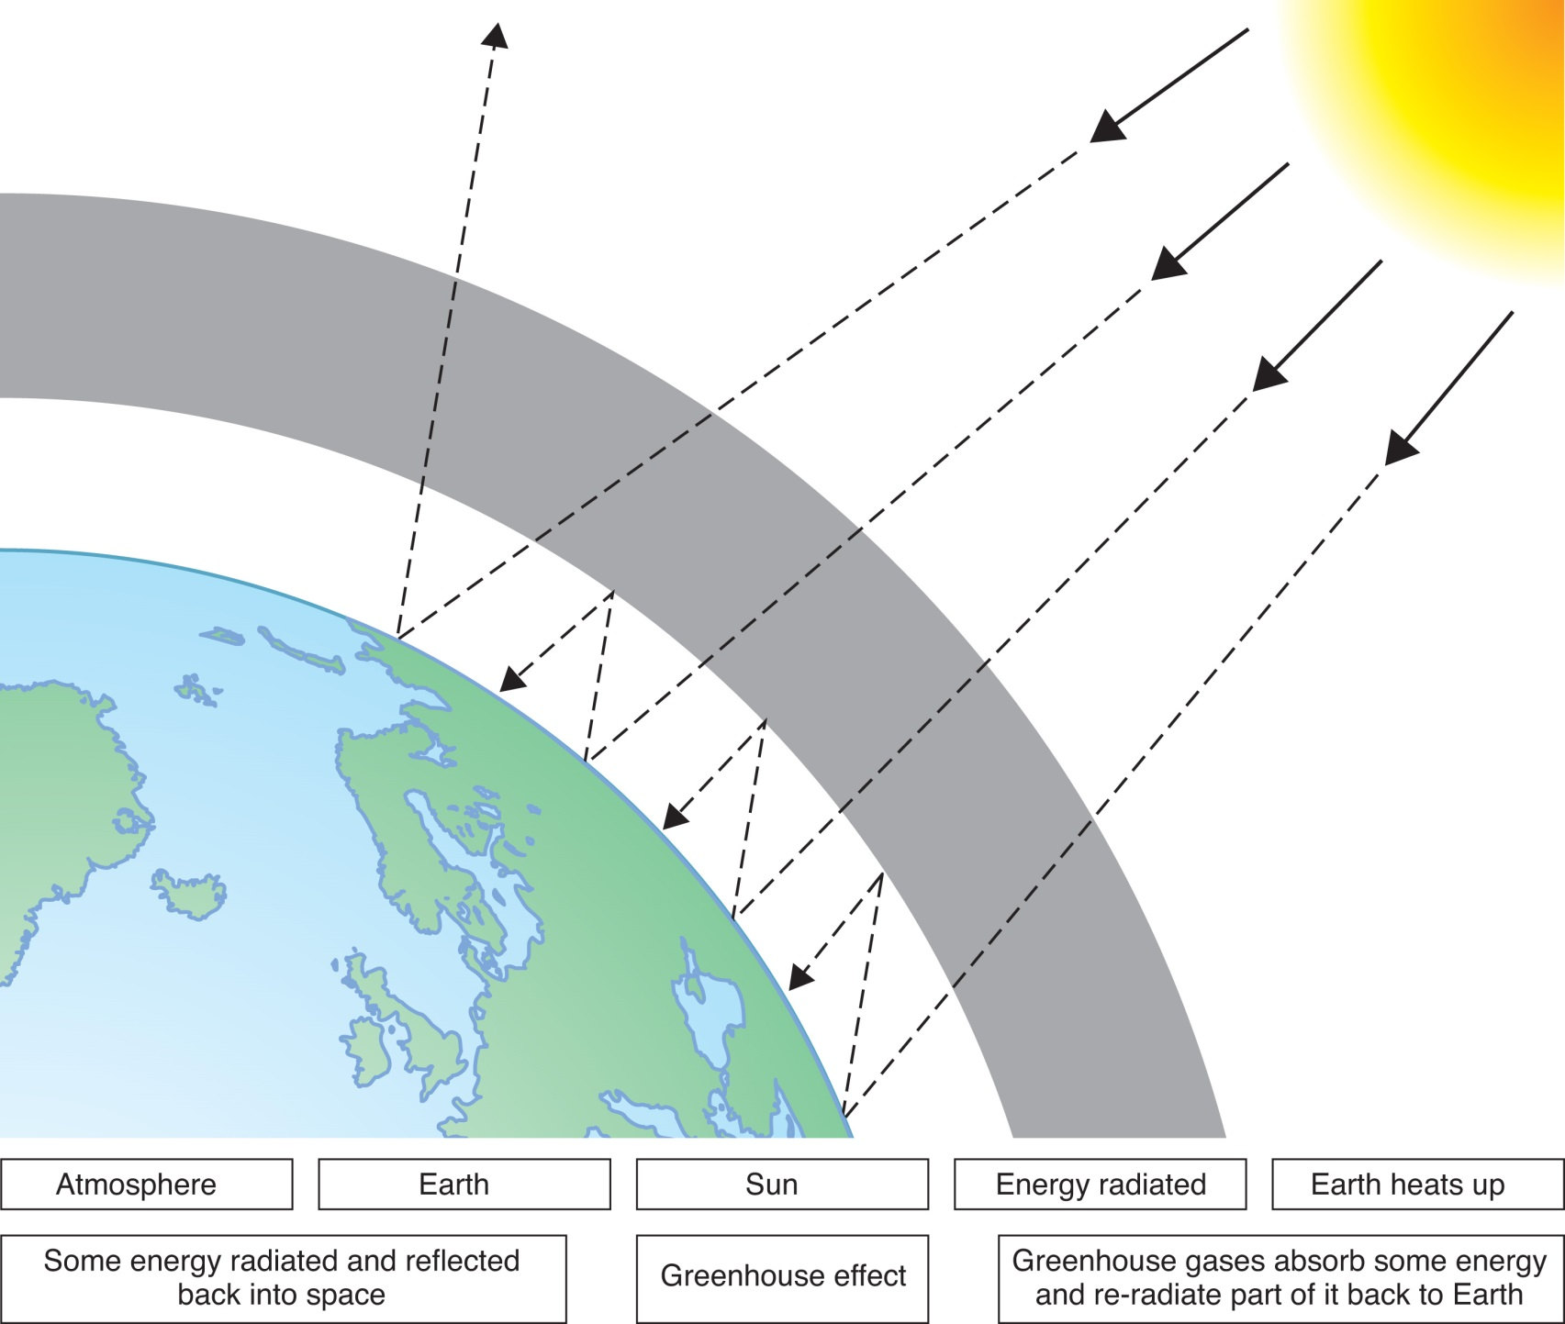
1Copy this diagram and add the labels to it. (pg 199 may help)
2. Use page 199 to write an explanation of the Greenhouse effect and global warming.
3. Use pg. 197 to write notes on the gases responsible for global warming

Slide 9
What do you think is the biggest cause of global warming? Explain your idea.

