Slide 1
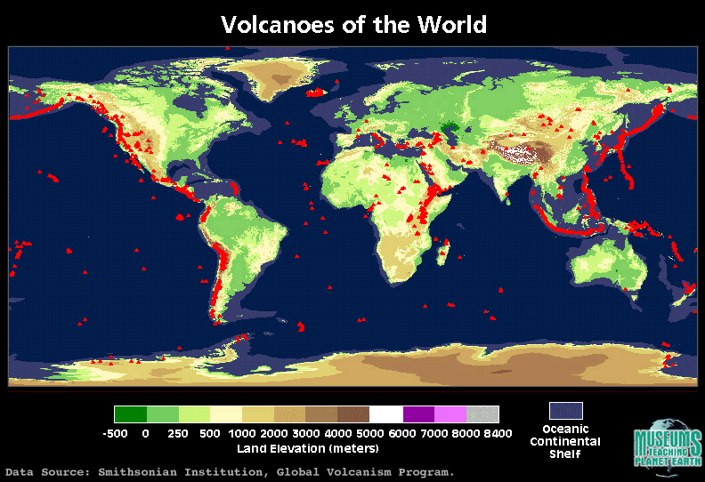
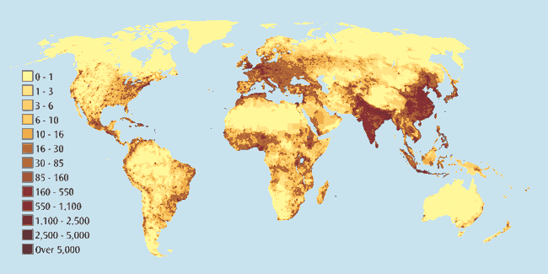
Ok…sooooo why do people live in volcanic areas?
Which volcanic areas are most populated?

Slide 2
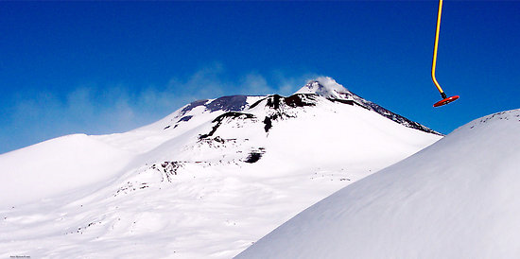
Mt. Etna: hot springs, ski slopes and volcanic eruption remnants attract tourists

Slide 3

http://www.visitmontserrat.com/

Slide 4
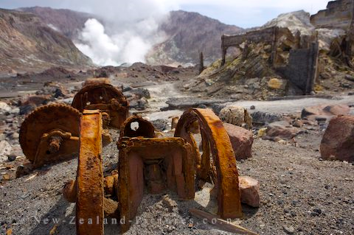
Sulphur mine in New Zealand – volcanoes bring valuable minerals including sulpher, diamonds, gold and copper to the surface of the earth

Slide 5
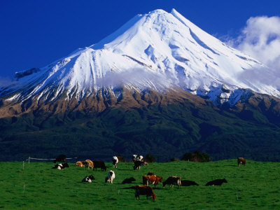
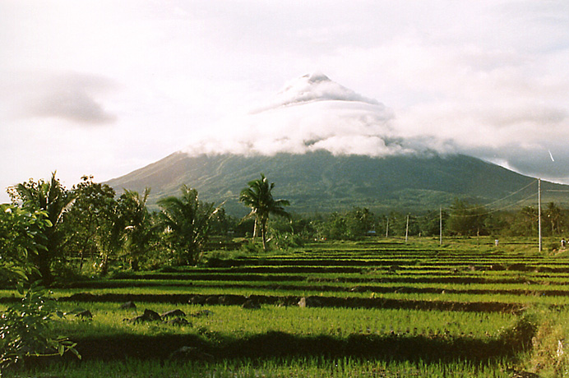
Fertile soil – volcanic ash contains minerals that enrich the soil (fertilizer!!)

Slide 6
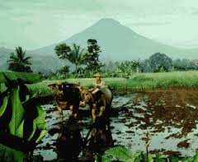
Do people always choose to live near a volcano?

Slide 7
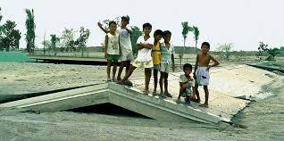
Why Stay?
A lack of education
about the dangers of
the volcano
Benefits ( such as
employment) outweigh costs
Unable to move away from area due to lack of money or job elsewhere
Tradition – many would not move even if they could; relatives and friends live there

Slide 8
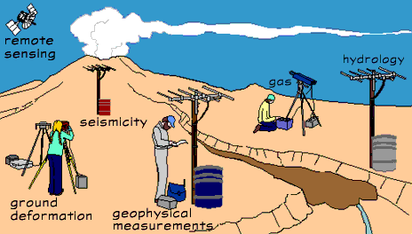
Would this make people feel safer?

Slide 9
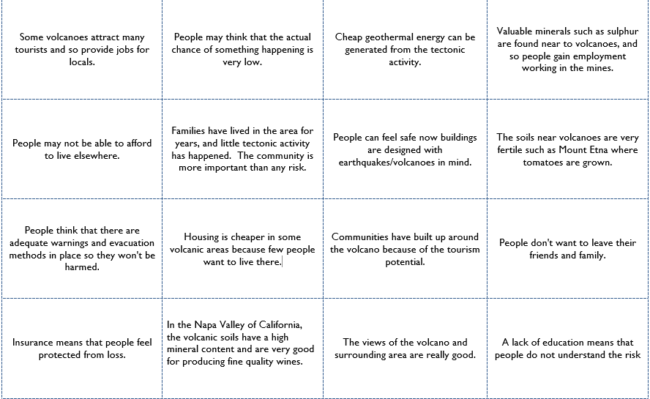

Slide 10
Task 1
Classify the cards………

Slide 11
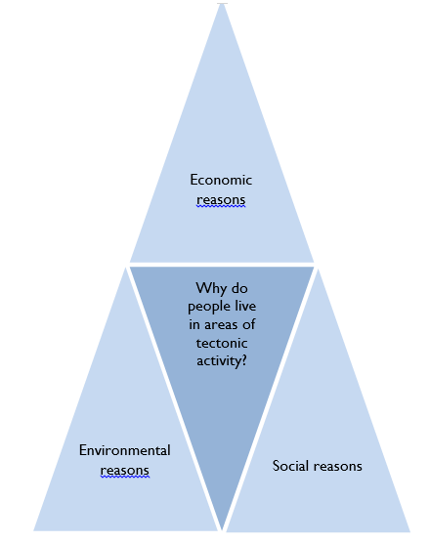
LEDC or MEDC
Classify by these……
Put those you consider to MOST IMPORTANT at the base of the triangle
Shade the social reasons one colour, the economic reasons another colour and the environmental reasons a third colour

Slide 12
Task pg 86-87
Name 3 ways a volcanic eruption can be predicted?
Name 3 ways a volcanic eruption can be prepared for?
Do you think it is easier to predict and prepare for volcanoes or earthquakes? Why?
Why do you think the effects of earthquakes and volcanoes are worse in LIC’s– Use examples in your answer (10 marks)

Slide 13
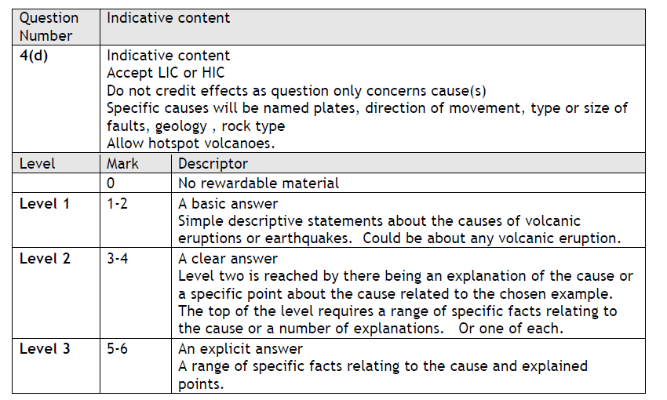

Slide 14
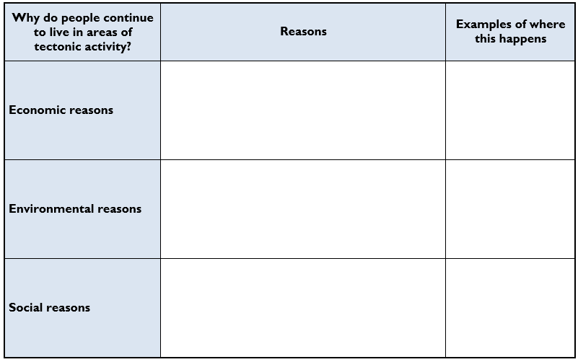

Slide 15
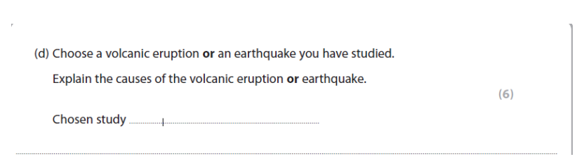
Exam question- January 2011
…………………………………………………………………………………………………………………………………………………
…………………………………………………………………………………………………………………………………………………
…………………………………………………………………………………………………………………………………………………
…………………………………………………………………………………………………………………………………………………
…………………………………………………………………………………………………………………………………………………
…………………………………………………………………………………………………………………………………………………
…………………………………………………………………………………………………………………………………………………
…………………………………………………………………………………………………………………………………………………
…………………………………………………………………………………………………………………………………………………
…………………………………………………………………………………………………………………………………………………
…………………………………………………………………………………………………………………………………………………
…………………………………………………………………………………………………………………………………………………

Slide 16
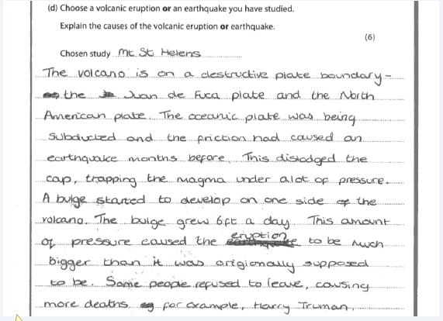
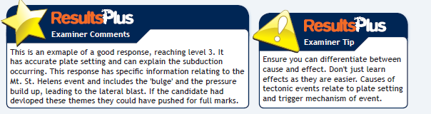

Slide 17

Exam question June 2011
…………………………………………………………………………………………………………………………………………………
…………………………………………………………………………………………………………………………………………………
…………………………………………………………………………………………………………………………………………………
…………………………………………………………………………………………………………………………………………………
…………………………………………………………………………………………………………………………………………………
…………………………………………………………………………………………………………………………………………………
…………………………………………………………………………………………………………………………………………………
…………………………………………………………………………………………………………………………………………………
…………………………………………………………………………………………………………………………………………………
…………………………………………………………………………………………………………………………………………………
…………………………………………………………………………………………………………………………………………………
…………………………………………………………………………………………………………………………………………………

Slide 18
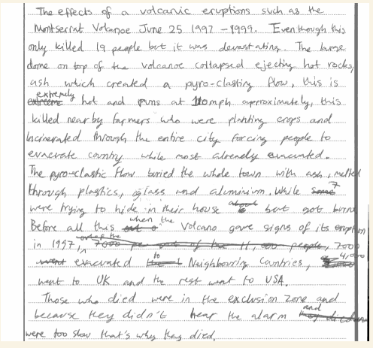
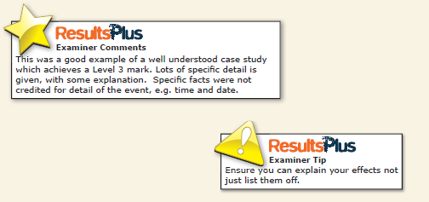
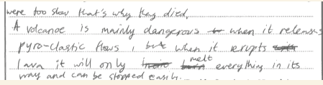

Slide 19
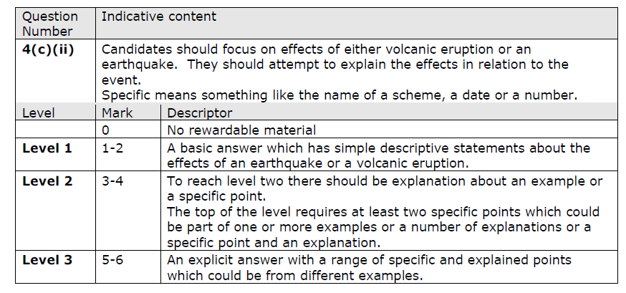

Slide 20
