Slide 1
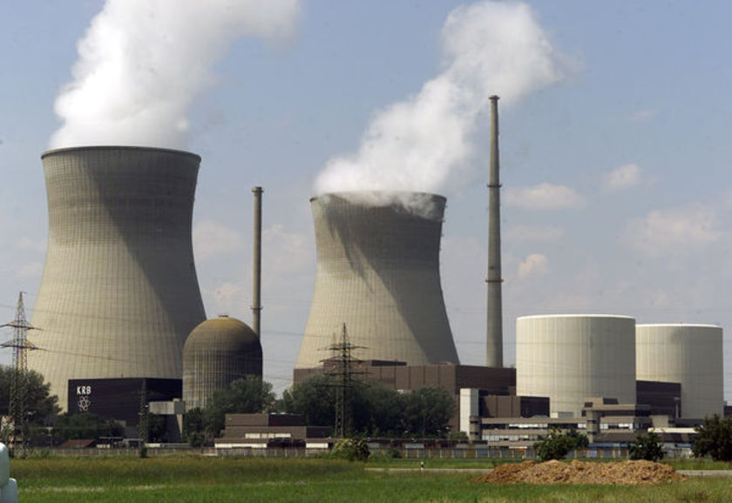
Aim: To judge positives and negatives of Nuclear Power
Question:
The government plans to build a nuclear power station 2 miles from where you live?
What would you want to know? Make a list.


Slide 2
Energy on Grand Bahama
Electricity demand in the Bahamas is growing by some 5 per cent a year, BEC says. 5 % growth represents 13 megawatts at a cost of $1.5 million per megawatt - about $20 million a year, or $200 million over 10 years.
Cost of generating electricity accounts for about one twelfth of Bahamas total gross domestic product (over $700 million in 2006 alone)

Slide 3

What do the following terms mean?
Literature
Books, magazines, journals, websites, pamphlets, leaflets, etc..
Fact
A statement about reality; about what is true or what exists
Statements of fact should be supported by evidence
Statements of fact can be independently checked
Opinion
A statement about an individual’s beliefs, feelings or personal judgement
Valid
Sound, defensible, well-grounded
The more facts there are to support an opinion, the more valid it may be

Slide 4
Parents who don’t vaccinate their children are irresponsible.
Vaccines protect against diseases which can cause some very serious damage.
In twenty years of medical practice, I’ve vaccinated thousands of children: less than 0.5% of these had even a mild reaction to these.
Dr J. Hibbert
Who is stating an opinion?
I don’t like the idea of vaccines – I think they’re unnatural.
It’s better to avoid them.
Mr N. Flanders
Are the two statements equally valid?

Slide 5

Read the summary of nuclear pros and cons
Summarize a list of at least three points in favour of nuclear power...
... and at least three points against nuclear power
Using the information from your notes (for and against nuclear)… answer the following question.

Slide 6
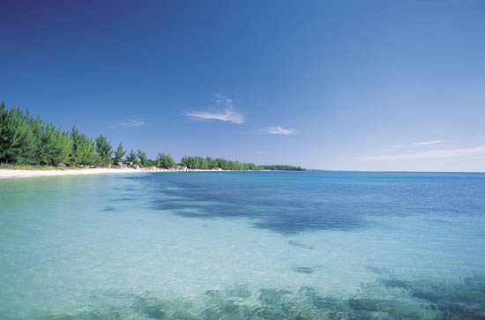
Is nuclear power an option for Grand Bahama? Explain your view…
Where should we put a nuclear power station?
Coast
Cooling water can easily extracted from the sea – cheaper
Firm geology eg. Granite
Reduces risk of damage from earthquake and can support big industrial building
Large area of low lying land
Needed for a large factory – cheaper to build
Low value land
Cheaper to build on
Away from towns
So people are not worried about medical effects of radiation or visual/air/noise pollution
Near transport routes (port, road and rail)
So raw materials and waste can be transported cheaply

