Slide 1
Ethnic Segregation

Slide 2
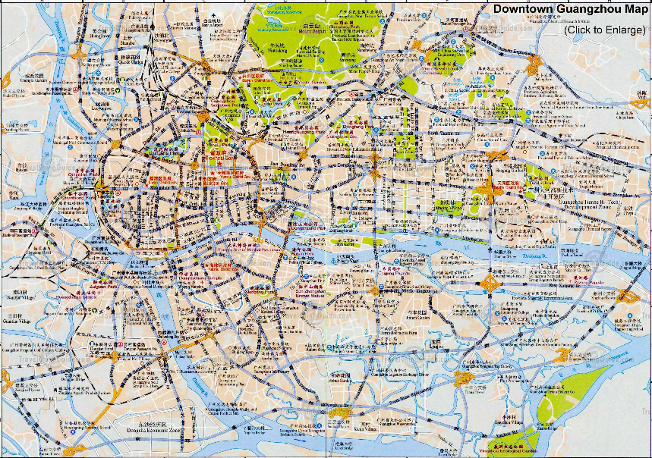
Review: Identify CBD
Guangzhou, China

Slide 3
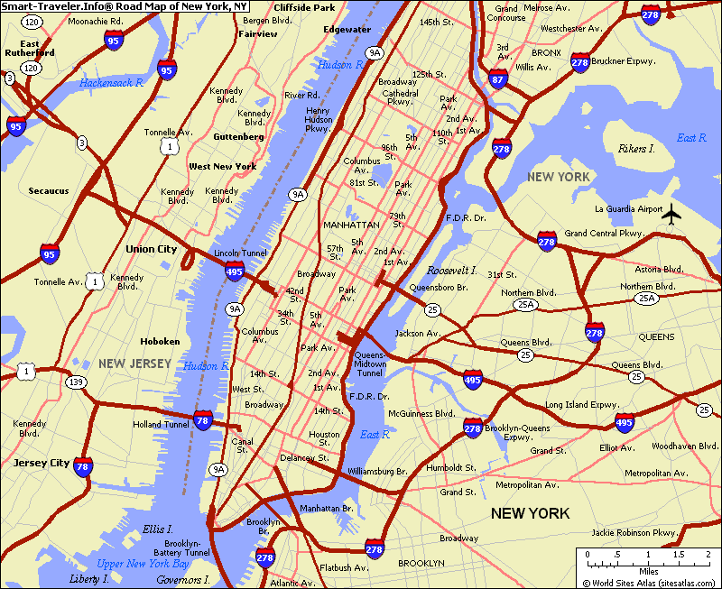
New York

Slide 4
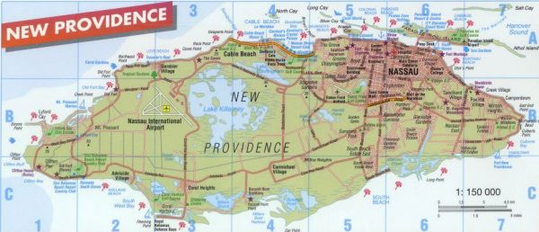
Nassau

Slide 5
What is ethnicity??
Ethnic groups are those human groups that entertain a subjective belief in their common descent because of similarities of physical type or of customs or both, or because of memories of colonization and migration, regardless of blood ties. (Weber, 1922)
A multi-dimensional concept that encompasses different aspects of identity such as Kinship • Religion • Language • Culture • Shared territory • Nationality • Physical appearance (Bulmer, 1996)
Group’s affinity is defined in opposition to other groups perceived as ‘different’ and with whom contact is required (Erikson, 2002)

Slide 6
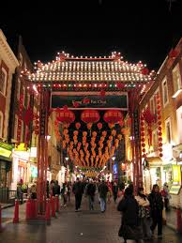
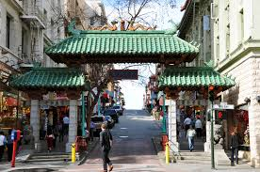
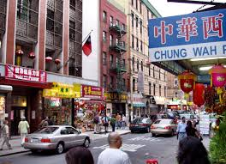
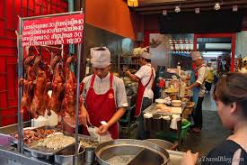
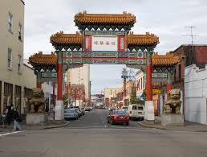
“Ethnic Segregation” Often in HICs immigrants or minority people are concentrated in certain areas of the city, based on their ethnicity. Small communities based on shared heritage and culture form, often in poor and cheap areas of the inner city.
“Chinatown”

Slide 7
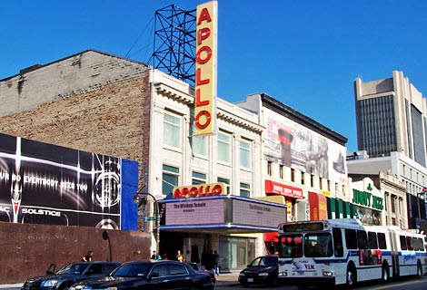
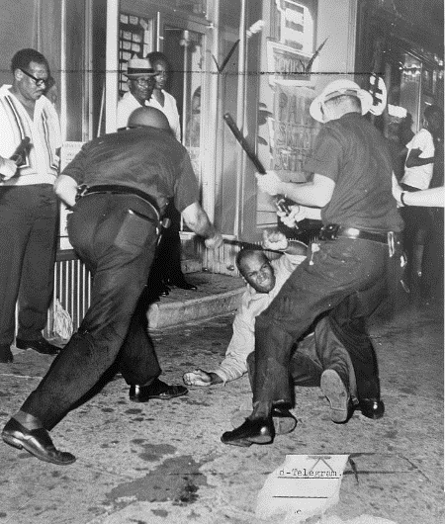
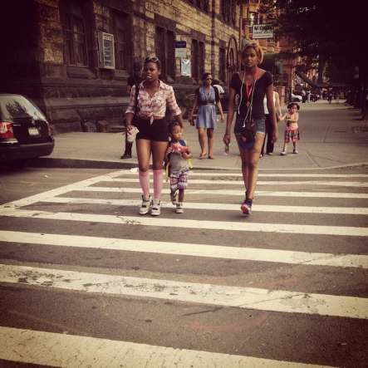
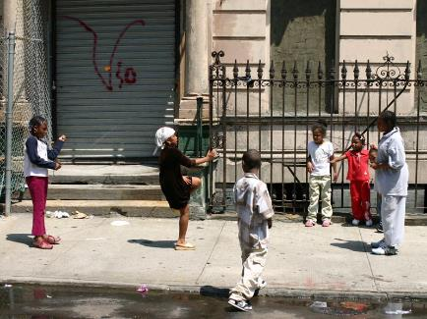
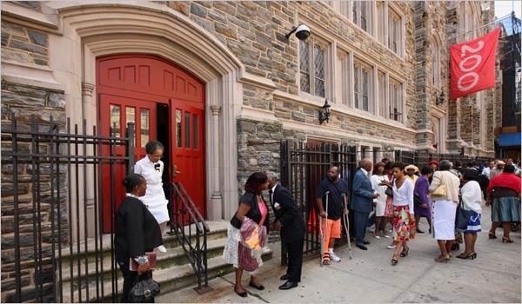
Harlem

Slide 8
Read over p.157-158 (Including Figure 6.18)
Make a table with two columns:
Title: Factors Encouraging Ethnic Segregation
First Column Title: Internal Factors Second Column: External Factors
(why migrants/minorities want?) (why other people want?)
Choose the 4 most important factors for each column and copy into your book

Slide 9
Make two columns IN YOUR NOTEBOOK: ‘positives & negatives’ Cut & Paste the factors given to you under either column in your book. Add one more factor of your own to each column.

