Slide 1
Sustainable Tourism

Slide 2
What is sustainable tourism?
A balance so that holiday makers can enjoy themselves without destroying the things that attracted them to the area in the first place.
It means that you should:
Reduce impact on the environment
Provide benefits for local people

Slide 3
Task
Write down at least 5 differences between the two men that show one is a sustainable tourist and one isn’t.

Slide 4
Which one is more sustainable?
Why?

Slide 5
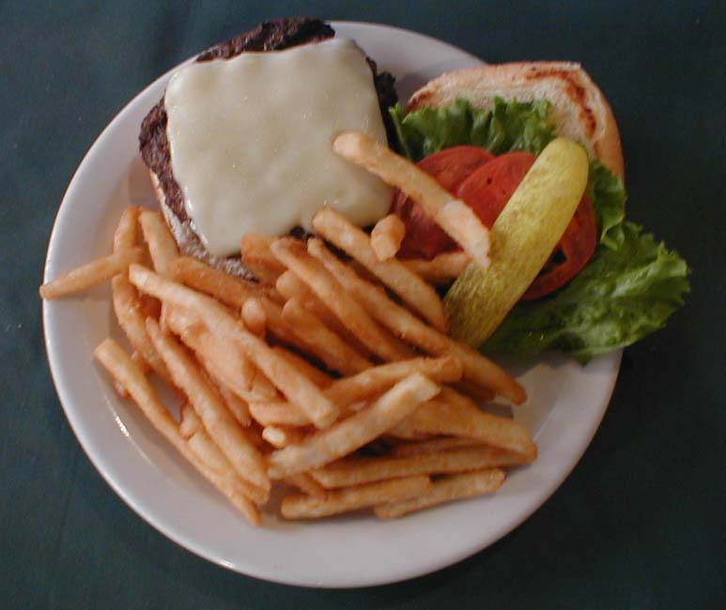
Which is more sustainable?
Why and why not?

Slide 6
Which is more sustainable?
Why?

Slide 7
Which is more sustainable?? Why?

Slide 8
Tourism Can Be Made More Sustainable By
Buying local food – not fast food, or food flown thousands of miles
Going to see attractions without harming the environment
Not polluting or littering in the foreign country
Supporting conservation efforts while abroad
Staying in sustainably-built structures with low impact on land
Reducing carbon emissions by walking or bicycling
Staying in smaller accommodations and using less resources

Slide 9
Task One: (point form)
Create two columns, one for ‘sustainable’ and one for ‘unsustainable’: list all of the tourist activities you could do on GB under one column or the other
Task Two: (point form)
Describe our ‘tourist’ experience on Lucaya Nature Tours.
From the moment we left to how we returned at 3pm, describe whether the action, activity or stop we made was sustainable or unsustainable

