Slide 1
Energy is transferred on earth in 3 ways: through surface currents, deep sea currents, and wind…

Slide 2
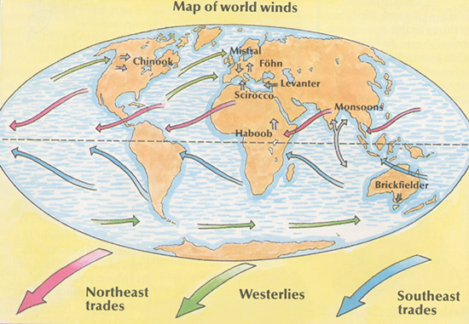
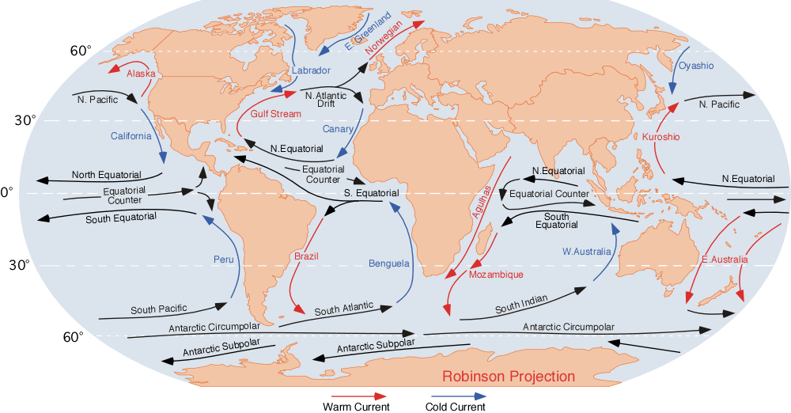
Ocean currents are in same direction as the wind – they become circular due to currents hitting land masses
http://library.thinkquest.org/C0112425/image/children/wind_map.jpg

Slide 3
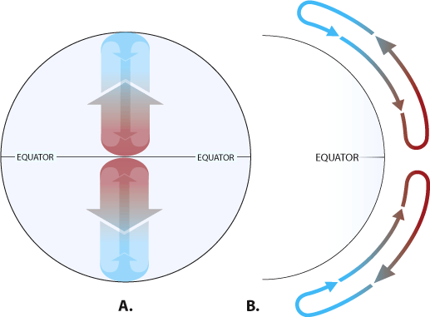
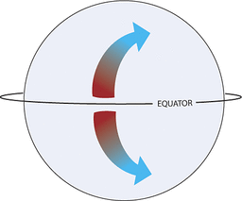
Why do our surface currents run in opposite directions?
If the Earth did not rotate and remained stationary, the atmosphere would circulate between the poles (high pressure areas) and the equator (a low pressure area) in a simple back-and-forth pattern.
But because the Earth rotates, circulating air is deflected. Instead of circulating in a straight pattern, the air deflects toward the right in the Northern Hemisphere and toward the left in the Southern Hemisphere, resulting in curved paths.
This is called THE CORIOLIS EFFECT

Slide 4
The winds drag on the earths surface, forming our now well known gyres and the GOCB…
Why is there no current at the Arctic?

Slide 5
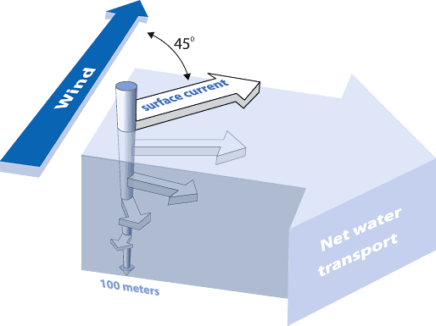
Ekman Spiral (Vagn Walfrid Ekman – Mathematician)
Theorized in 1902
When surface molecules moved by the
wind, they drag deeper molecules with…
Friction causes dragging on lower
water molecules which move also but
at a slower pace, creating a spiral effect
The movement ceases at a depth of
100m below the surface

Slide 6
El Nino and The Southern Oscillation: (ENSO)
What is El Nino?
The “Christ Child” – the warming of the Eastern Pacific that occurs every 2 or 10 years and lasts up to 2 years.
Begins at Christmas..
Originally was thought to be just surface current… but now understood to be much more. Scientists still do not understand HOW it happens but can explain WHY…

Slide 7
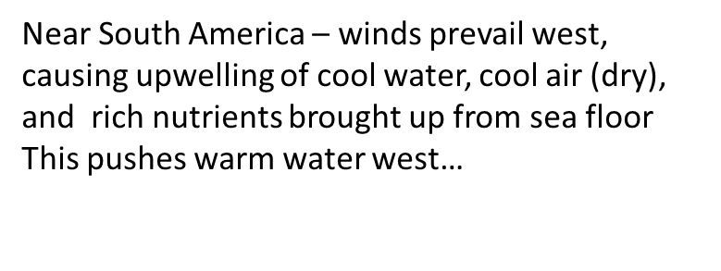
The Walker Circulation: Normal model of airflow in the Pacific
Near Australia:
Low Pressure system, warm air and ocean brought across Pacific…
Sea levels up to 1m higher and much warmer
Warm air rises and flows at high altitudes back across Pacific to descend and start cycle again…
What is happening to the thermocline?

Slide 8
El Nino: Reverse of the oceanic conditions… The Southern Oscillation: Reverse of the atmospheric conditions Together they form ENSO: The complete reverse of the Walker Cycle

Slide 9
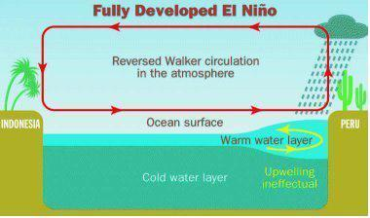
ENSO vs. Walker
ENSO: the anomaly of a band of sea surface temperatures (SSTs) that are warm in east or cooler in the western Pacific due to shifting atmospheric and oceanic circulation…

Slide 10
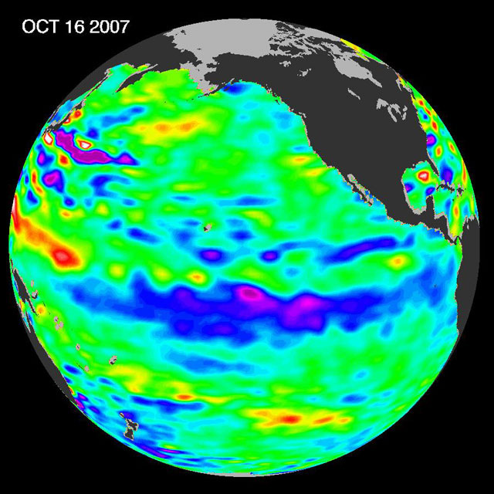
La Nina
Intensification of normal walker conditions…….
Low pressure over south East Asia is even lower causing flooding
High pressure in South America is even higher –
Dry conditions in South America causes drought
Stronger trade winds increase sea level in South
East Asia andtronger upwelling of equatorial current
Unusual rainfall in Sahel, Africa

Slide 11
El Nino and La Nina causes huge problems because…
They are difficult to accurately predict
They affect all parts of the globe, not only the Pacific
Some poorer countries do not have resources to cope with weather changes
Indirect impacts on other parts of the world through trade and aid.

Slide 12
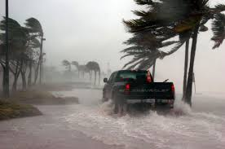
ENSO causes extreme weather conditions in many parts of the world.
Find a world map from the internet, copy and paste it into Powerpoint
Annotate the map using p141 Figure 6.10 to understand the impacts of El Nino across the planet.
Save it in your ‘Oceans’ folder to study from.

