Slide 1
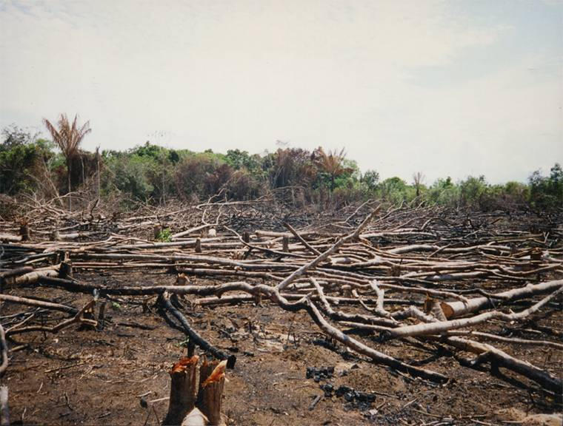
Development in the Amazon – Day One

Slide 2
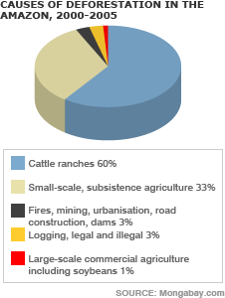
Causes of deforestation in the Amazon
Predict – Which colour is which types of deforestation?
Write down…
Write down the correct figures

Slide 3
Large scale development in the Amazon
In the 1970s Brazils government aimed to open up the Amazon to development.
Road and rail development
Logging
Ranching
Hydroelectric Power (HEP)
Mining
Settlement

Slide 4
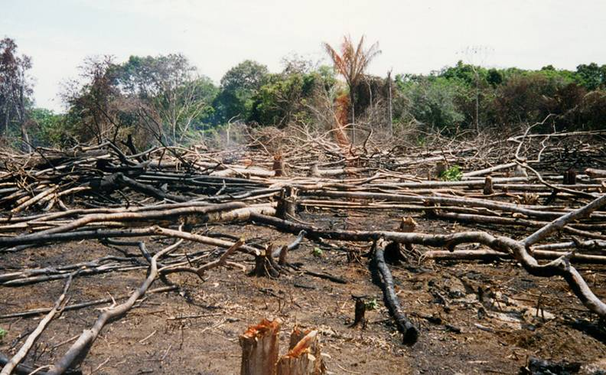
They used “slash and burn” techniques to clear the land for settlement and ranching.

Slide 5
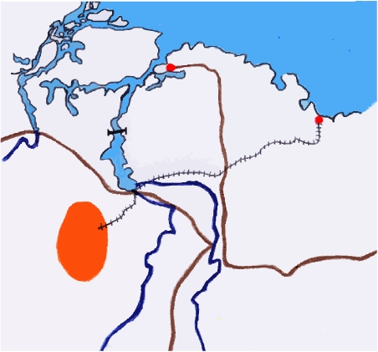
Developments in the Amazon – the Carajas Project
Carajas Project
In 1985 the government approved the development of the largest iron ore mine in the world.
It is an open pit mine, and largely powered by the hydroelectric power of the Tucurui Dam
Belem
Sao Luis
Tucurui
rail link
iron ore, copper, manganese, nickel, bauxite, gold, tin, lead, zinc
Carajas
TransAmazonian Highway
0
100km

Slide 6
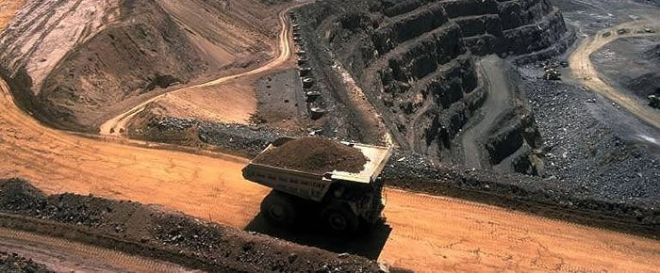
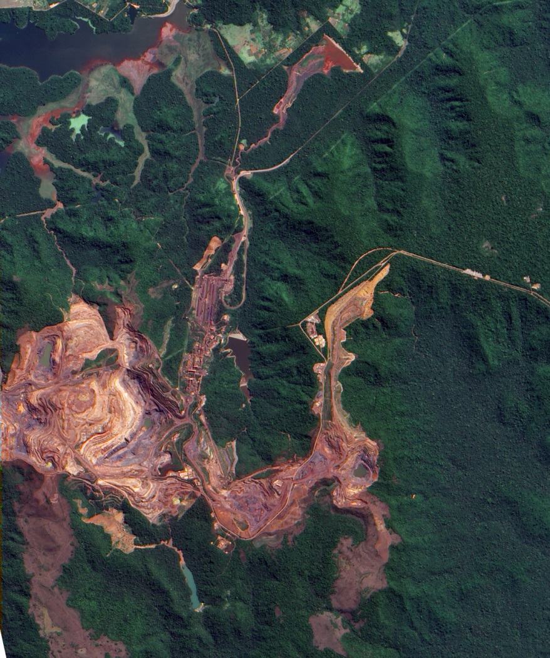
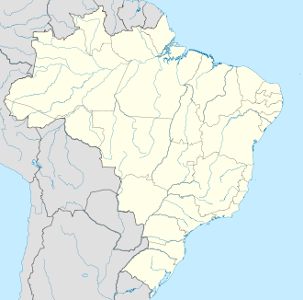
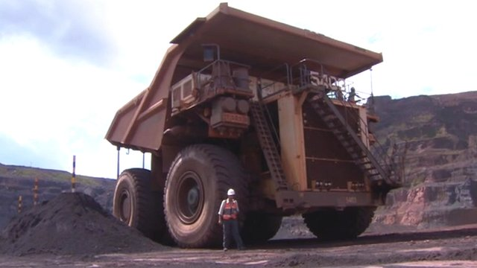
Carajas mine – Its HUGE!!
Carajás mine

Slide 7
Tucurui Dam – cost $5 billion
Describe the dam’s impact on the landscape.
Road
River Tocantins
Tucurui
Dam
HEP plant
flooded an area 3 times the size of the
Grand Bahama
Amazonian Indian villages
Before Tucurui Dam
After Tucurui Dam

Slide 8
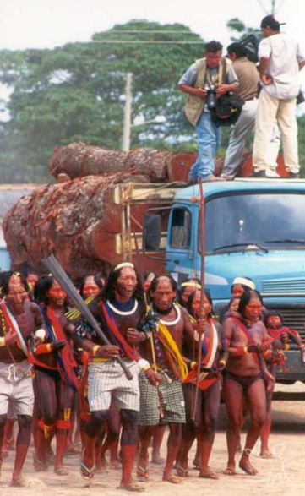
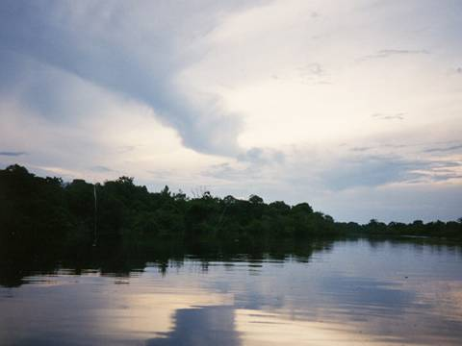
Tucurui Dam
Tucurui Dam was built between 1976 and 1984, The reservoir created upstream of the dam is over 2000km². The dam will produce more than 4000 MW of electricity.
Fish have stopped migrating upstream, chemicals from ‘defoliation’ have poisoned the river, thousands of people were displaced.

Slide 9
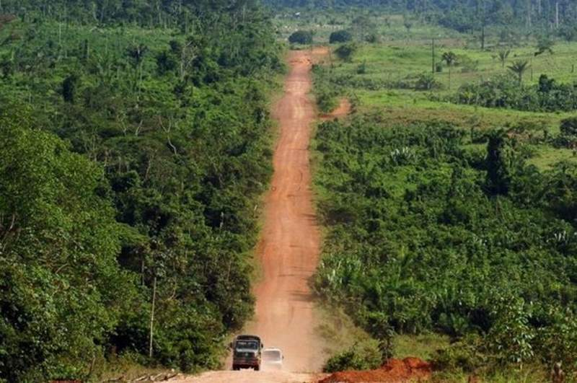
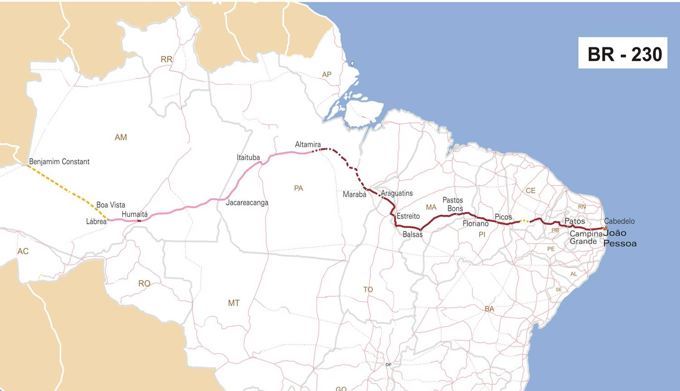
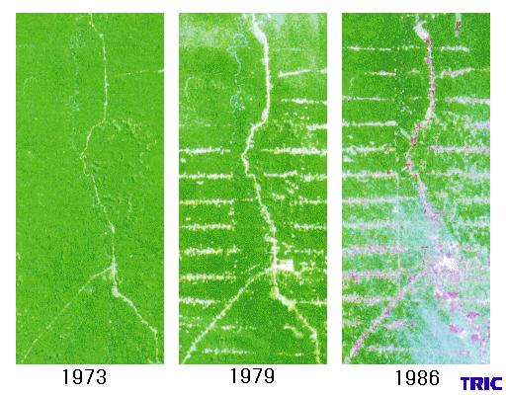
Trans amazon highway
Why was road building such as the Trans Amazonian Highway vital to all these large scale development projects?

