Slide 1
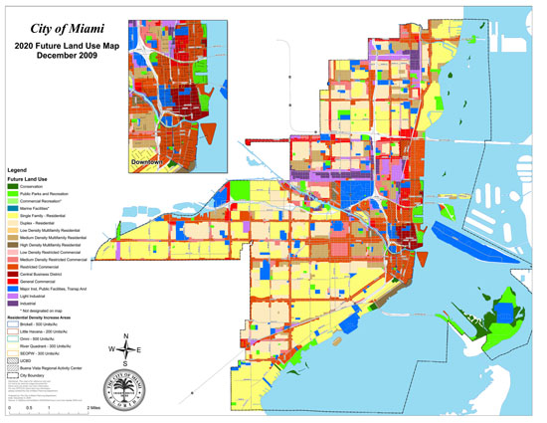
Land Use Segregation Segregation: separation into similar groups types of land use and businesses also tend to cluster together – this happens because the land value is cheaper towards the edge of a city so houses or businesses can spread out over a larger area.

Slide 2
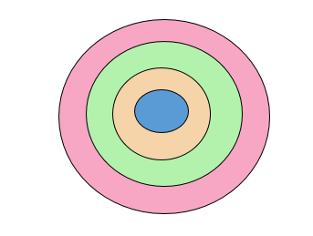
It is possible to see the same 4 areas in towns and cities wherever they are in the world because all cities grow outwards from the historical centre.
THREE RULES in all cities from the centre to the edge:
The age of the buildings decreases.
The architectural style of buildings changes.
The density of buildings decreases

Slide 3
1. Make a copy of this in your book
Give your diagram a title
Urban Land Use Model
Core
Inner city ring
Suburban ring
Urban fringe
Split a page into 4 sections
Label each section the core, inner city ring, suburban ring and urban fringe

Slide 4
Task
Look at the pictures in the next few slides.
Add information to each box to describe what you see in each picture

Slide 5
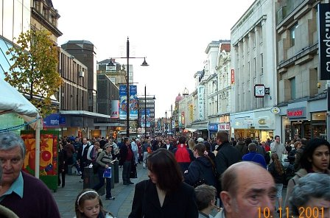
Core

Slide 6
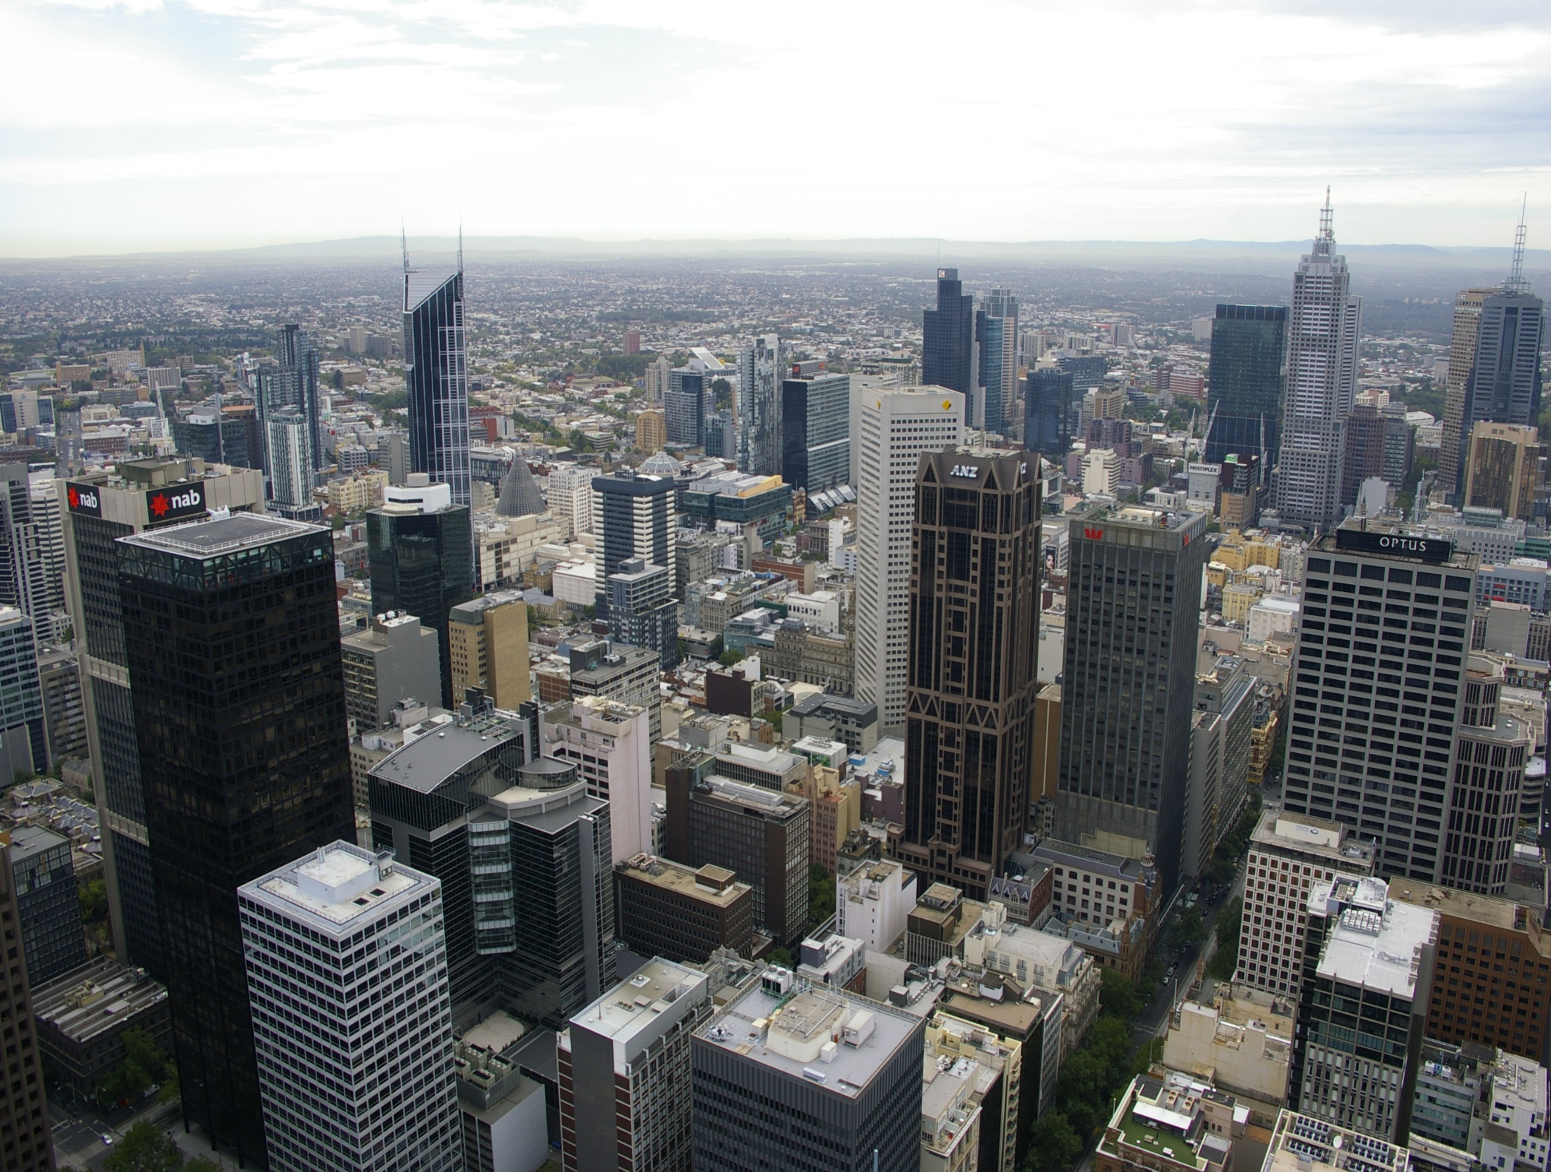
Most expensive land

Slide 7
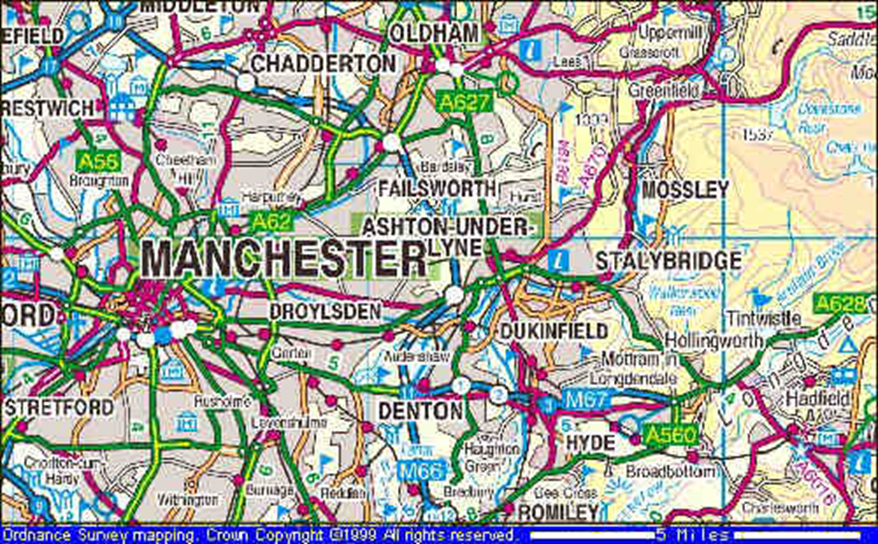
Also in CORE CBD: The Central Business District
The commercial, office, retail, and cultural center of the city and usually is the center point for transportation networks.

Slide 8
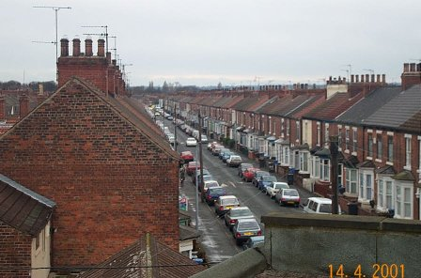
Inner City ring

Slide 9
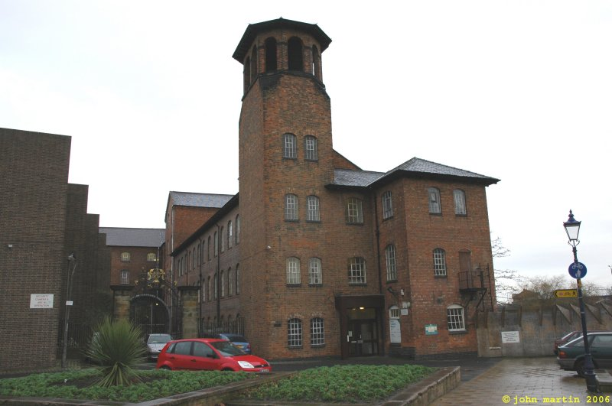
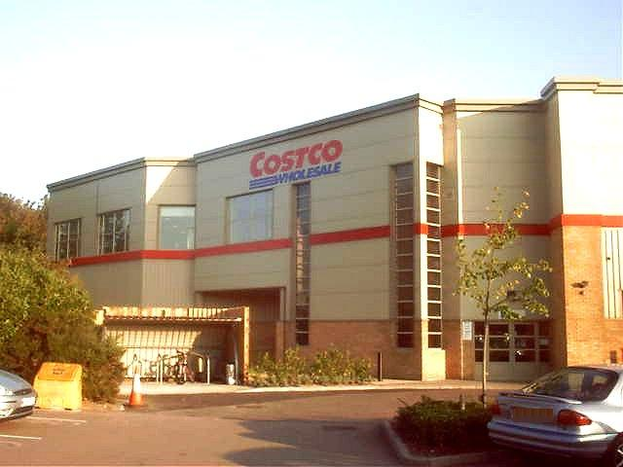
Some older industry
Some newer industry

Slide 10
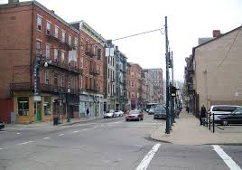
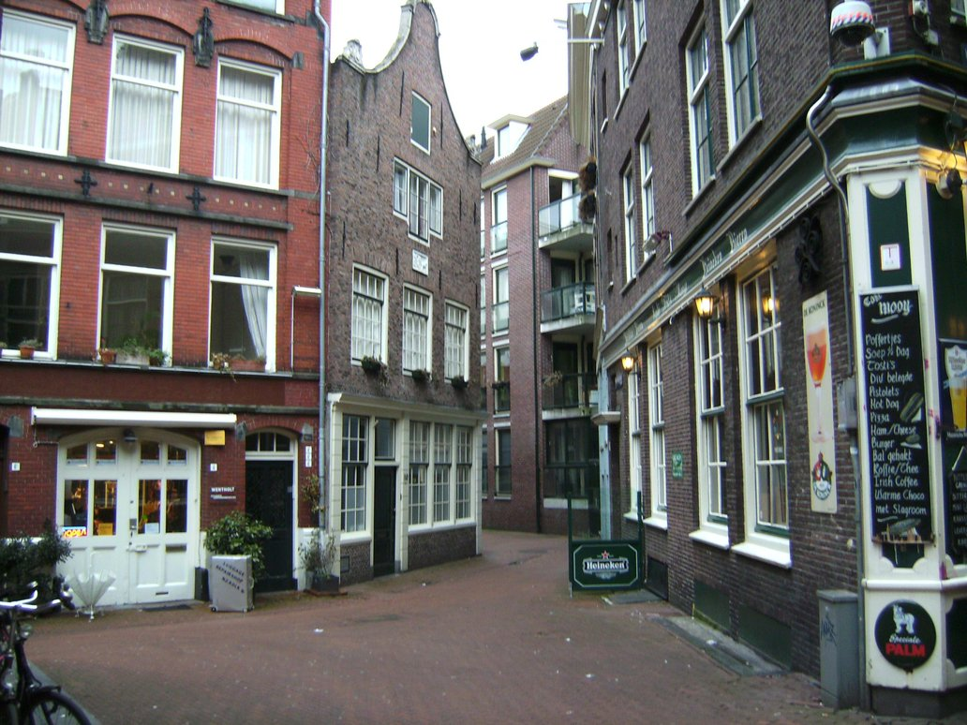
Inner City Ring: very old, crumbling buildings mixed with newer stores on the cheap land. Often cite of minority neigbourhoods. Cheap land but still close to the city so some stores locate here.

Slide 11
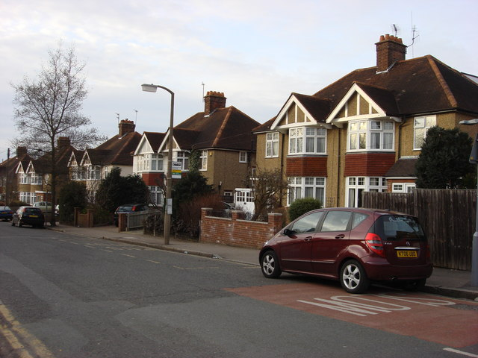
Suburban ring

Slide 12
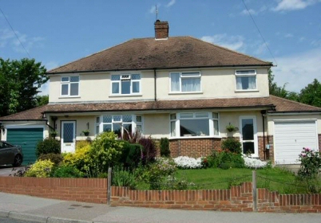
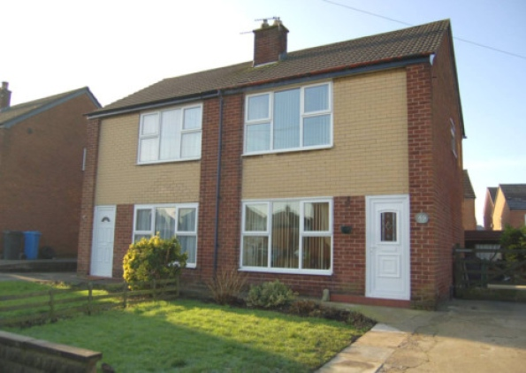

Slide 13
Suburban Ring: Newer homes, more space and green space, mane families live here with small shops and neigbourhoods. Cheaper than living in CBD with bigger homes and yards so families relocate.

Slide 14
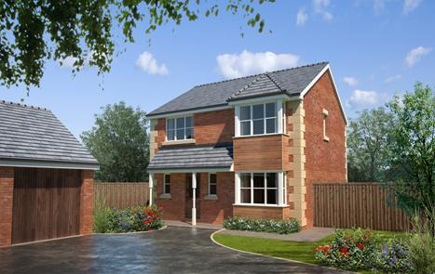
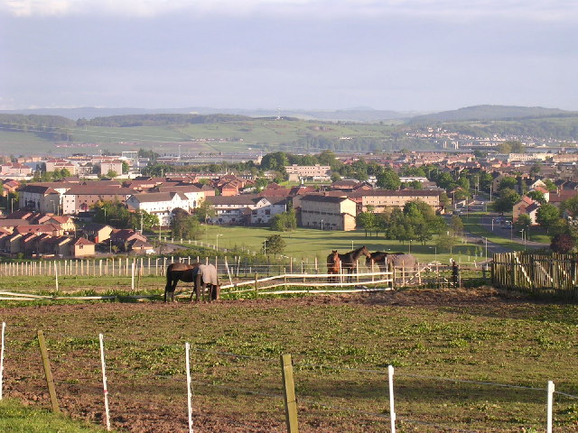
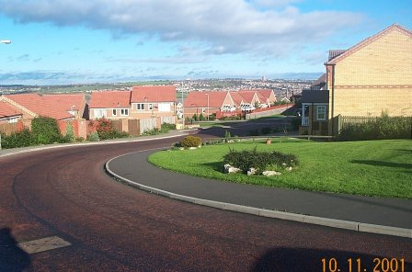
Urban fringe

Slide 15
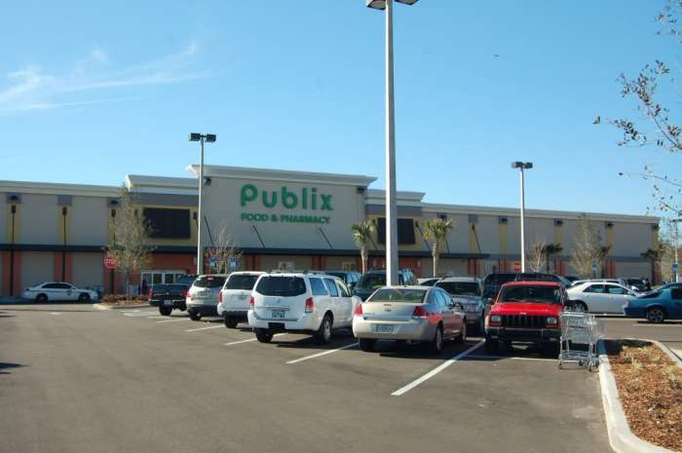
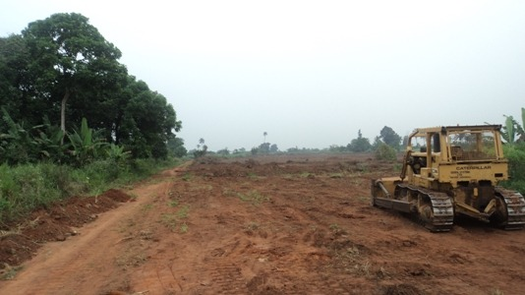
Least expensive land

Slide 16
Urban-Rural Fringe: combination of farmland and national parks, outlet malls and huge department stores like Walmart. Land cleared for further development and homes located far apart from one another…

