Slide 1
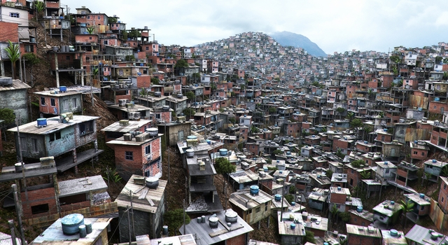
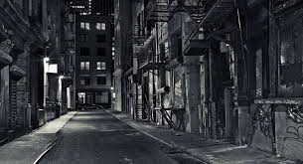
Poverty in HIC vs. LIC Cities
What are the distinguishing features?

Slide 2
New York

Slide 3
Rio De Janeiro

Slide 4
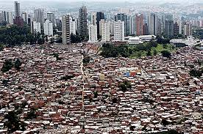
Low Income Countries: Slums, Shantytowns, Favelas
Filled with people from countryside
(due to urban-rural migration)
Remember, average line of latitude for
megacities has moved south!
Made with found materials, no proper buildings
No resources, unsanitary conditions, often extreme poverty
Few resources or services, except _______________
Found on outskirts of city (cheapest land, first place migrants come)

Slide 5
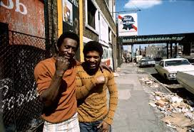
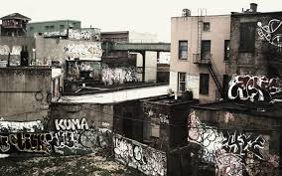
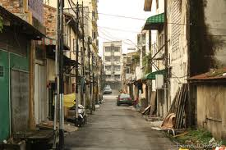
High Income Countries Ghettoes, Inner City, District Slums
Usually occupied by minority groups
(African Americans – NY, LA / Native Americans – Vancouver)
Squatters occupy crumbling, old buildings
Many government/NGO services offered, such as _________ (list 4)
Found close to center of the city (abandoned)

Slide 6
Textbook pages 166-167
Define ‘poverty’
Define ‘deprivation’

