Slide 1
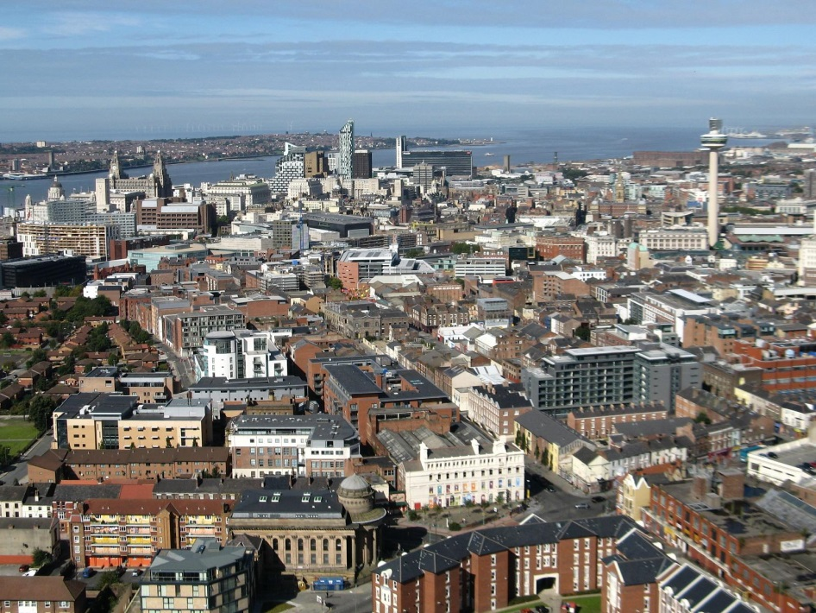
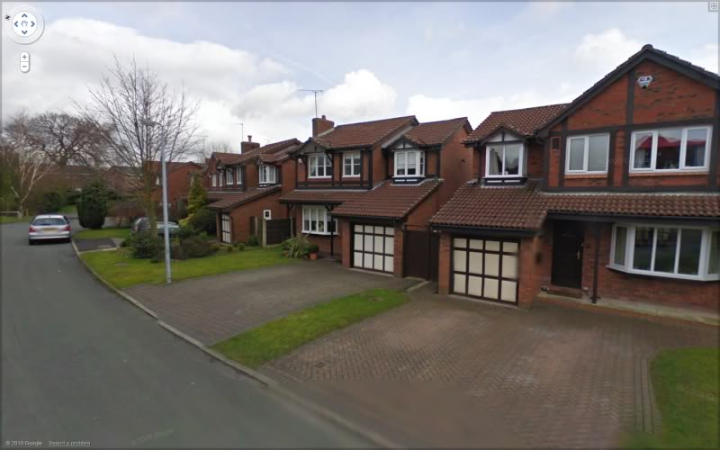
suburbanisation is when ...
People move out of inner city areas to the surrounding urban areas where the building density is less
These areas then become more built up and offer many services such as transport to the CBD and inner city

Slide 2
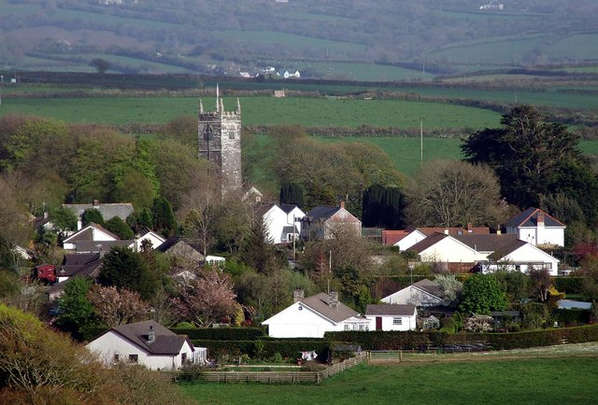
Counter-urbanisation
Moving from
Inner city to Urban rural fringe

Slide 3
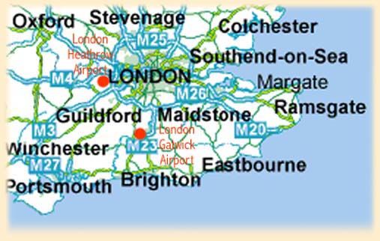
Counter-urbanisation is...
People move out of inner city areas to the urban-rural fringe
People move to commuter villages – towns only few miles to large urban area. Many people still travel back to city for work.
Fast transportations allows people to travel to work
(trains, highways, carpooling)
Key definition
Commuter range the distance people will travel from their homes to their place of work

