Slide 1
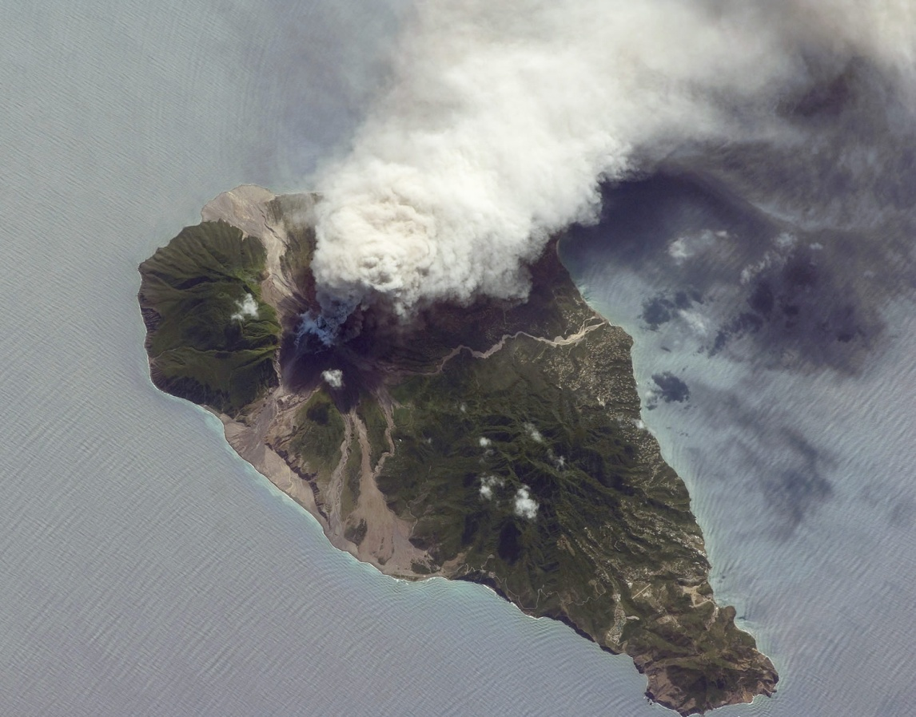
A case study for the Montserrat volcanic eruption

Slide 2
Write following in your book; leaving 5-7 spaces after each number
1. The location of Montserrat - include a sketch map
2. What caused the eruption? (type of boundary, plate names, process)
3. The type of eruption (lava, lahar, pyroclastic cloud etc)
4. Describe the short term (weeks afterwards) effects of the eruption
5. Describe the long term (years afterwards) effects of the eruption
6. How is the hazard of the volcanic activity 'managed' ? Was the volcano monitored?
7. Why did only 19 people die despite the dangerous eruption?

Slide 3
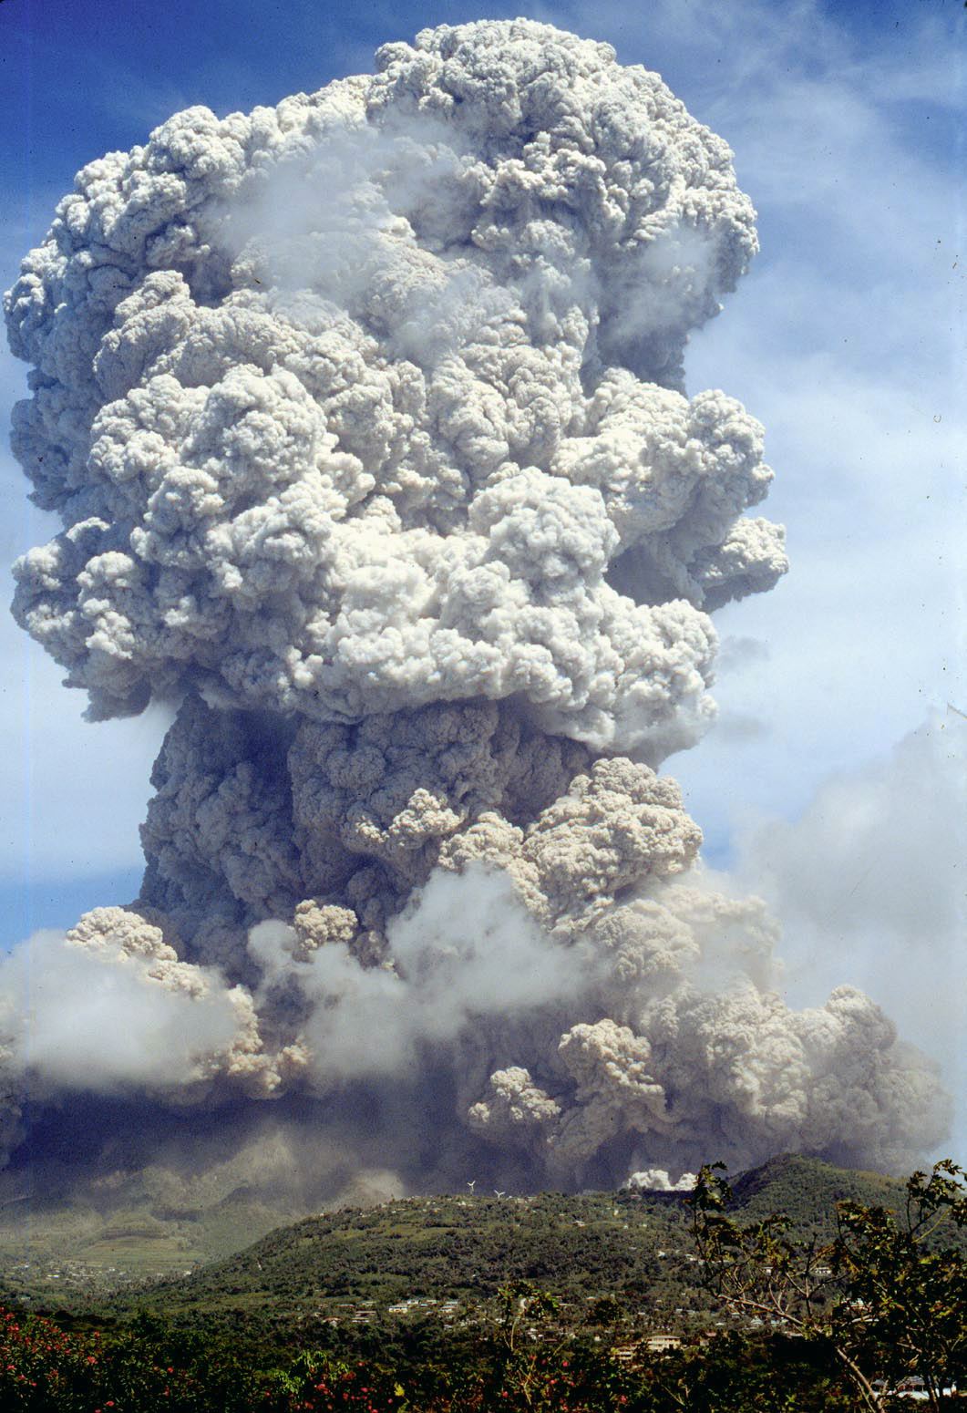
The Montserrat (Soufriere Hills) Volcano is a stratovolcano which became active in 1995 and has remained so ever since.
The lava eruptions are andesitic – thick and sticky, and form domes on the volcano. When they collapse hot rocks, gas, and ash flow down the side of the volcano in pyroclastic flows

Slide 5
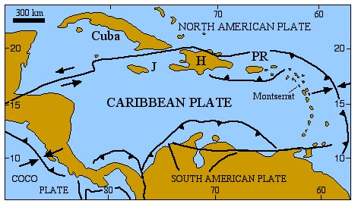
Montserrat is situated on a destructive (convergent) plate boundary: the North American plate is being subducted under the Caribbean plate… why has this happened?

Slide 7
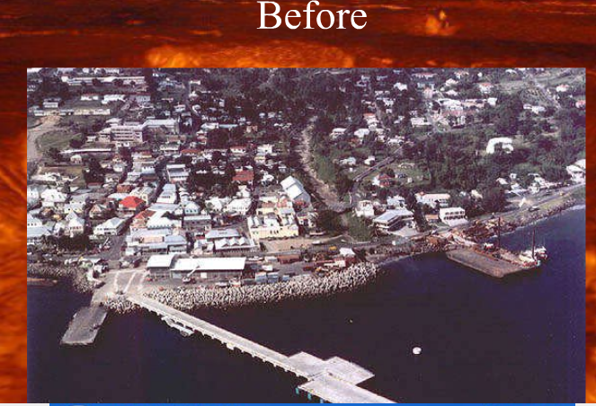

Slide 8
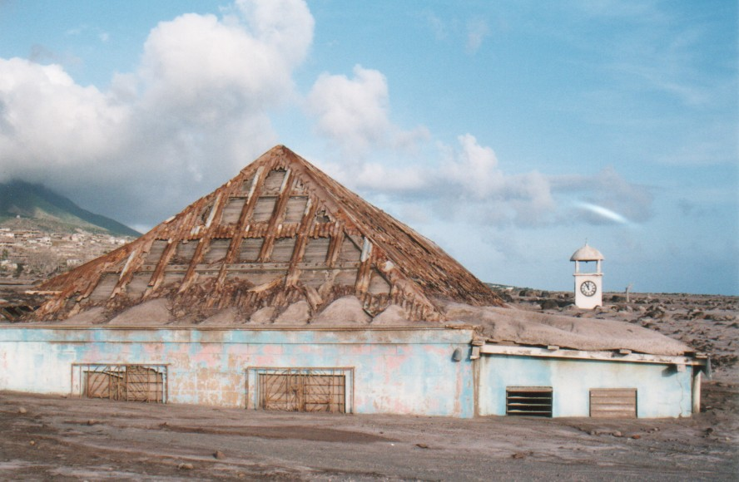
In August of 1997, a series of pyroclastic flows and lahars (mudflows) destroyed the capital city of Plymouth
Photograph by Adam Goss http://people.cornell.edu/pages/arg32/watson/montserrat.html and used with permission

Slide 10
After: the damage from 5 million cubic metres of hot rocks and gas

Slide 11
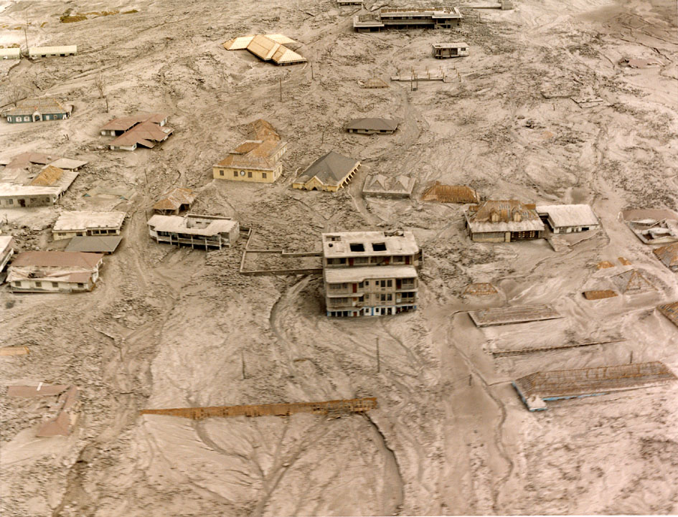
Nearly 8,000 people out of a total population of 12,000 left the island for nearby Antigua, some went to the USA and Britain.
Photograph from MVO http://www.mvo.ms/ and used with permission

Slide 12
What is the future for Montserrat?
Photograph by Adam Goss http://people.cornell.edu/pages/arg32/watson/montserrat.html and used with permission

Slide 13
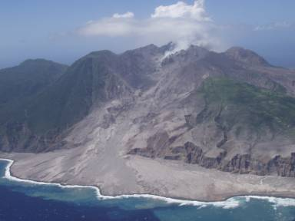
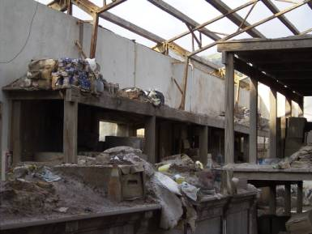
Coral reefs have been damaged and fish stocks affected
Most of the islands small businesses have been forced to close
Photographs from MVO http://www.mvo.ms/ and used with permission

Slide 14
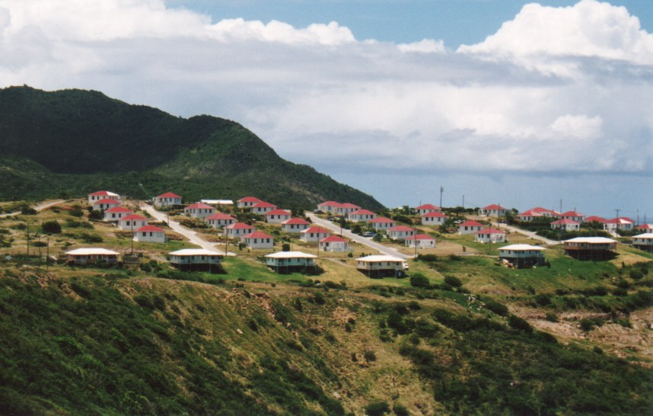
Today, Montserratians are rebuilding their country with help from the British Government. Slowly, people are moving out of the shelters or back from abroad to resettle in developments constructed in the North.
Photograph by Adam Goss http://people.cornell.edu/pages/arg32/watson/montserrat.html and used with permission

Slide 15
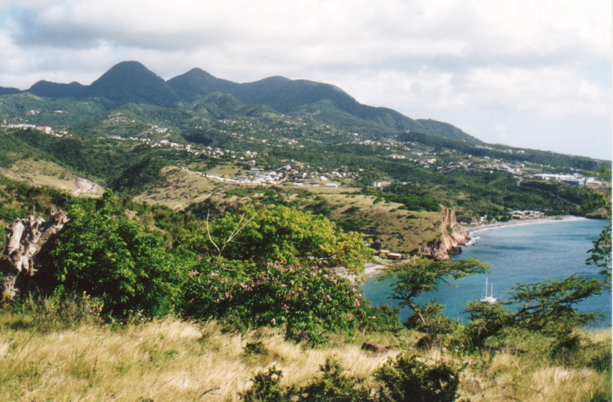
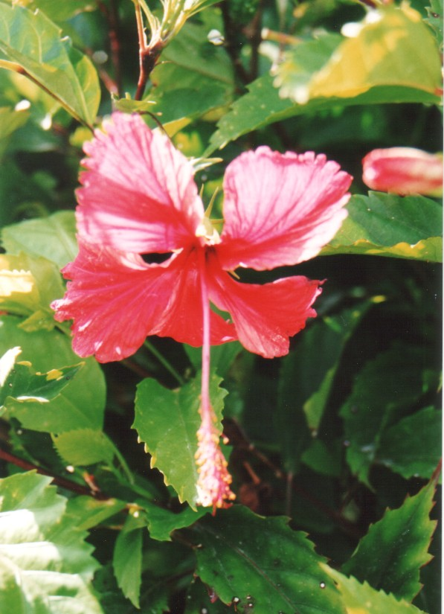
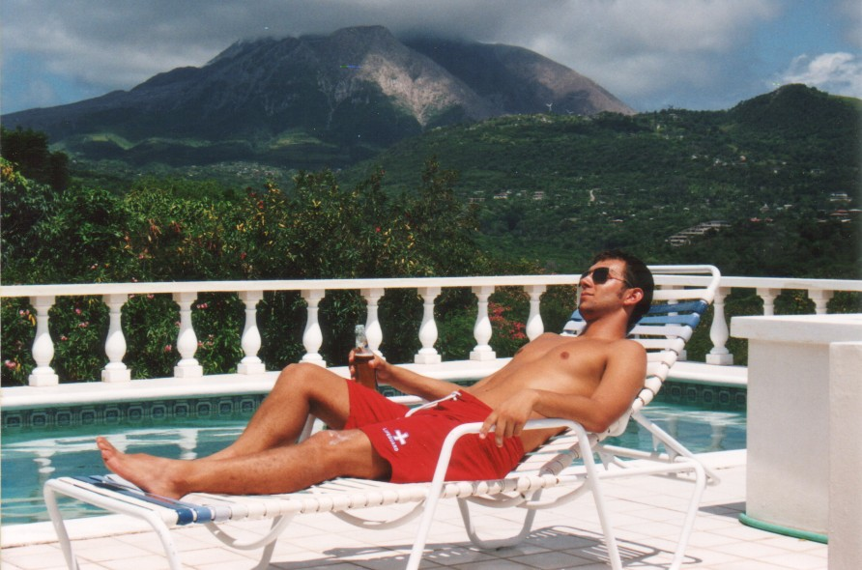
The north of the island remains untouched by the volcano.
Photograph by Adam Goss http://people.cornell.edu/pages/arg32/watson/montserrat.html and used with permission

Slide 16
Exam question- January 2011
…………………………………………………………………………………………………………………………………………………
…………………………………………………………………………………………………………………………………………………
…………………………………………………………………………………………………………………………………………………
…………………………………………………………………………………………………………………………………………………
…………………………………………………………………………………………………………………………………………………
…………………………………………………………………………………………………………………………………………………
…………………………………………………………………………………………………………………………………………………
…………………………………………………………………………………………………………………………………………………
…………………………………………………………………………………………………………………………………………………
…………………………………………………………………………………………………………………………………………………
…………………………………………………………………………………………………………………………………………………
…………………………………………………………………………………………………………………………………………………

Slide 18
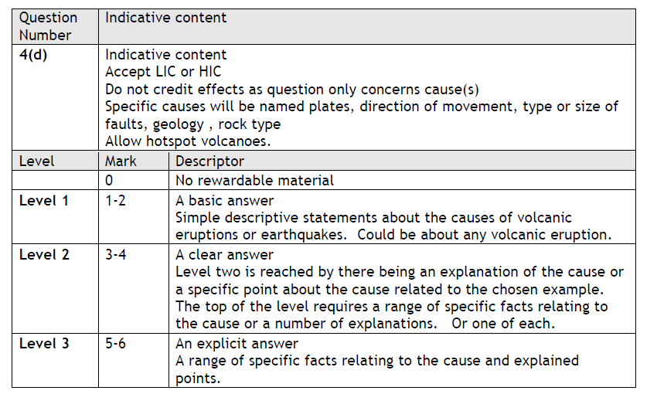

Slide 19
Exam question June 2011
…………………………………………………………………………………………………………………………………………………
…………………………………………………………………………………………………………………………………………………
…………………………………………………………………………………………………………………………………………………
…………………………………………………………………………………………………………………………………………………
…………………………………………………………………………………………………………………………………………………
…………………………………………………………………………………………………………………………………………………
…………………………………………………………………………………………………………………………………………………
…………………………………………………………………………………………………………………………………………………
…………………………………………………………………………………………………………………………………………………
…………………………………………………………………………………………………………………………………………………
…………………………………………………………………………………………………………………………………………………
…………………………………………………………………………………………………………………………………………………

Slide 20
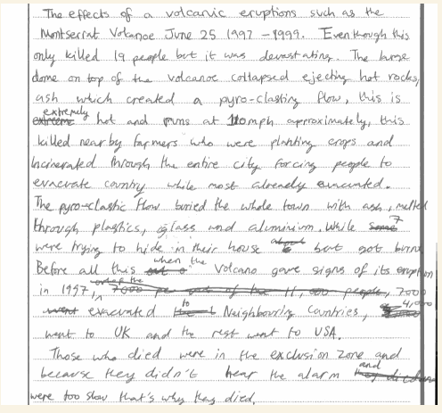

Slide 21
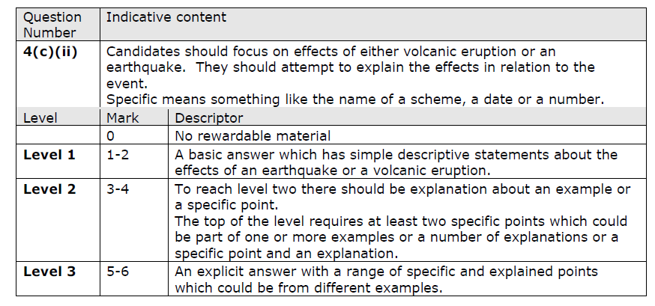

Slide 22
Overview of the eruption….
The Soufriere Hills volcano began to erupt in 1995 following a long period of inactivity (hadn't erupted for 350 years).
The eruptions forced the evacuation of the capital Plymouth and the part of the island that was actually the most densely population - and for good reason as it had the best advantages for settlement.
Pyroclastic flows killed some of the people who returned against advice, and have also created an area of new land as the debris has been deposited off the coast.

Slide 23
Cause of the eruption…
Destructive plate boundary (convergent)
North American Plate is being forced (subducted) under the Caribbean plate
Convection currents pull the plate into the mantle causing the rock to melt.
The molten rock is lighter than the surrounding rock which causes it to rise through the cracks towards the earths surface

Slide 24
Cause of the eruption
The volcanic eruption was so deadly because the volcano produced sticky andesitic lava (thick lava).
The lava is so thick it created a dome on the side of the Chances Peak volcano.
As the dome collapsed a huge ash cloud was formed.
Also the dome collapse caused hot rocks, gases and ash- a pyroclastic flow.

Slide 25
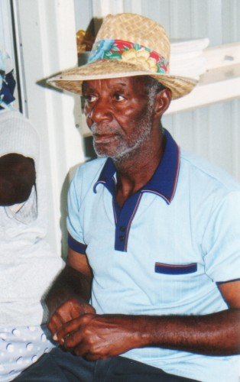
What would this Montserrat resident have to say about the future?
Think about …
Social problems
Economic problems
Environmental issues
What are the short term priorities?
What are the long term needs?
Photograph by Adam Goss http://people.cornell.edu/pages/arg32/watson/montserrat.html and used with permission

Slide 26
What to include in your case study
1. Describe the location of Montserrat- you could include a sketch map
2. What caused the eruption?
3. List the Primary and Secondary hazards of the Soufriere Hills volcano
4. Which part of the island was evacuated first, and when did this take place ?
5. What is a pyroclastic flow ?
6. Describe the long and short term effects of the eruption
7. What were the effects on the people an the environment?
8. How is the hazard of the volcanic activity 'managed' ?
9. Why is the fact that the south of the island has been most badly hit a particular problem for the people of Montserrat ?
10. What role did the British have to play in the evacuation of the island?
With any case study you should include Place names, figures to make it specific to that area

Slide 27
KEY FACTS
Think of these as 'bullet points' - a useful REVISION technique is to try to reduce any topic down to just 10 bullet points which contain the main aspects of what it is you want to get across....

Slide 28
Exam question June 2011
…………………………………………………………………………………………………………………………………………………
…………………………………………………………………………………………………………………………………………………
…………………………………………………………………………………………………………………………………………………
…………………………………………………………………………………………………………………………………………………
…………………………………………………………………………………………………………………………………………………
…………………………………………………………………………………………………………………………………………………
…………………………………………………………………………………………………………………………………………………
…………………………………………………………………………………………………………………………………………………
…………………………………………………………………………………………………………………………………………………
…………………………………………………………………………………………………………………………………………………
…………………………………………………………………………………………………………………………………………………
…………………………………………………………………………………………………………………………………………………

