Slide 1
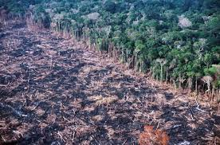
The causes of deforestation in the Amazon

Slide 2
The Amazon Rainforest is contained in … (Name the countries).

Slide 3
Why is the rainforest important?
Home to Indigenous People
(The Awa tribe)
Contains medicine
(Quinine – an aid to cure malaria)
Creates Oxygen
(20% of the world’s oxygen created by the Amazon)
Preserves Biodiversity
(10% of all biodiversity on earth)
“Carbon Sink” – holds carbon
(90-140 billion metric tonnes)
Feeds Oceans
(15-16% of the world’s total river discharges)

Slide 4
In the last 50 years, 17% of the amazon has been lost to human activity

Slide 5
Why is deforestation occurring? … Logging. (Paper/building supplies)

Slide 6
Mining (gold)

Slide 7
(hydroelectric power) HEP

Slide 8
Residential areas (homes)

Slide 9
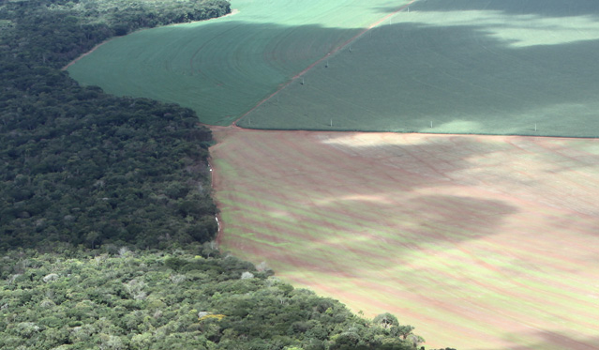
Agriculture (farmland/pasture land)

Slide 10
Roads (Trans-Amazon highway)

