Slide 1
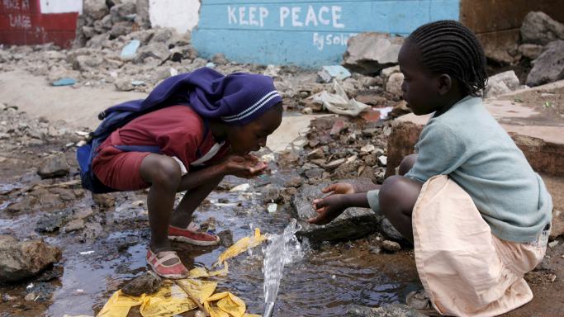
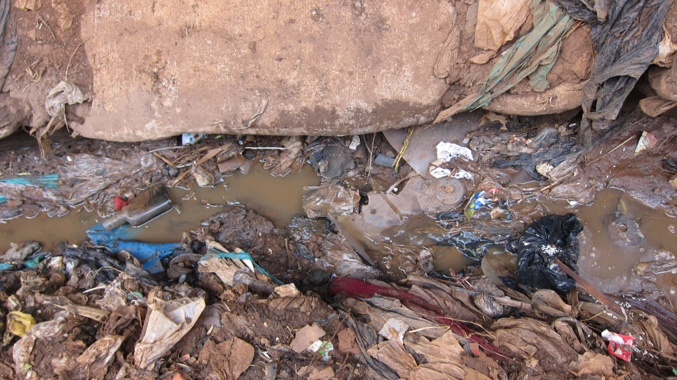
Urbanization issues
Social problems (ie; crime)
Access to resources (ie; water)
Education
Environmental (ie: pollution)
Congestion (traffic)
Employment
Housing
Health (disease)

Slide 2
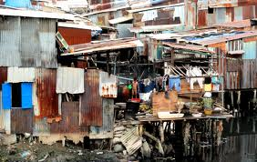
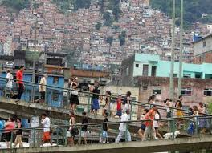
Slums, shantytowns & favelas the consequences of rapid urbanization
The Human Face of Rapid Urbanization

Slide 3
Two videos yesterday; India and Bangladesh how are they similar?
Slums/Shantytowns: are located in developing nations. Why?
Other countries such as UK, US already ‘developed’ infrastructure
Recent ‘population boom’ mostly in developing nations
Rural-urban migration and promise of better life sends people to city

Slide 4
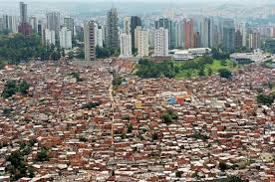
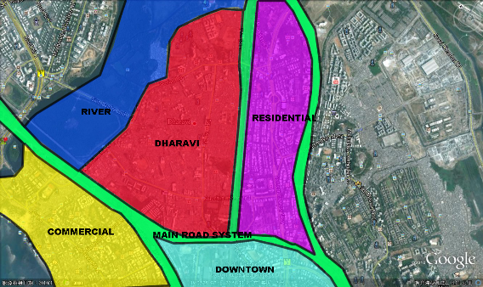
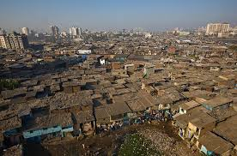
Location: slums are located on the edge of urban LIC areas; it is the first place migrants come to, land is cheap (free), there is less surveillance from city

Slide 5
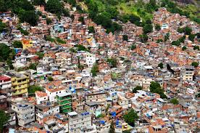
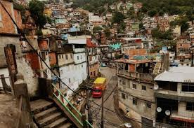
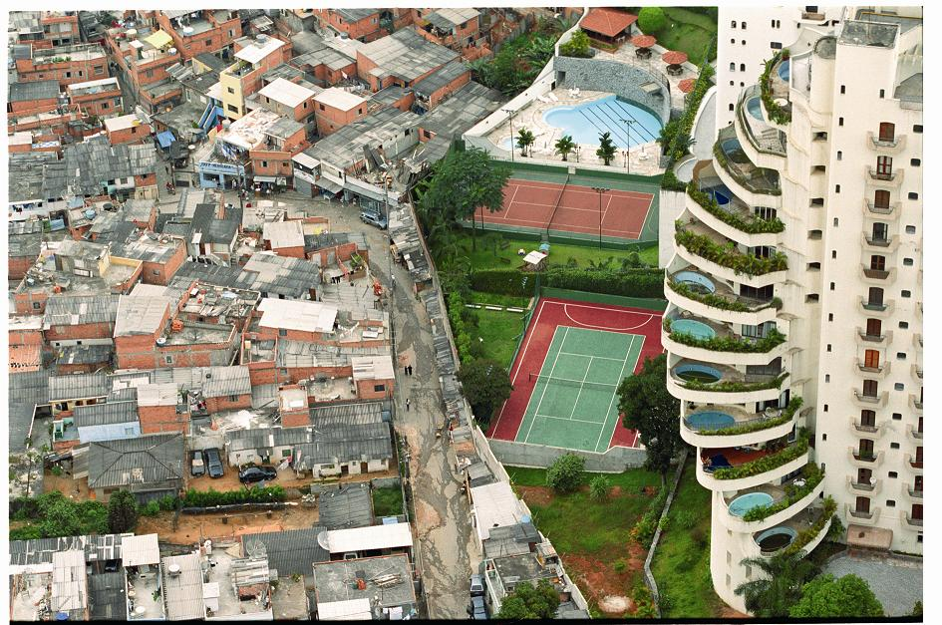
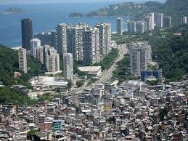
Rocinha, Rio de Janiero: - there for over a century - 6% of brazil’s population lives in favelas; 70 000 of them in Rocinha - houses used to be made of ‘found’ materials, now concrete and brick - basic plumbing, access to water and electricity are now in almost all houses

Slide 6
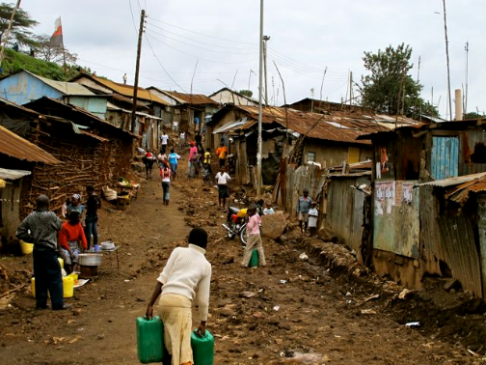
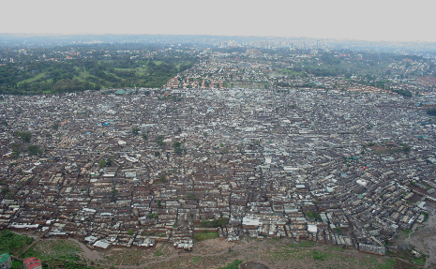
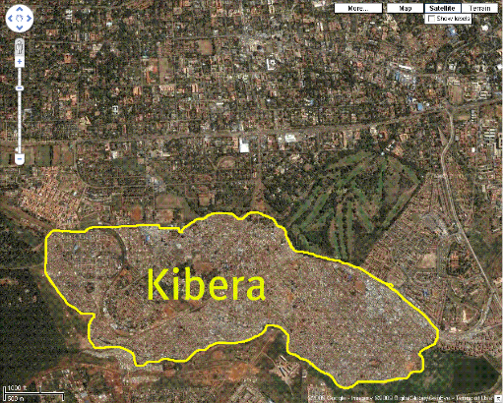
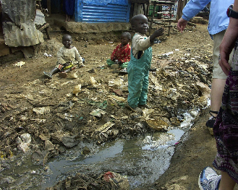
Kibera: Africa’s biggest slum (Nairobi, Kenya)
500 000 – 1million people
Disease such as HIV/AIDS common
Residents lack access to basic services like water/electricity
Assault/rape is common

