Slide 1
Question 1 There are 5 oceans - can you name them and put them in size order?
Pacific
Atlantic
Indian
Southern
Arctic

Slide 2
Question 2 How much of the earth surface is covered by water?
About 70%

Slide 3
Question 3 How much of that water is contained in the oceans?
97.3% of the earth’s water is contained in the oceans!

Slide 4
Question 4 Where is the deepest part of the ocean?
Marianas Trench

Slide 5
Question 5 Why is the sea salty?
Salt comes from rivers which have eroded away the land and carry minerals into the sea
Some salt comes from dissolved from rocks and sediments below the ocean floor, through volcanic vents.
Rain also deposits mineral particles into the oceans.
Evaporation causes pure water to rise out of the ocean leaving the salts behind.
The water returns to the ocean, via rivers or precipitation, to wash down more salt, which becomes ever more concentrated.
THE WATER CYCLE

Slide 6
Distribution of the oceans
Most maps focus on land surfaces and split the largest ocean

Slide 8
North Hemisphere
South Hemisphere
Distribution of Oceans is not even
Oceans cover 50 % of the surface in the North Hemisphere and 90% of the area in the Southern Hemisphere

Slide 9
Find a map to show the location of these important areas:
Pacific ocean
Atlantic ocean
Indian ocean
Southern ocean
Arctic ocean
South China Sea
Caribbean Sea
Mediterranean Sea
Bering Sea

Slide 10
Sea currents
Surface currents are called Gyres
Surface ocean currents are caused by prevailing winds (most usual winds) blowing across surface of the sea
The dominant pattern of Gyres is circular

Slide 11
How do the oceans control climate?
Warm ocean currents move water AWAY from the equator. Warm water causes air above it to rise
Cold ocean currents move water away from cold areas TOWARDS the equator. Cold water sinks.
Eg. Gulf Stream – If it wasn’t for this the temperate climate of UK would be sub arctic!!

Slide 12
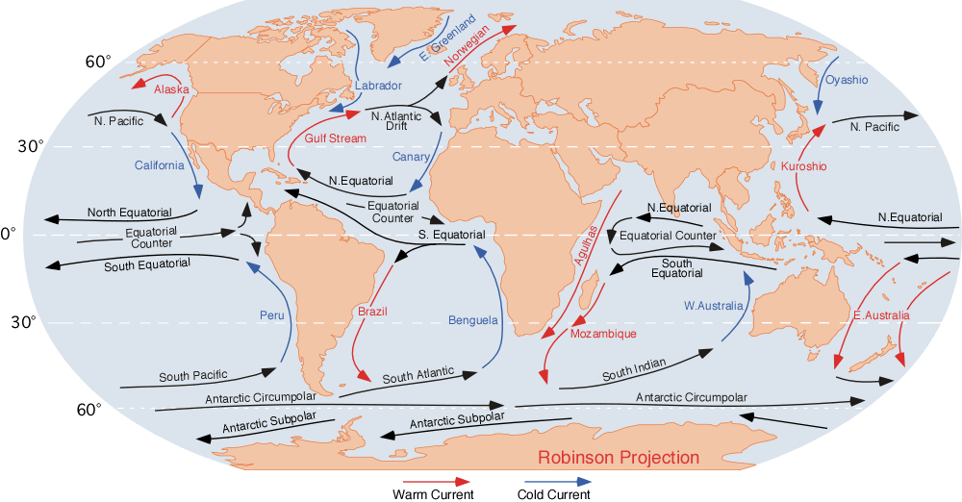
Main direction of surface currents
Clock wise Northern Hemisphere
Exception – Antarctic current. Doesn’t exist in North Because land gets in the way!
Counterclockwise Southern Hemisphere

Slide 13
Gulf stream is narrow and fast flowing. Transports heat from tropics to colder areas in North. Reason why UK has Mild winters compared to places at the same latitude
Because of Earths rotation, water piles up on one side of the Gyre. This make the current on the other side flow very quickly eg. Gulf stream
Labrador current – cold current reduces Canadian temperatures in Summer but only if wind blow from sea to land

Slide 14
The Great Ocean Conveyor Belt: A global thermohaline circulation, driven by the formation and sinking of deep water and responsible for the large flow of upper ocean water

Slide 15
How do desert locations match ocean currents?

Slide 16
Account for the following:
Namib desert in Southern Africa
Monsoon in Asia
Desert areas in California
Temperate climate in UK

Slide 17
Answer questions a-c using textbook….pg 135

