Slide 1
Write an IGSCE long answer question about ‘deindustrialization’
“In many HICs the nature of employment is changing. With reference to one HIC, describe and give reasons for this change.” (9)

Slide 2
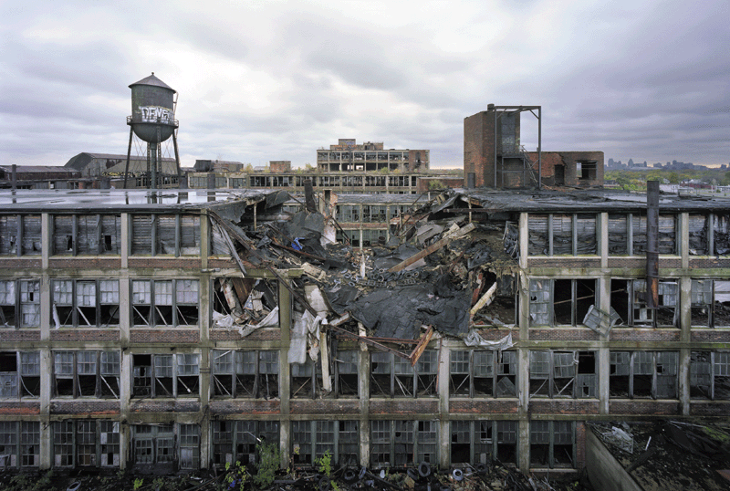
Deindustrialization:
A reduction in size or share of
manufacturing industry
A process of social or economic
change caused by removal or reduction in industrial capacity
There has been a global shift in manufacturing … where? Explain
USA used to be the industrial heartland of the world….

Slide 3
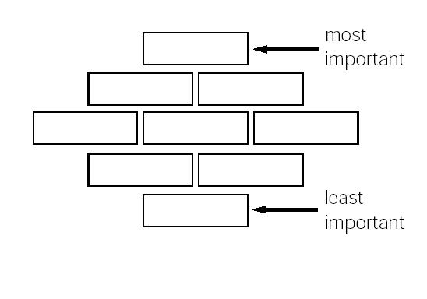
As you watch the movie “Detropia”
1. Find indicators of the changing nature of employment in Detroit
2. Draw two columns:
Title the first “causes of change” (how is employment changing?)
Title the second “effects of change” – write down all facts/stats
3. Use a different colour for
SOCIAL and ECONOMIC issues
By the end of the movie,
use the diamond formation
to try and put these problems
in order of importance

Slide 4
Global shift = deindustrialization in some HICs
CAUSED BY:
TNCs – search for cheapest locations and therefore most profitable
Transport – faster and cheaper (no need to be close by)
Communications – enables movement elsewhere
Energy – easily available/cheap in many countries
Governments – tempt industrialists elsewhere (LICs) with incentives
(tax breaks, cheap buildings)
New branches of manufacturing – ‘footloose’ industries (ie: clothing) can move anywhere; not tied to raw materials and markets…

Slide 5
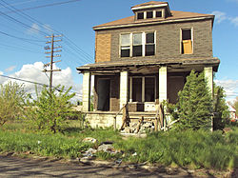
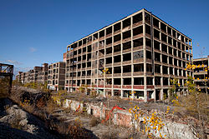
Detroit: ‘Motor City’
1950s-1980s
The 4th largest city in the USA
Booming economy on the Canada-US border
(imports/exports)
World automotive centre
Today:
18th largest city in America
Highest crime rates in America
2013 city filed for bankruptcy
Car manufacturing almost completely gone

Slide 6
Mark scheme
Level 1 1-3 marks | Expect simple list of problems Description With or without named area – no specific detail. Undeveloped points with little explanation
Level 2 4-6 marks | Appropriately named area with some evidence of specific detail Range of problems - Some explanation and development of points. At least one problem explained in depth
Level 3 7-9 marks | Expect at least three developed points set in context of a specific example Problems may be linked together Highest responses show evidence of higher level thinking – judge which problems more important than others
A* 9
A 7-8
B 6
C 4-5
D 3
E 1-2

