Slide 1
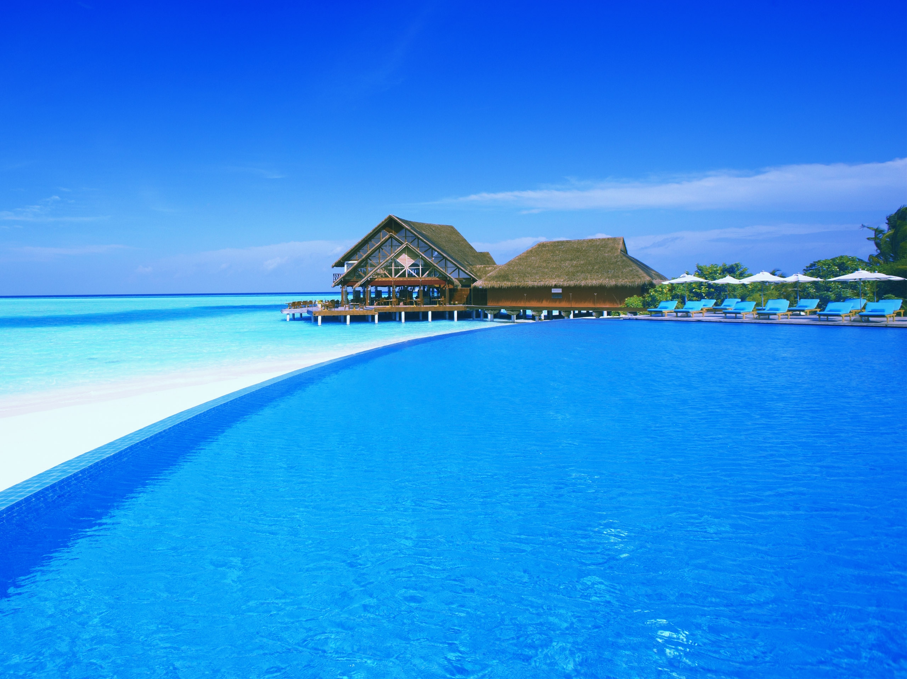
How has tourism in The Bahamas changed over the years?

Slide 2
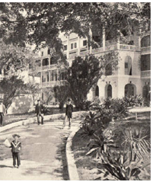
Nassau: used to be an outpost of British empire. Not used for tourism until 1861 when H.M. Flager brought the Royal Victoria Hotel in Nassau… THE BEGINNING! It was destroyed by fire in 1922 ☹

Slide 3
Why did tourists come then?
At that time, it was thought the climate and “healthiness” of the islands made it a good place to recover from illness… ??
Eventually, tourists started coming by the hundreds of thousands after WWII, because it is close to North America and people there had higher incomes.

Slide 4
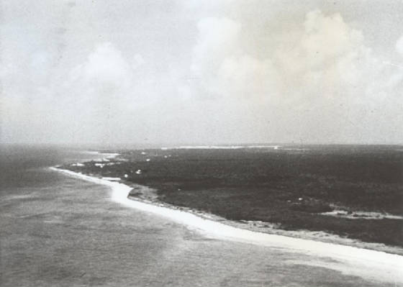
Where is this?
Lucayan beach before development!

Slide 5
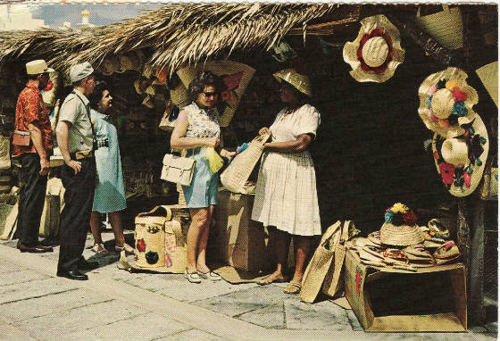
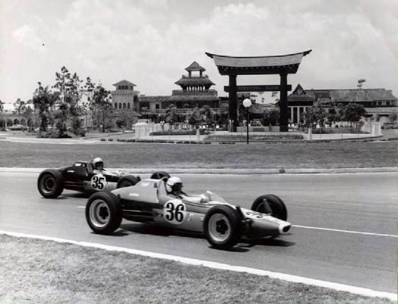
The international bazaar in 1960’s and 1980’s

Slide 6
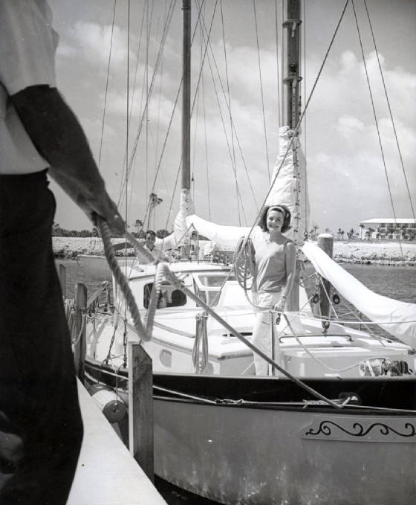
Bell Channel Marina, 1962

Slide 7
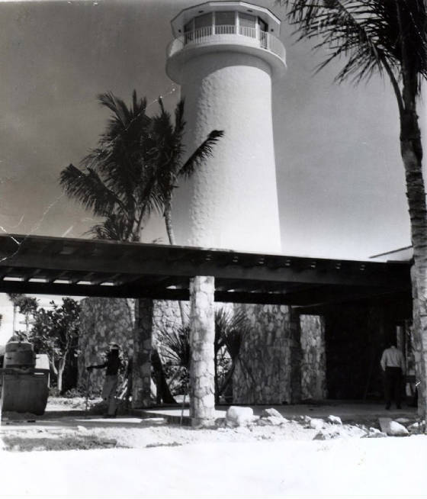
Construction of Lucaya Hotel - 1963

Slide 8
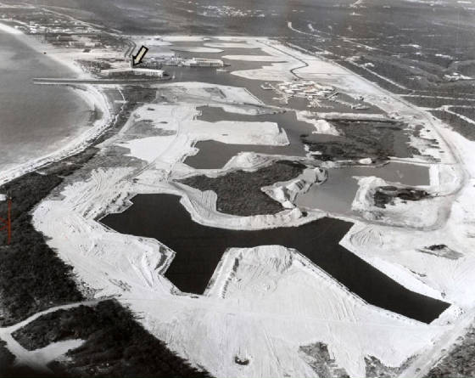
Constructing the canal system in 1966

Slide 9
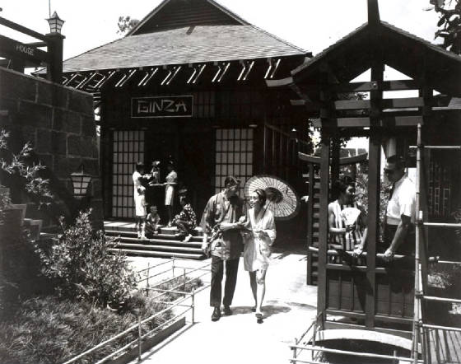
1970

Slide 10
After WWII, tourism developed on Grand Bahama island closer to the Bazaar and airport
Not until the canal system and hotels were constructed along the coast did tourism shift to Port Lucaya

Slide 11
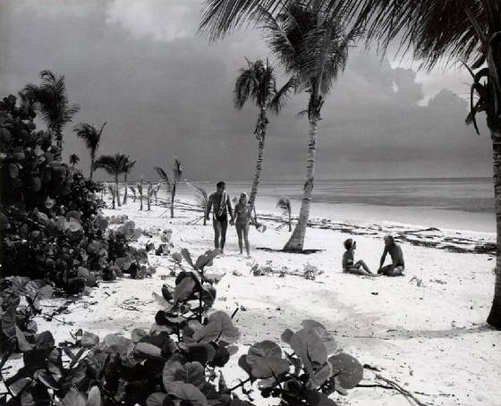
Where am I?
Taino Beach 1970

Slide 12
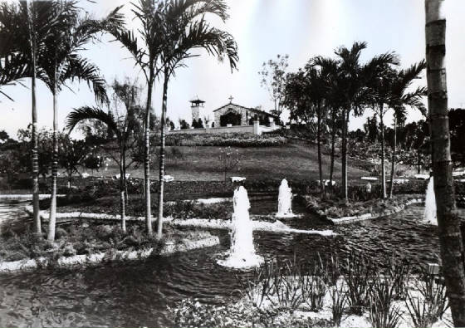
Where am I?
Garden of the Groves 1980

Slide 13
Task 1
Read the History of Tourism in the Bahamas worksheet and highlight the key dates
Task 2
Create a timeline in your book to show the top ten most important dates and facts in the development of tourism in the Bahamas.
Task 3
What do you think was the most important factor in the development of tourism in the Bahamas? Why?

