Slide 1
Consequences of desertification:
Reduced agricultural output – fewer crops can be grown
Malnutrition – peple don’t have enough to eat
Famine – people starve
Refugees – people move to new areas
Food Aid – sent by other countries to help

Slide 2
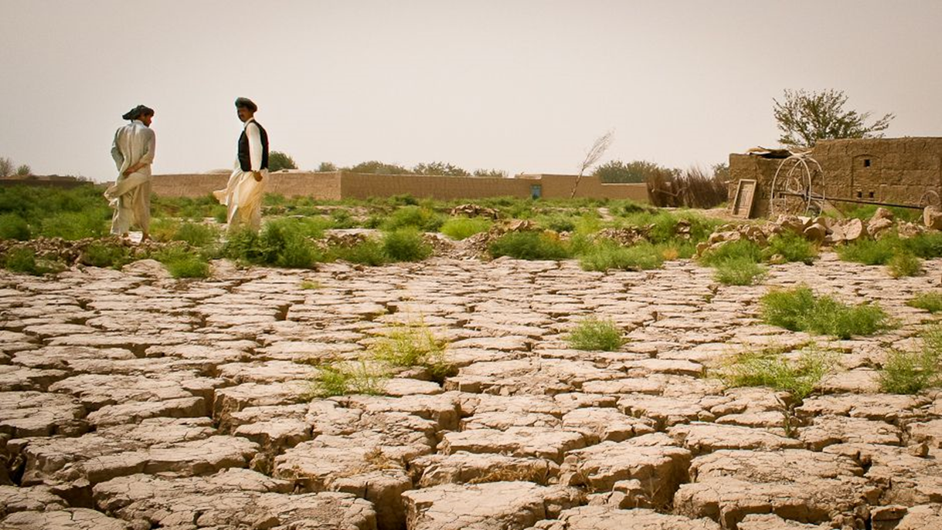
Desertification
What to do about it?

Slide 3
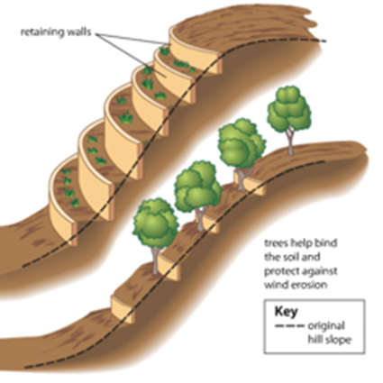
Soil Erosion Can Be Managed …and Desertification Prevented
In Two Ways:
#1 - By Preventing Soil Erosion through
a process called terracing.
This builds walls down a sloped area
to catch water when it rains.
It is popular in many Asian nations.

Slide 4
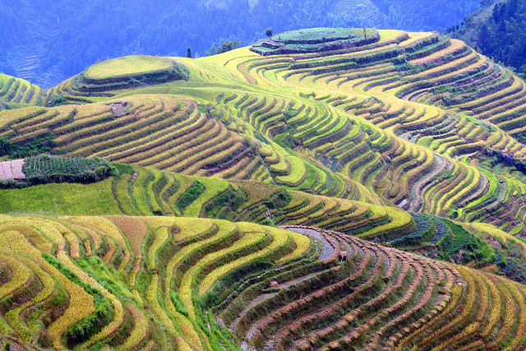
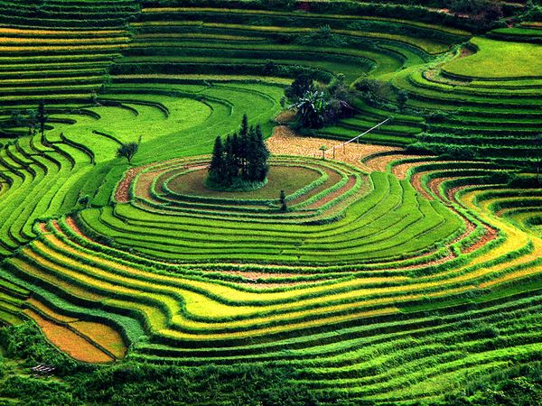

Slide 5
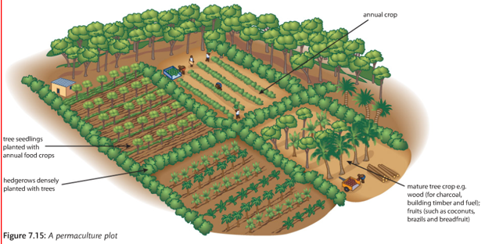
Also to manage desertification:
#2 - Maintaining water levels in the soil through permaculture; a type of pesticide free farming with a mix of small crops (nutrients), trees (oxygen) and livestock (manure) to keep
the soil fertile…

Slide 7
There are other more long-term ways to maintain water levels in the soil… Africa’s “Great Green Wall”

Slide 8
Homework: Look at the causes of desertification; choose one and come up with an additional long-term solution to help reduce or stop desertification in the Sahel… 10 sentence minimum, due next class. Write in your notebook under title: “Sahel Homework”

