Slide 1
Business Growth and Changing Locations in HICs

Slide 2
Type of industry | Location factors | Examples
Heavy industry | Near to raw materials - heavy to transport Unskilled labour needed Large power supply Large land area | Steel making
Light industry | ‘footloose’ – no need to be close to raw materials Lots of unskilled labour needed Found on ‘industrial estates’ near to other industries | Making clothing
High tech industry | Near to transport to get raw materials and get goods to market FAST Skilled labour force - Near universities Build on science parks near to other industries and knowledge netoworks | Making micro processers in computers

Slide 3
The location factors for tertiary industry
Tertiary activities:
Seek prosperity, labour, accessibility to market (often in CBD but increasingly moving outward in decentralization, which means moving to urban-rural fringe in business parks, superstore and retail parks/outlet malls)

Slide 4
The location factors of quaternary industry
Quaternary activities:
Seek prosperity, new technology, accessibility to transport and other tech firms, transport, government policy (incentives), on science parks or near universities, known as ‘knowledge networks’ – areas where high quality minds and tech converge to enhance learning communities

Slide 5
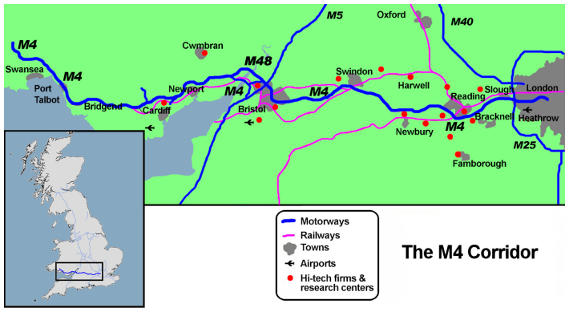
Case study - M4 growth corridor
Map from memory

Slide 6
Use pg. 104-105
1. Draw the sketch of the M4 growth corridor in your notebook and
describe the route of the M4 motorway in UK
2. Give examples of 4 hi-tech companies that have located on this motorway
3. For each one of these factors, explain why the M4 corridor is a good site using specific evidence for each location factor:
Transport and accessibility
Labour
Universities
Incentives

Slide 7
Manufacturing: Secondary and Quaternary
As seen in the M4 growth corridor, high-tech industries clustering together on outside of cities mostly in HIC countries (close to knowledge networks)
There is also a global shift in manufacturing; where increasingly TNCs (transnational corporations) are seeking to move their companies to places with cheaper labour/resources, a larger market and/or fewer restrictions
Since 1970, HICs share of world manufacturing has declined 20%; lost to MIC and LIC countries

