Slide 1
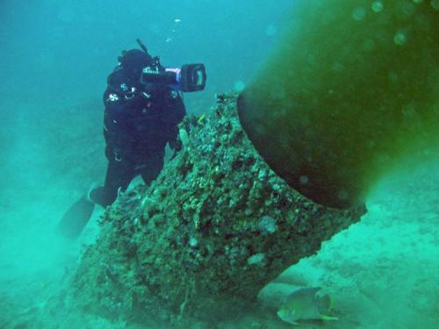
Describe the sources and distribution of pollution in the oceans

Slide 2

How would you measure “impact” on the ocean?

Slide 3
How would you measure “impact” on the ocean?
http://globalmarine.nceas.ucsb.edu/
Looked at impacts of
    6 types of fishing
    Inorganic pollution
    Invasive species
    Nutrient input
    Acidification
    Oil rigs
    Organic pollution
    Commercial shipping
    Sea surface temperature changes
    UV impacts

Slide 4
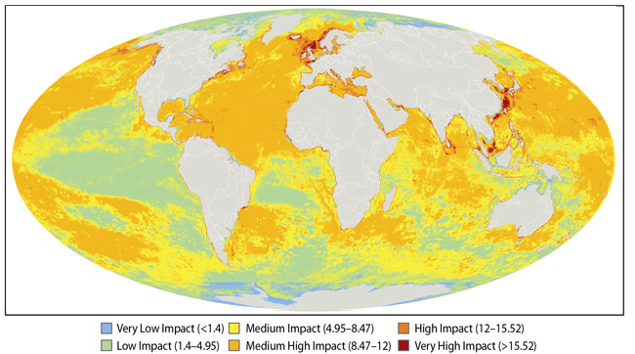
Map to show impact of people on the sea – can you describe the pattern of impact?

Slide 5
Describe the pattern of impact…..
Most heavily impacted areas are North Sea, South and East China Sea and the Bering sea.
Most impacted areas are oceans closer to dense human settlement for example Japan greater than 15 and close to shipping lanes for example between USA and Europe
Also heavily impacted are Coastal areas of Europe, North America, Caribbean and South East Asia (medium to high impact)
Least impacted areas, less than 1.4 are poles (far from populated areas), North Australia, some parts of South America and Africa (least developed nations)

Slide 6
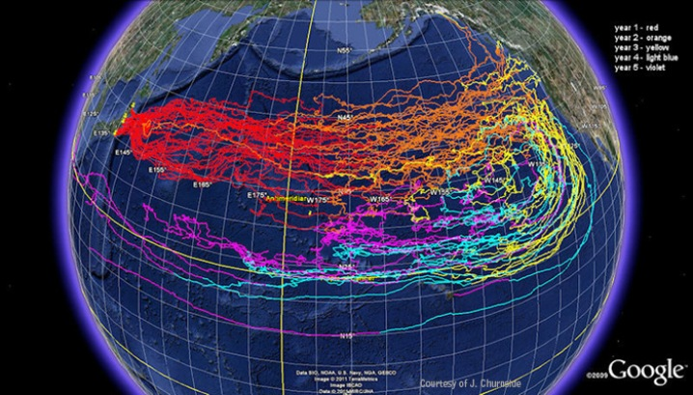
Sources of pollution in ocean
Radioactive waste causes direct damage to ecosystems
Question:
What year did Fukushima happen and what was it?

Slide 7
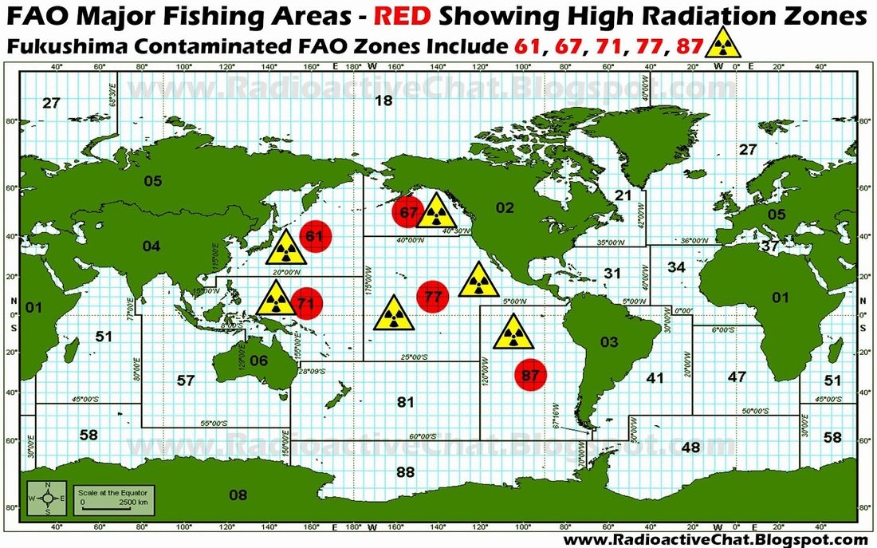

Slide 8
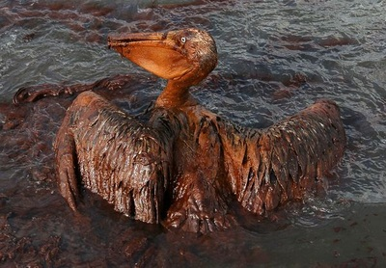
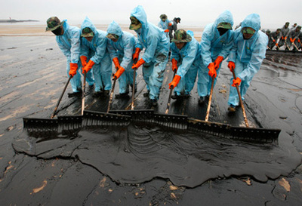
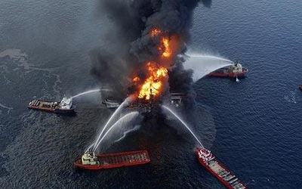
Oil waste from shipping, oil spills or run off has a direct impact on food chain
Question: how many gallons of oil spill into the ocean each year?

Slide 9
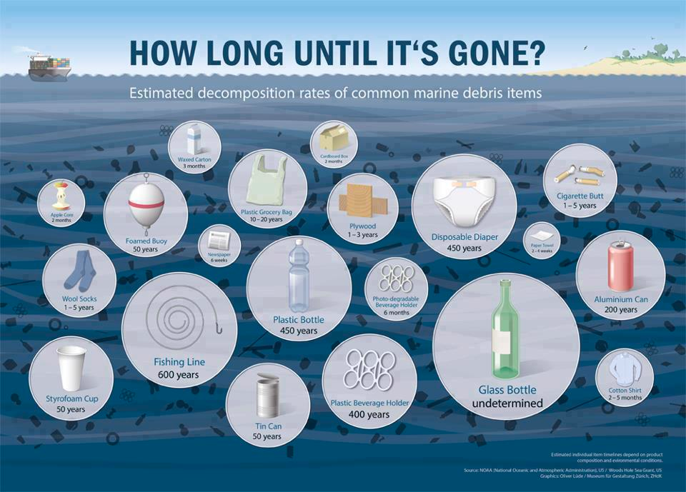

Slide 10
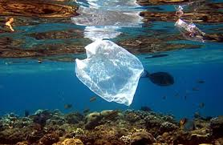
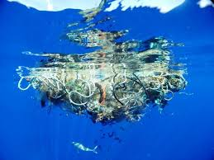
Garbage/trash such as plastic does not biodegrade and kills animals that ingest it
Question: What Is the Great Pacific Garbage Patch?

Slide 11
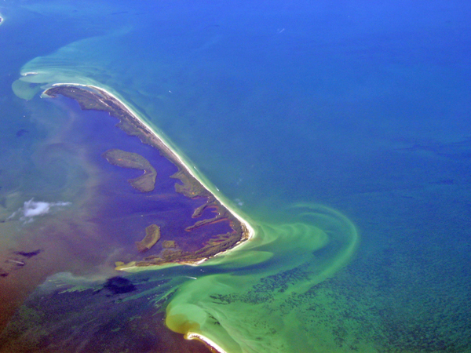
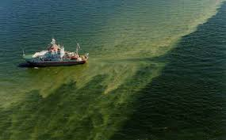
Chemical waste dumping or city run off
- Farm and Human wastes cause eutrophication where excessive nutrients are added to an environment
Question:
What types of toxic pollutants are dumped in the ocean?

Slide 12
Your Task:
Choose an ocean pollutant (oil, chemical, radioactive or plastic)
Write an article for Vice Magazine (hip, trendy, look it up if you don’t know) on the major issues involved with your source of pollution.
Include:
Current levels of pollution
Future (expected) levels of pollution
Major Contributors
What can be done??
Minimum 2 pages. List Your Sources (they must be credible).

