Slide 1
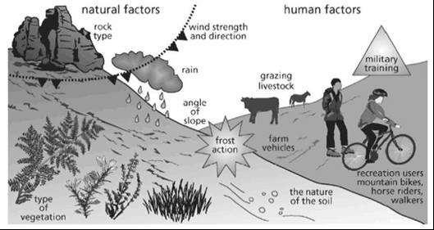
Review: Soil Erosion

Slide 2
Reasons for soil erosion – physical reasons human reasons
Deforestation
High winds cause the top soil to be removed
Dry soil
Using heavy machinery which compacts the earth so rain cannot be absorbed
Too much farming - nutrients disappear (no humus) and soil is exhausted
Heavy rain (sheet or gully erosion)
Overgrazing land (cattle eating vegetation)
Steep slope
Ploughing the fields in the same direction

Slide 3
Finish in Class
List 5 human causes of soil erosion using your textbook in your own words
(pg.180-181)
2. For each cause, accompany with a small illustration or graph remind you HOW this causes soil erosion…

Slide 4
Desertification… the process by which productive land turns into a desert-like landscape, often through loss of top two productive layers of soil (soil erosion)… TOO MUCH SOIL EROSION… Turns into Desertification.

Slide 5
Almost half of the world’s earth surface is made up of drylands or arid regions
Why are ARID regions at higher risk of desertification?

Slide 6
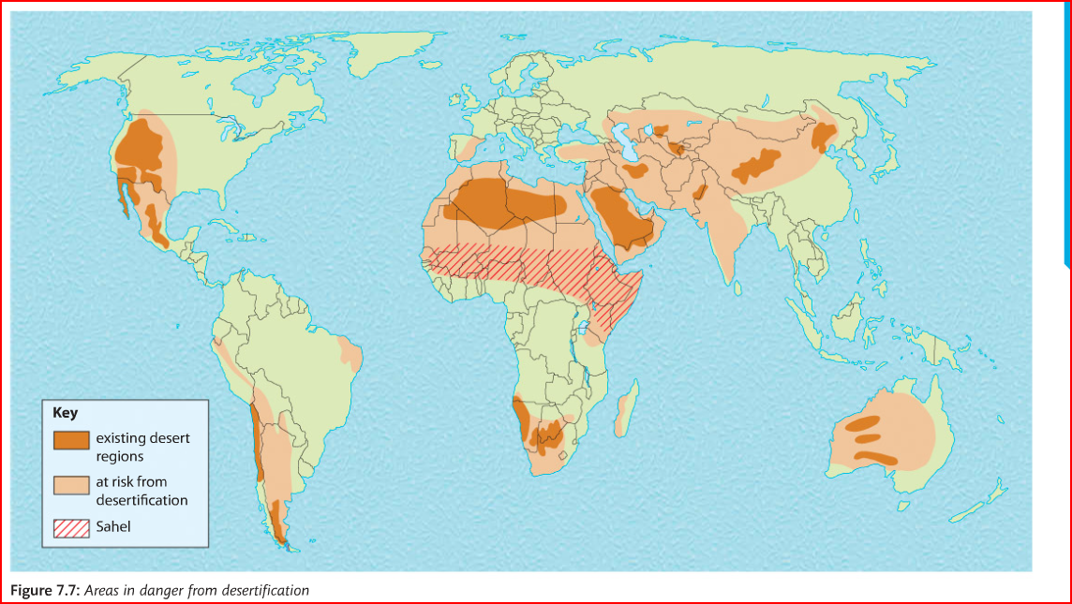
In Your Notebook, describe the pattern of areas at risk from desertification

Slide 7
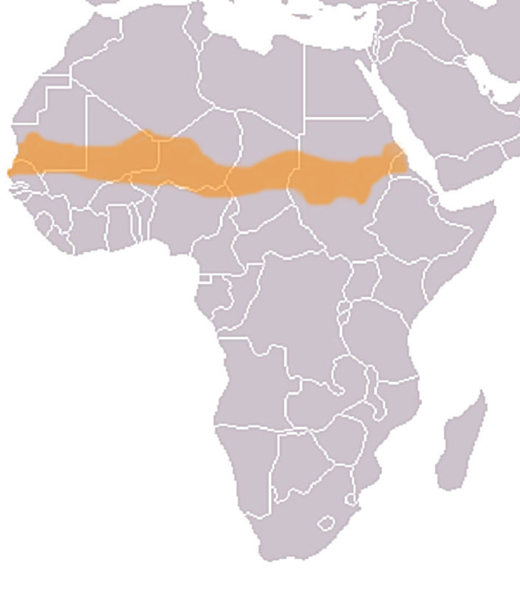
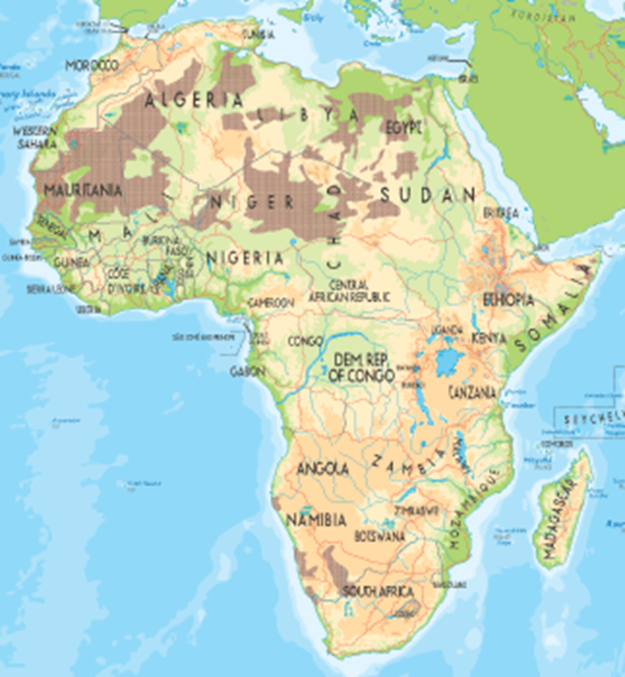
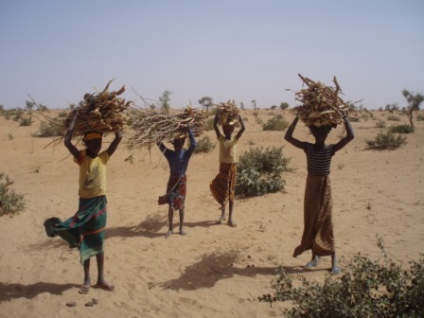
Desertification: Sahel region of Africa
The Sahel is the “zone of transition’ in Africa between the arid Sahara Desert to the north and the humid Savanna to the south.

Slide 8
Read p183 - 184
Case Study: the Sahel region
Look on the web and name 4 countries located in the Sahel region of Africa.
Read the pages above and answer the following questions:
Describe the Sahel Region (flora, fauna, climate)
Name three human causes of desertification
Why is desertification happening in the Sahel?
3. Complete the graph on the following slide.

Slide 9
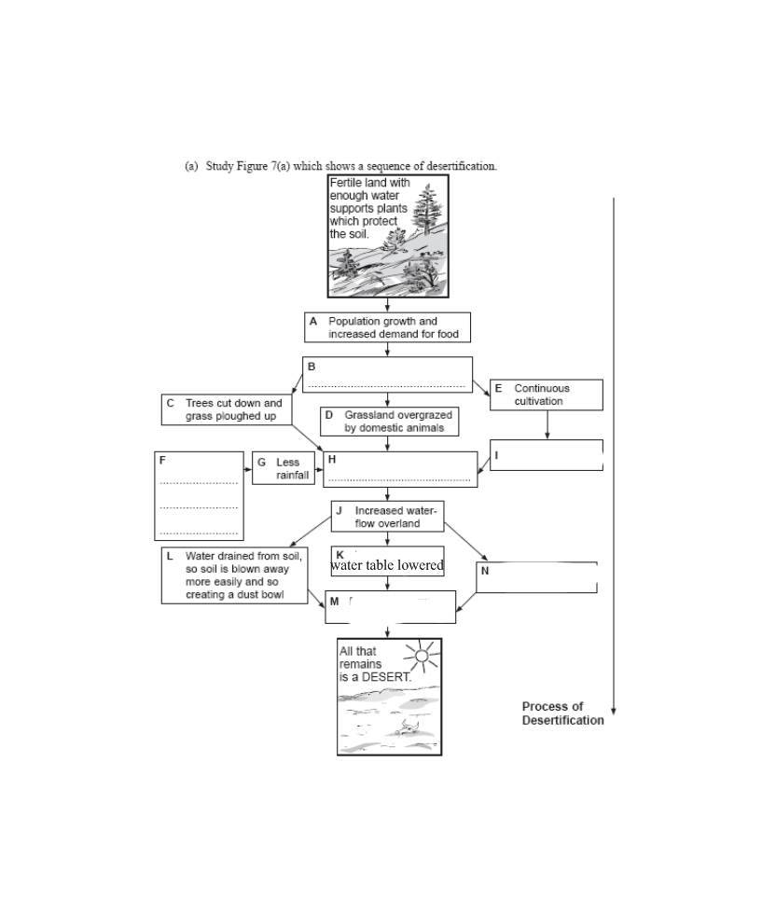
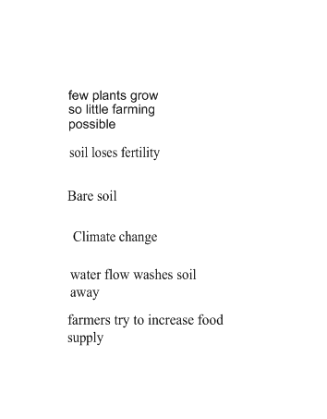

Slide 10
Review:
What are human causes of desertification?
Population growth (war, migration
Overgrazing
Overcultivation
Deforestation
Which happens first?

Slide 11
Task for Today – Battle Royale
Read through 2 additional consequences of desertification in the Sahel region.
For each,
explain the consequences for: - Local people (in the Sahel countries worst hit) - The region (Sahel) or continent (Africa) - The Global Community (World)

