Slide 1
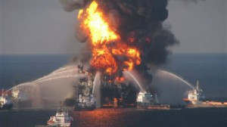
Deepwater Horizon Oil spill
SL Core Patterns in resource consumption
Environmental Impact of Increased Oil Demand
Transboundary Pollution Event

Slide 2
The global consumption of key raw materials is rising fast.
Between 1980 and 2000 the world population increased by 40% – in that same period, the world consumption of cement increased by 77%, and plastics by just under 200%
All together the developed countries comprise only 22% of the world population, but they consume more than 60% of the industrial raw materials.

Slide 3
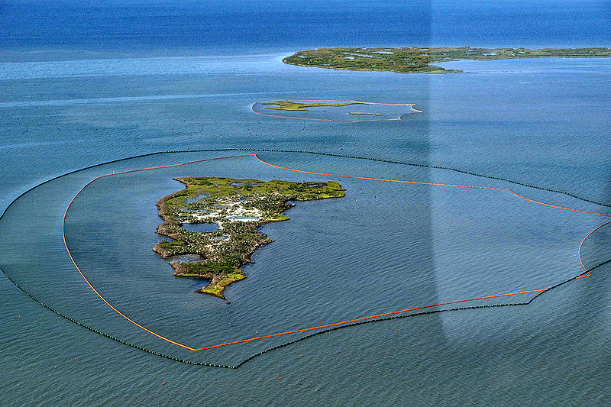
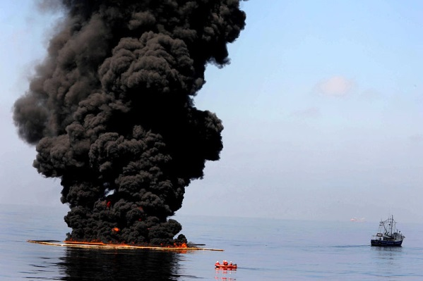
Case study: Deepwater horizon Oil Spill
Where
When
Who
Why
What
Classify the statements
Classify into causes, effects and responses
Classify into Natural, Economic, Social and Political
Classify into LONG term and SHORT term
Classify into National and International

Slide 4
Worst Oil Spill in US History - explosion killed 11 people - BP pipeline leaking 42 miles off Louisiana coast -capped 87 days later - released 2.9 million barrels - spread throughout ocean (at top, mid and bottom levels) - affected millions of living organisms

Slide 5
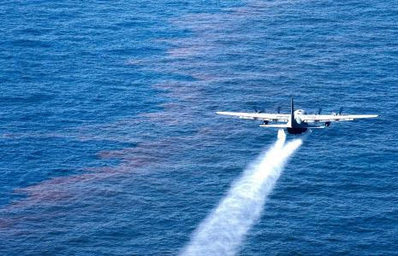
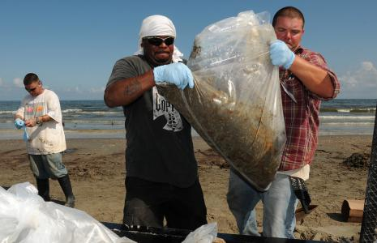
Clean-up methods - surround the slick with floating booms - remove oil with skimmers on surface - use sorbents to remove oil from surface (like moss, peat, ash). - dispersants (chemicals released from planes to halt slick from getting to protected areas - humans to clean up beaches/wild life

Slide 6
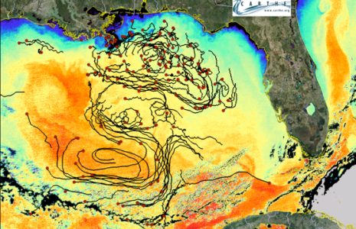
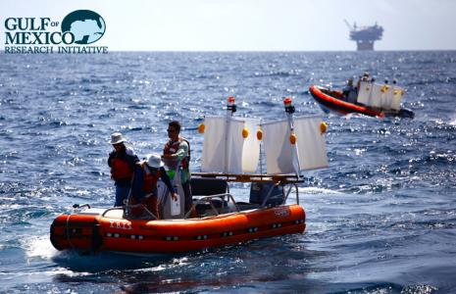
Effects: - marine and wildlife (extremely ill, covered in oil – difficult to hunt and/or fly or swim - microscopic plankton, reefs wiped out; deformed species - oil spread to greater gulf region (mapping drones to left) - research initiatives are still track- ing spill effects among wildlife AND humans who worked on the cleanup - spill in public eye: have you read anything about Keystone pipeline?

Slide 7
The Deepwater Horizon was a 9-year-oldsemi-submersible, mobile, floating,dynamically positioned drilling rig that could operate in waters up to 10,000 feet | Oil leaked at a high rate which is difficult to calculate. Some estimates are around 40,000 barrels a day. | On 20 April 2010, high-pressure methane gas from the well expanded into the drilling riser and rose into the drilling rig, where it ignited and exploded, engulfing the platform
The immediate effect was that it killed 11 people and injured 17 others. | Local industries, such as fishing was threatened. There was a ban on fishing in the water. | 665 Miles of coastline contaminated by oil
Plants and animals were completely covered in the oil. Seabirds, sea turtles and more than 150 dolphins have been found dead. | Fish stocks were harmed, and productivity decreased. Since the 2010 spill, Louisiana's statewide oyster catch has dropped by more than 25% | The size of the oil spill was one of the largest America had seen. However because the oil entered warm waters, organisms in the water helped to breakdown the oil.
Much oil was released at depth and there is scientific uncertainty about its impact | Oil was naturally dispersed, collected in large booms and chemically dispersed and burnt.. The dispersants used are themselves hazardous chemicals. Tar balls reaching beaches were cleaned. | BP says it has paid out $32 billion for the disaster, including $14 billion for cleanup. It's also spent $300 million on everything from testing seafood to its ad campaign that encourages people to come back to the Gulf
The U.S. Travel Association estimated that the economic impact of the oil spill on tourism across the Gulf Coast over a three-year period could exceed approximately $23 billion, in a region that supports over 400,000 travel industry jobs generating $34 billion in revenue annually | The U.S. Travel Association estimated that the economic impact of the oil spill on tourism across the Gulf Coast over a three-year period could exceed approximately $23 billion, in a region that supports over 400,000 travel industry jobs generating $34 billion in revenue annually | "The problem is right when they used the dispersants, that's when the tuna came to the Gulf to spawn," said Cheril Carey, a national sales representative for a company specializing in yellow fin tuna. "It takes a tuna five to 15 years to mature. So although we may have fish now, we may not have them in five to 15 years.
Potentially, oil entering the Loop current in the Gulf of Mexico could go through the Florida Strait, with potential oiling of shorelines and marine resources along the western edge of Cay Sal Bank. Over time, there is the potential for oiling along the Biminis, Great Isaacs, West End Grand Bahamas. | After Hurricane Isaac in September 2012, about 565,000 pounds of oiled material traced to the spill was brought to land. This was a greater amount than had been collected in the eight months prior. | ExxonMobil, Chevron, ConocoPhillips and Shell have made plans to fund a billion dollar joint venture to build a new rapid response capability for deep water offshore drilling response in the Gulf of Mexico
BP is one of the largest UK own Trans National Corporations. On 25 June, BP's market value reached a 1-year low. The company's total value lost since 20 April was $105 billion. | 20% of the juvenile bluefin tuna were killed by the oil spill. Exacerbating the 82% decline of the tuna's spawning stock in the western Atlantic during the 30 years before the oil spill | The Gulf is used for foraging by seabird species that breed in the Caribbean and Mexico which may be harmed by direct contact with oil or by eating or being fed oiled prey or tar balls.
The real estate prices and a number of transactions in the Gulf of Mexico area decreased significantly during the period of the oil spill | On 30 April 2010 President Obama ordered the federal government to hold the issuing of new offshore drilling leases and authorized investigation of 29 oil rigs in the Gulf | The U.S. State Department used assistance from 8 countries who provided skimming boats and equipment

Slide 8
“Global interactions always lead to positive environmental change.” Discuss this statement. [15 marks]

Slide 9
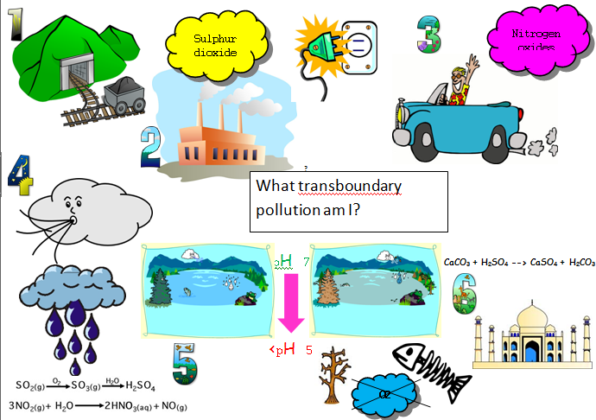

Slide 10
Aim: To describe pollution affecting more than one country and examine its consequences and responses.

Slide 11
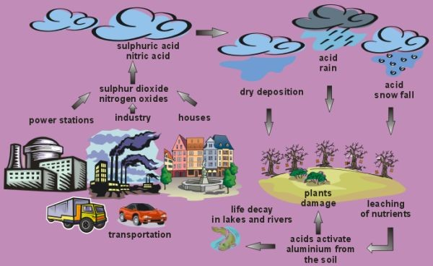
http://www.youtube.com/watch?v=9aEx067YkDE
Also natural sources such as Sulphur emissions from Volcanoes.
Complete tasks……..

