Slide 1
Characteristics of the Earth’s Crust:
3 Layers: Core, Mantle and Crust
2 types: Oceanic and continental

Slide 2
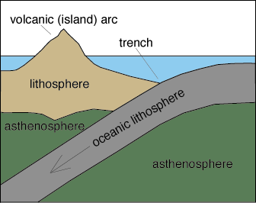
Oceanic Crust
Found under the oceans, formed at spreading centres of ocean ridges
5-10 km thick – is thinner than Continental Crust (30-50km)
‘Floats’ on the mantle – same as continental crust
A part of the earth’s lithosphere- the outermost shell of our planet
Oceanic/continental crusts are part of the 12 tectonic plates which cover the earth and are responsible for volcanoes and earthquakes along plate boundaries

Slide 3
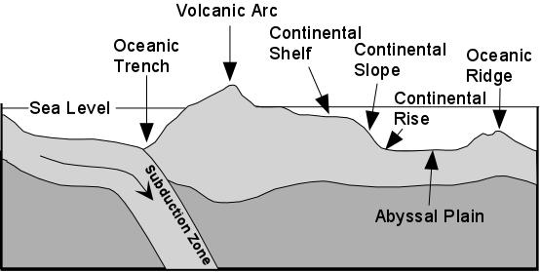
Ocean Floor Has Many Features:
Using sonar, seismic profiling, satellites, and underwater research vehicles, oceanographers have discovered that the topography, or shape of the ocean floor is quite similar to many of the dramatic sights we see on the landforms on Earth’s continents

Slide 4
Many of these features form at plate boundaries: either divergent, convergent or transform boundaries

Slide 5
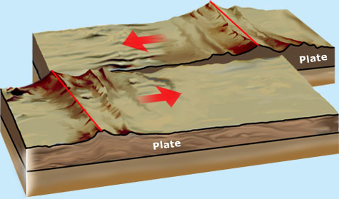
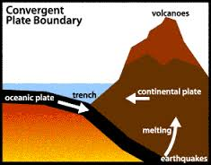
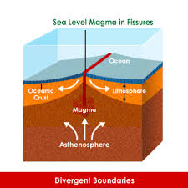
Plate Boundaries (In and Out of Ocean)
Transform Boundary
Convergent Boundary
Two plate boundaries collide and one slips under the other (subduction)
Divergent Boundary
Two tectonic plates are moving away from eachother (destructive)
Type of fault which is not destructive and primarily horizontal in motion

Slide 6
Many of these features offer further oceanic resources for human exploitation…
Oceans offer two types of resources…
ABIOTIC: non living, non organic material
(heavy metals/ores such as copper, silver, gold, cobalt iron)
BIOTIC: living (or once living) component of a community of organisms
(fish and shellfish, oil – although this is debatable)

Slide 7
Your task for today:
Download the Student Worksheet 3b under Ocean Floor (Bathymetry)
-Pages 135-6 AND pages 143 complete the Student Worksheet in class
(you may use pairs to complete – however all is fair game for a test!)

