Slide 1
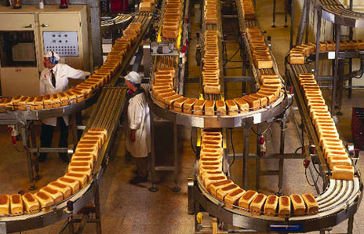
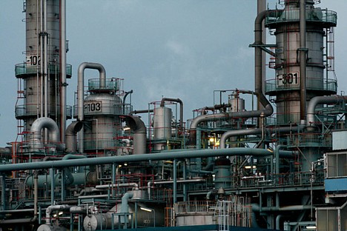
Changing Locations: Quaternary & Tertiary Business Locations

Slide 2
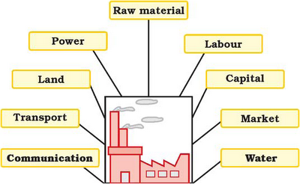
Location factors You are building a business – what do you need to consider?

Slide 3
Which would be most important for a factory making cars?

Slide 4
Which would be most important for a factory making computer chips?

Slide 5
Which would be most important for a bread factory?

Slide 6
Which would be most important for a law business (tertiary)?

Slide 7
Location of Tertiary/Quaternary: Your Choices
Law Firm:
Computer Chips
Bread Factory
Car Manufacturer
1. Capital
2. Water
3. Communication
1. Raw Material
2. Water
3. Transportation
1. Technology
2. Capital
3. Power
1. Capital
2. Technology
3. Government Policy

Slide 8
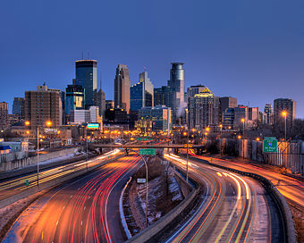
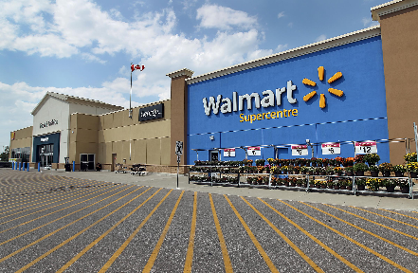
Location Factors: every business is found in a particular area which suits their ‘needs.’ depending on the sector and activity, these needs will change. One example is _____________.
The fact that many businesses are located in the CBD is because accessibility is a key factor for many businesses such as ______.
Lately, however, many business move outside the CBD towards the urban rural fringe, for more space, cheaper land, attractive environments and accessibility that is still good for customers.

Slide 9
For Grand Bahama
Using Google Earth: choose two businesses from different industries (P/S/T/Q)
Describe location of these industries - where are they in Freeport? – where are they close to?
Explain the location of these businesses… why have they located there? What location factors are most important to their business?
1. Power company
2. Sands Brewery
3. Bahama Rock
4. Stattoil or BORCO
5. First Caribbean Bank
6. Cable Bahamas
7. Soloman’s (either)
8. Cost Right

