Slide 1
Choose a company that produces or sells goods in America. Pretend its 50 years ago and you are looking overseas to sell your product.
BARBIE
GENERAL MOTORS
COCA-COLA
What will your strategy be?
Where will your factories be? Who is your target market?
Where will you get your resources (inputs)?
Who will be your employees? (Top level and lower level)

Slide 2
Globalization at a local level: IB Style Question…Examine the reasons why the level and rate of adoption of globalization varies from place to place

Slide 3
Define: TNCs Globalisation Glocalisation
Activities established in many sites all over the world, based on countries advantage (ie: cotton production in US due to high subsidies).
IN SHORT:
Establish businesses at most favourable locations
Adoption of international foreign own company location as an “insider” to local communities, in order to establish subcontracting opportunities and access diverse markets.

Slide 4
What are the reasons why the level and rate of adoption varies from place to place
➡The level of economic development of countries and regions.
➡The size of markets in terms of population.
➡Contrasts between urban and rural areas.
➡The level of infrastructure (roads, communications)
➡Cultural acceptance of global business
➡Government reaction to foreign direct investment and the presence of foreign business eg. tax advantages in free trade zones
➡Economic activity at the local level

Slide 5
Why does McDonalds need a local as well as a global strategy?
Use pg. 395 to write down some of the differences between local production and global production…..

Slide 6
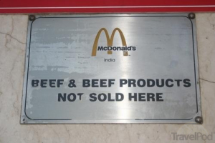
McDonalds as an example of glocalisation…….
Use pg. 393, choose two questions to answer in a short paragraph using the McDonalds example AND Walmart (394)…..
Replace ‘fast food’ with ‘TNCs’ in the questions…

