Slide 1
Discuss….
Why do mega cities
keep growing?
What Are Positives and Negatives About the Growth of Megacities?

Slide 2
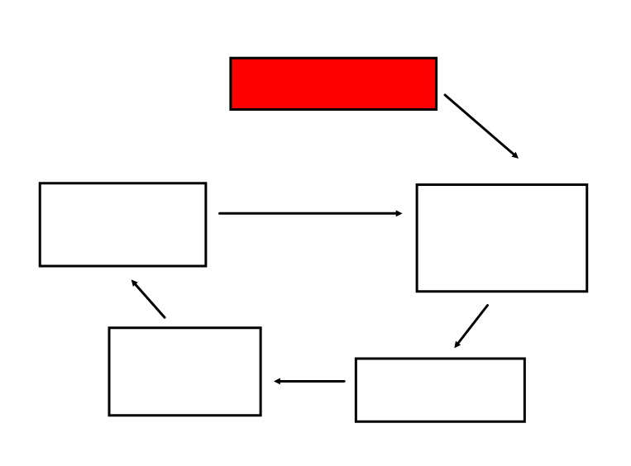
Copy the flow diagram and try to put the boxes in the correct order….
Diagram to show why megacities grow
1. More jobs available
2. Economic growth
3. Businesses move into city to reduce their transport costs between different areas
4. City gets larger
5. People migrate to cities
2
4
3
5
1

Slide 3
Think about a mega city:
With your partner can you come up with
5 positive words....
and 5 negative words...
to describe the megacity
Write down your best words LARGE on post it notes
Attach the note to the appropriate whiteboard

Slide 4
Card sort...
With the person sitting next to you, can you shade into two colours
One for advantages and one for disadvantages...

Slide 5
A 60 second speech...
You will be split into positives or negatives. Sit with the other people in your group.
Write a 60 second speech (about 20 lines) on the positives or negatives of living in a megacity.
You need to persuade another person that living megacities is positive or negative. Use your geography vocab
Use post its!!

Slide 6
Go back to your original place And talk....
You now have 60 seconds to CONVINCE your partner that megacities are good or bad places to live...

Slide 7
I would like to live in a megacity...
WHY?
Agree
Disagree

Slide 8
So.... why do people live in megacities?
Are there more benefits than problems?
Write a long answer (9 points):
I would like / would NOT like to live in mega cities because…………
However, ……………………..
Use EXAMPLES from cities you know

