Slide 1
Soil Composition
Bedrock
Sub Soil
Top Soil
Parent Material
Organic Layer

Slide 2
What is EROSION?? What is SOIL erosion??

Slide 3
There are two different ways soil can be eroded
By Water
‘gully erosion’ and ‘sheet erosion’
By Wind

Slide 4
Use the text book page 180 to write a definition of these words:
Soil erosion
Sheet erosion
Gully erosion
Wind erosion

Slide 8
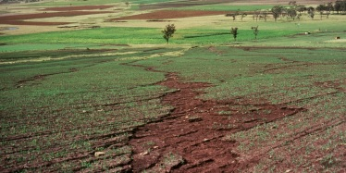

Slide 10
Go Outside!!
Although Grand Bahama does not see much wind erosion, you can identify ‘sheet’ and ‘gully’ erosion by water on our campus…
Identify two areas on our campus…
Draw a sketch of each with labels

Slide 11
Finish in Class or for Homework
List 5 human causes of soil erosion using your textbook in your own words
(pg.180-181)

