Slide 1
Trade: Subsidies and Tariffs

Slide 2
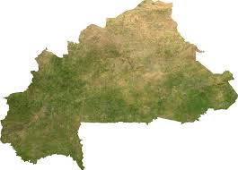
Today we will look at the country of ‘Burkina Faso’ – do you know where this is?
TRUE or FALSE:
Burkina Faso is in Oceania
Burkina Faso has a cool, damp climate
Burkina Faso is one of the world’s wealthier countries
Find Burkina Faso on the map on page 141
Write:
Where in Africa it is, it’s position relative to another country
and all of the countries that it shares a border with

Slide 3
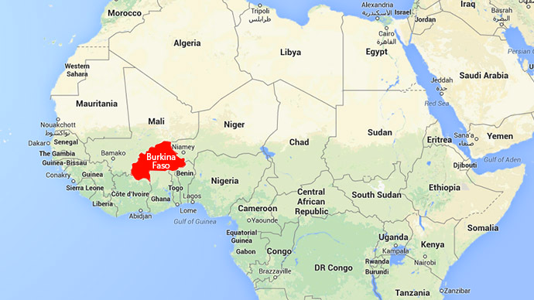
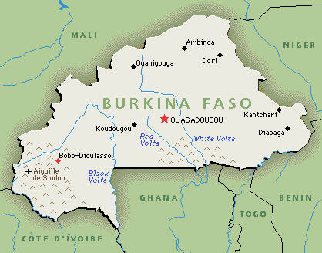
Burkina Faso
Burkina Faso is in West Africa
It is directly North of Ghana
It shares a border with Ghana,
Cote D’Ivoire, Mali, Niger, Benin & Togo

Slide 4
Burkina Faso is a highly developed country Do you agree? Why or why not? Use the detailed statistics below in your answer
POPULATION:
UK – 61 million
Burkina Faso – 15 million
GDP per capita:
UK - $35 000
Burkina Faso - $12 000
LIFE EXPECTANCY:
UK – 79 years
Burkina Faso – 51 years
ADULT LITERACY RATE:
UK- 100% of population
Burkina Faso – 24% of population

Slide 5
Like many other countries, Burkina Faso relies on trade exports to make money.
Their major export is cotton
Millions of small farmers in Burkina Faso grow cotton on small farms
What happens to these farmers when the price of cotton falls?
How much has the price of cotton fallen since 1980?
 | Percentage fall in real prices: 1980-2000
wheat | -45%
cotton | -48%
coffee | -65%
cocoa | 71%
sugar | 77%

Slide 6
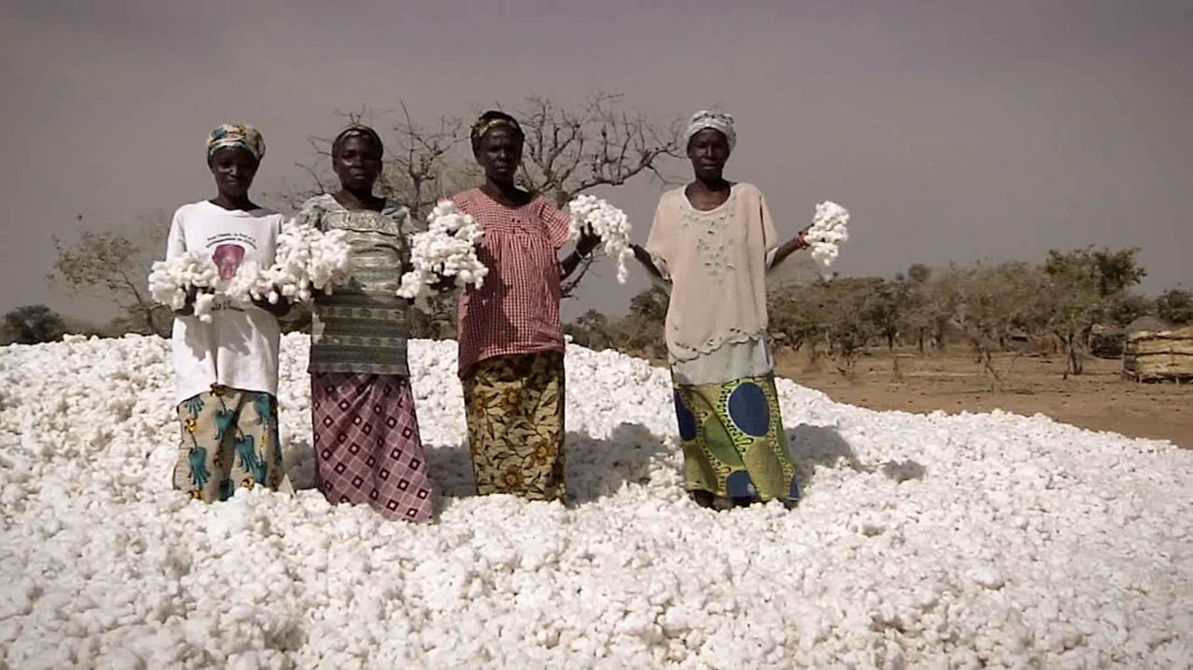
Why do prices fall in global trade?
More farmers in more countries start to grow a crop (such as cotton)
Many also use better seeds, pesticides and fertilizers
So there are big crop harvests in different countries around the world
With so much of a crop (large supply), competition causes the price to fall

Slide 7
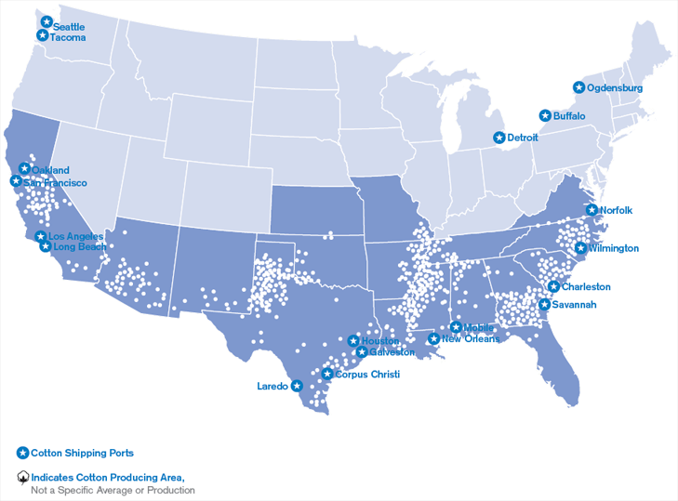
Countries such as the USA are more productive than Burkina Faso: Why?
United States:
Uses heavy machinery
They use pesticides and fertilizers, GMO foods
They have huge flat fields with lots of space
Burkina Faso:
Pick cotton by hand on small farms
Slow pace, smaller space, smaller yields
Cannot afford pesticides, fertilizers, or GMO seeds

Slide 8
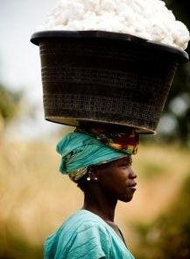
Two more things cause problems for farmers in low income countries: #1
Subsidies
Subsidies are money given to farmers in HICs (such as USA) by the government to help them grow crops.
Cotton is the most heavily subsidized crop in the USA
With extra money, HIC farmers grow more crops…
and what happens to farmers in Burkina Faso???

Slide 9
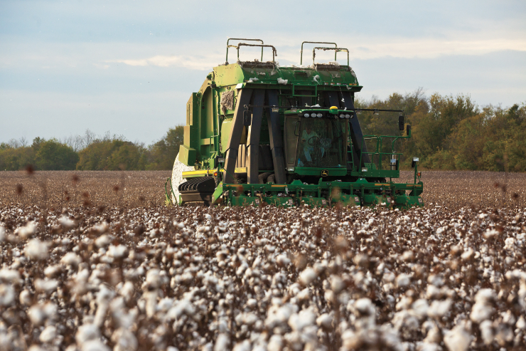
The second reason trade becomes unfair
Tariffs
A tariff is a tax
Some countries put tariffs on imports of goods already grown in their country
This makes the price higher for consumers for imports, so they buy the local good instead.
What good do you think has tariffs in the USA?

Slide 10
What is to be done about this situation?
World Cotton Production:
Small producers such as Burkina Faso can’t compete with big producers like China and the United States.

