Slide 1
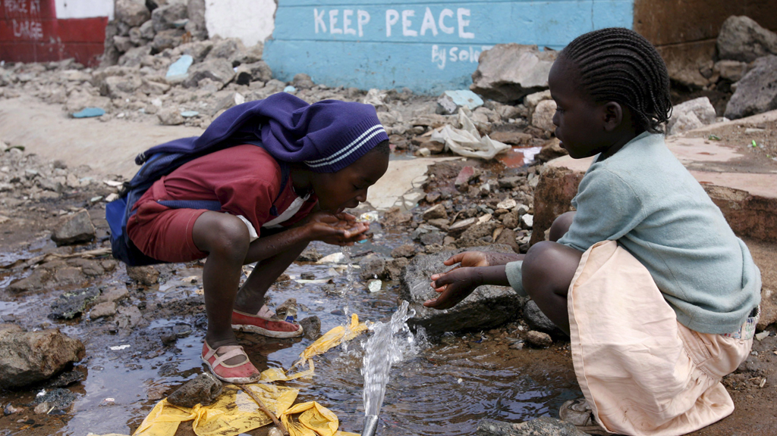
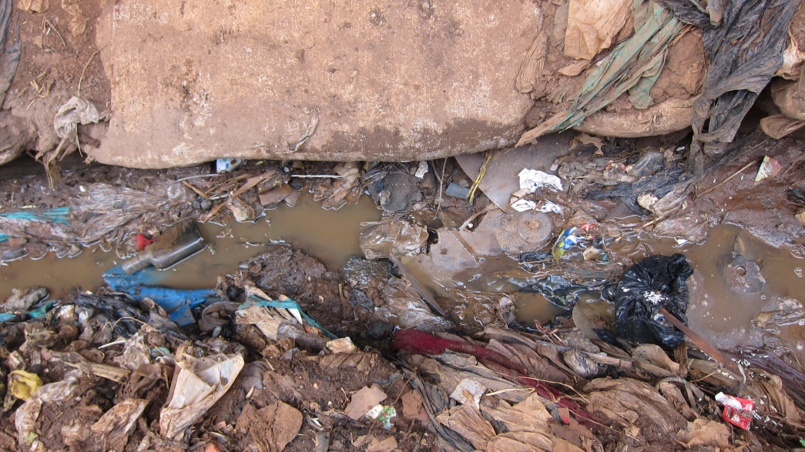
Urbanization issues
Social problems (ie; crime)
Access to resources (ie; water)
Education
Environmental (ie: pollution)
Congestion (traffic)
Employment
Housing
Health (disease)

Slide 2
Two videos yesterday; China and India what was the difference?
Slums: mostly in developing nations. Why?
Other countries such as UK, US already ‘developed’ infrastructure
Recent ‘population boom’ mostly in developing nations
Rural-urban migration and promise of better life sends people to city
Political ideas: communism/socialism vs. capitalism

Slide 3
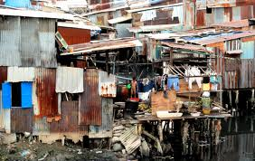
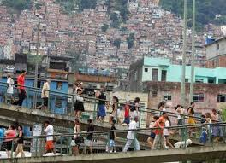
Slums, shantytowns & favelas the consequences of rapid urbanization
The Human Face of Rapid Urbanization

Slide 4
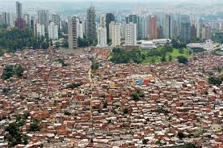
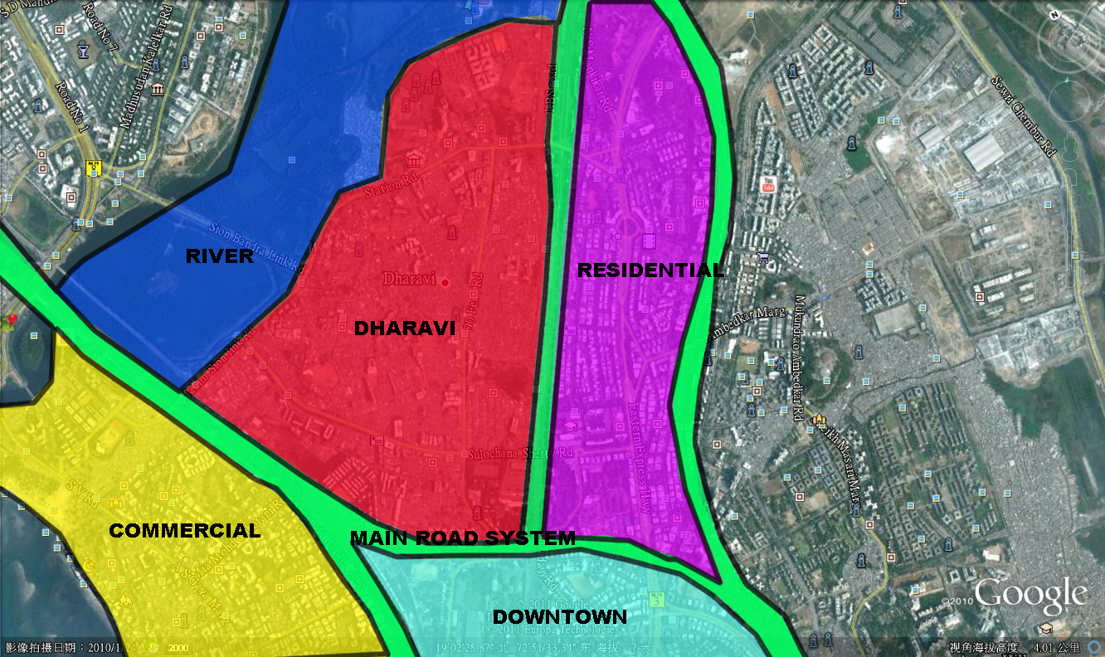
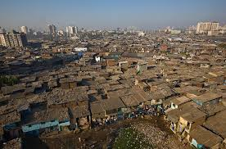
Location: fringe of urban LIC areas

Slide 5
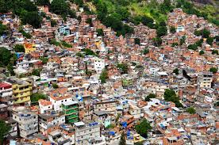
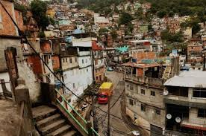
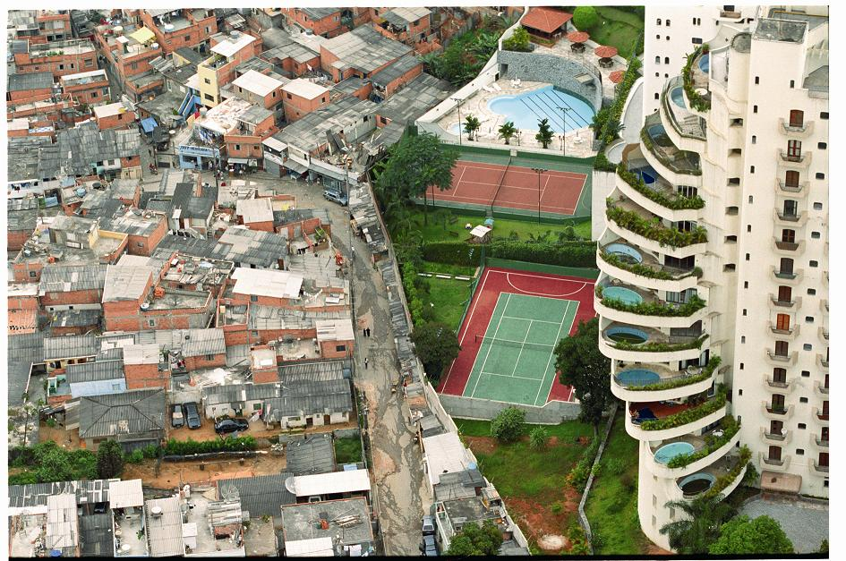
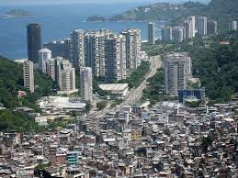
“favelas” of brazil: - been there for over a century - 6% of brazil’s population lives in favelas - experience all of the problems we listed and more (fire safety)

Slide 6
There is a final assignment coming at the end of this film
“WASTE LAND”
Create a project that will help those living in the favelas in Brazil.
It can be ECONOMIC, ARTISTIC, ENVIRONMENTAL, SOCIAL, or OTHER TYPE of project
Which “problem of urbanization” are you looking to address
How will you (and those living in slums) address it??

