Slide 1
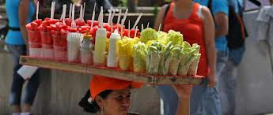
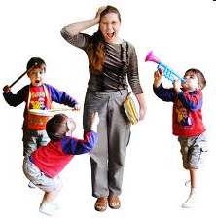
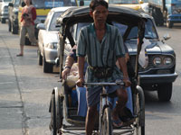
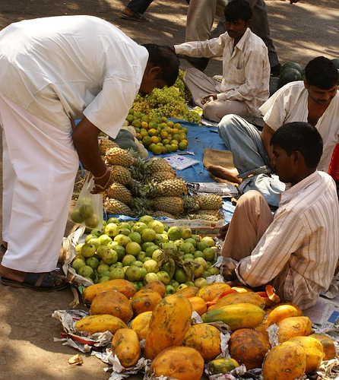
What’ s the connection here?
Are you an informal worker?

Slide 2
Beggar, Rickshaw Drive, Babysitter
“don’t effect the economy much”
“…isn’t officially employed”
3. “they are not proper jobs”
4. “unofficial means of income”
5. “does not help the economy”

Slide 3
Definition
The informal sector is made up of jobs over which there is little or no official control.
HIC’s
jobs such as child minding and cleaning .
Maybe called ‘Black economy’
Workers paid by the day or hour in cash and don’t pay tax
MIC and LIC’s
Less controlled and involves a greater variety of people and jobs.
Includes street vendors, shoe-shine boys, car washers, litter pickers, as well as employees of back street workshops who work long hours in dangerous conditions.
For example - India it has been estimated that the informal economy provides 68 to 80% of income

Slide 4
Formal or informal
Often outside the law | Fixed prices | Self employed | Legal
Men, women and children | No sick pay or holiday pay | Decide your own hours – paid for time you do the work | Pay tax
No government assistance | Irregular hours and uncertain wages | Often in a transnational | Usually men
Street stalls, services and small scale industry | Police, army, civil service | Employs many 1000’s of unskilled workers | Uses some skilled and unskilled workers
Permanent jobs and regular wages | Uses cheap or recycled materials | Often low standard of goods | More expensive raw materials

Slide 5
Case study
Dharavi, Mumbai, India
Examples of jobs
Numbers of people involved
Conditions of work
Ambitions……..

Slide 6
Case study
Katanga, Democratic Republic of the Congo
Examples of jobs
Numbers of people involved
Conditions of work
Ambitions……..

Slide 7
Why do you think people end up in informal jobs?
High population in large cities because of rural to urban migration – not enough formal jobs
Lack of education/training for a higher paid job
Lack of transport to get to formal employment
Older siblings need to work to earn money for a large family instead of attending school

Slide 8
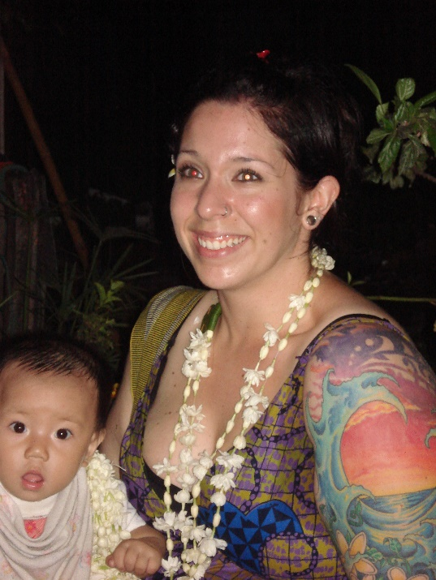
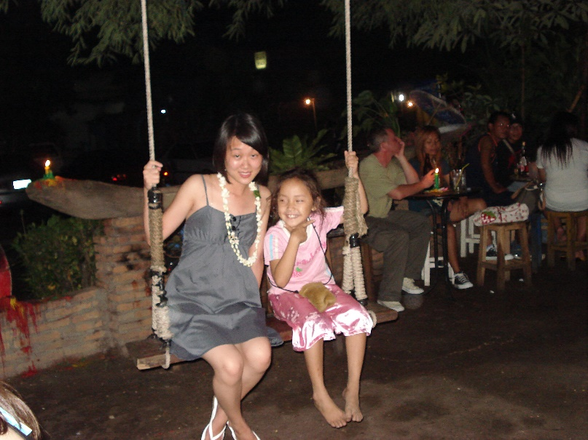
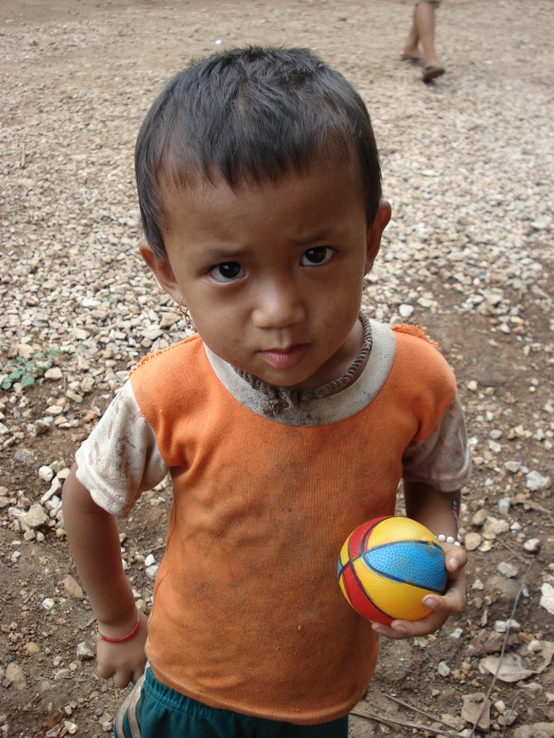
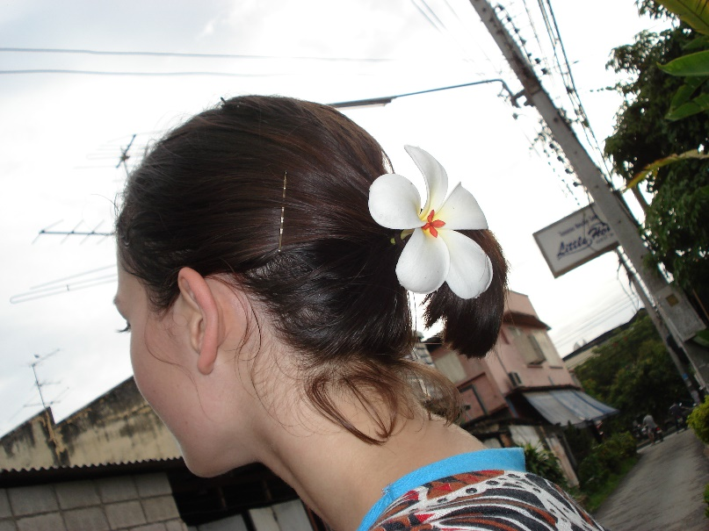
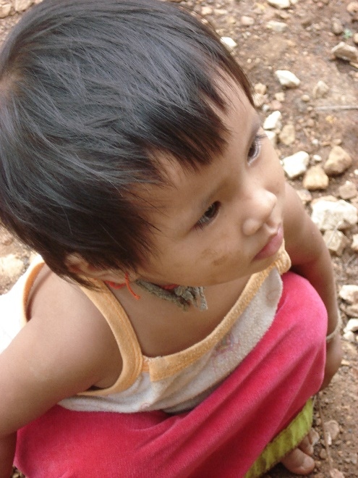
The Flower Children of Thailand

Slide 9
Is informal employment worth it?
Make a table to show the benefits and costs of informal employment (pg 98-99)
Which do you think carries more weight…….
Benefits of informal employment | Costs of informal employment

Slide 10
IGCSE Q
1)Compare the percentages in formal and informal employment between USA and developing countries. (4)
2)Give reasons for the differences you have shown (6)

