Slide 1
The impact of food miles: - List the food item/country - Calculate the distance from that country to Freeport - Add your totals together to get the total food miles - Think about how each item arrived… what sort of transport was used?

Slide 2
Think about a typical dinner that you eat. What foods does it include?
Do you know where that food comes from (before it ends up in the supermarket)?
Where it is grown? Using what methods? Where it is processed, if it is processed?
On average how far do you think a food item travels before it ends up on your plate? Make a prediction in miles.

Slide 3
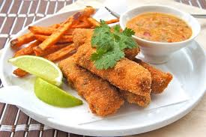
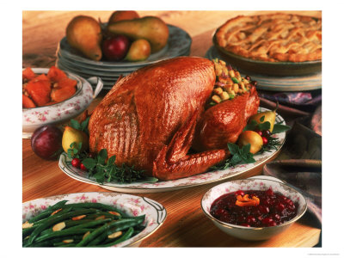
Food miles
A measure of the distance food travels from its source to the consumer. This can be given either in units of actual distance or of energy consumed during transport.
How does agro-industrialization affect food miles?
Transport from field to warehouse to factory to supermarket to home (often frozen which uses more energy)
Growth of food outside the usual season often requires more transport eg. Growing strawberries for the UK in Kenya in Winter
Due to perishable nature of food, much is transported by plane which has a high environmental cost
(read case study Kenya p.354 – take some notes)

Slide 4
Environmental impact of air travel
25%
Transport produces________ of the worlds CO2
Within transport, aviation accounts for about ________ %
Airlines are particularly bad because nitrous oxides from jet engines produce ozone - a greenhouse gas.
Impact is intensified because gases are emitted directly into the upper atmosphere
The trails left by planes act like clouds and cause warming
13%

