Slide 1
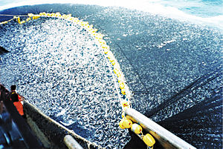
The spatial and temporal consequences of overfishing.

Slide 2
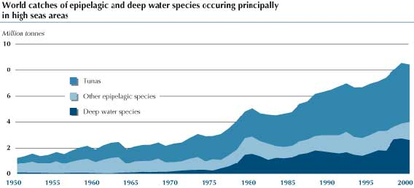
Describe the trend..

Slide 3
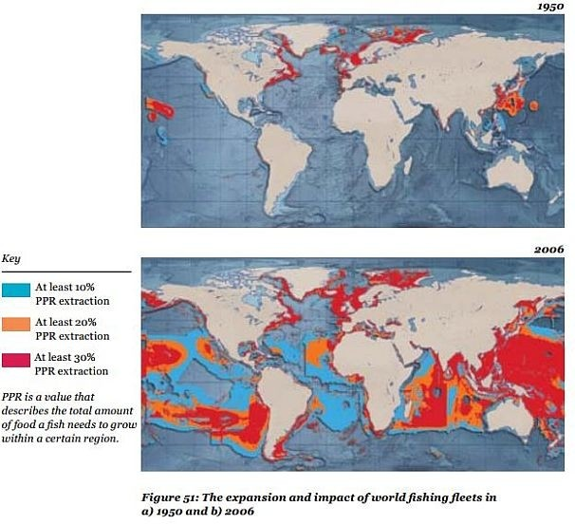
Describe the pattern of fishing extraction in 2006.
Can you give reasons for this?

Slide 4
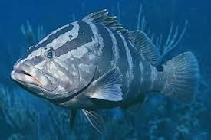
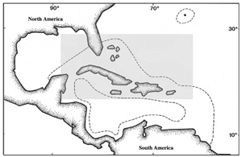
Nassau Grouper
Highest priced/most desired fish in Bahamas
Do not reach sexual maturity until 5 years old
(slow reproductive rate)
Migrate to breed and spawn (100km)
(easy target for fisherman)
Fisherman target largest and oldest fish, with greatest breeding capacity
Nassau grouper has disappeared from the US Virgin Islands, Belize and Jamaican Waters; once a site has been overfished it does not re-form

Slide 5
Conservation Attempts
Reefcheck: out of 162 reefs surveyed 142 had none and only 12 had two or more groupers
BAN: Bermuda has banned the harvest of grouper since 1996; Grouper also banned in USA
ENFORCEMENT: Penalty in Cayman Islands is $500 000 or up to one year in prison
SEASONAL CONTROLS: In Bahamas closed season for grouper (Dec-Feb) but some say not enough
Revision of legal size limit (3lbs), protection of spawning sites, greater enforcement and extension of closed season

Slide 6
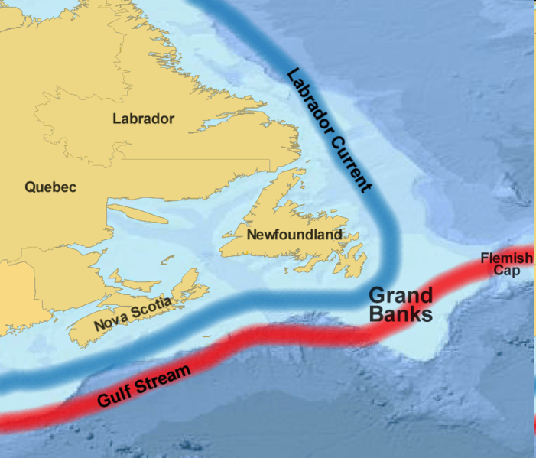
Issues in different parts of the world
Canada, Newfoundland Grand Banks
Cod fishing collapsed in 1992, not recovered as the place cod took in ecosystem has been taken by other species such as langoustines
From Blue Planet write down issues with Blue fin, Cod, Orange Roughie, Shrimp

Slide 7
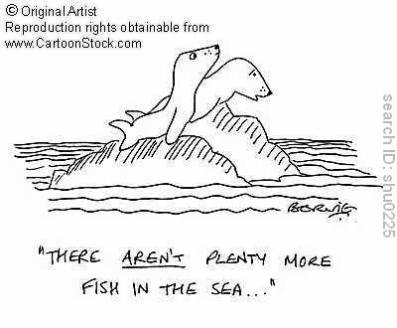
Too many fishermen, too few fish

Slide 8
What are the main problems?
Too many people fishing
Boats too big
Too many fish caught – species disappearing
Juvenilles taken out
Fishermen have few transferable skills to be employed in another job
What things would you do to fix these issues?

Slide 9
Summary of problems
Bigger fishing boats (since 1970’s) can catch more fish
Use of technology (since 1970’s) eg. Satellites allows more fish to be caught and freezing allows ships to travel further
Smaller (alternative) fish are being caught as the traditional fish are in decline.
Juvenile fish removed so reducing future populations
Habitats such as deep sea are being destroyed by bottom trawling
Large bycatches in Shrimp industry means most fish caught are wasted.
Fishermen have few transferable skills – difficult to find alternative employment

Slide 10
Add these issues to a world map…
Iceland
worlds most successful managed fishery
Irish Sea
Cod and mackeral disappeared from. Haddock in danger
Mediterranean
Most species overfished
North Sea –
Cod stocks less than 10% of 1970 levels
Black Sea
Pollution led to extinction of 14 species of commercial fish
West African Coast
Fishing rights bought by EU countries as their own stocks fell
Eastern Atlantic
Bigeye tuna endangered
South East Asia
Coral reefs depleted of fish and habitat lost
Australia and New Zealand
Decline in many non target species such as squid

