Slide 1
Review: Why are many environments becoming increasingly fragile?
Because of the human impact on these environments; population growth and resource consumption are increasing at a rate faster than the earth can regenerate to support human life.

Slide 2
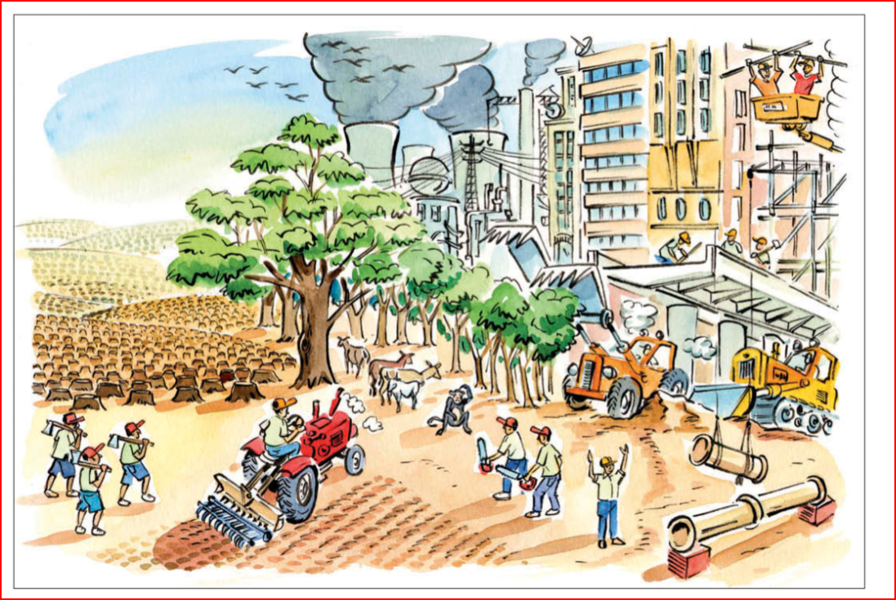
Are people using the Earth sustainably?

Slide 3
A definition of sustainability may be
“ actions that meet the needs of the present without reducing the ability of future generations to meet their needs.”
Task
Think about our lives on Grand Bahama, can you explain three ways that you don’t think it is sustainable?

Slide 4
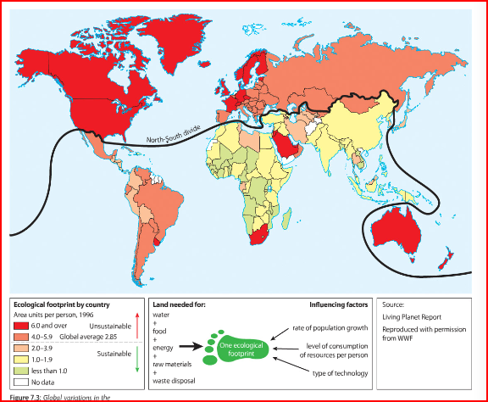
Record which parts of the world have the highest and lowest footprints.
Give two detailed reasons for this?

Slide 5
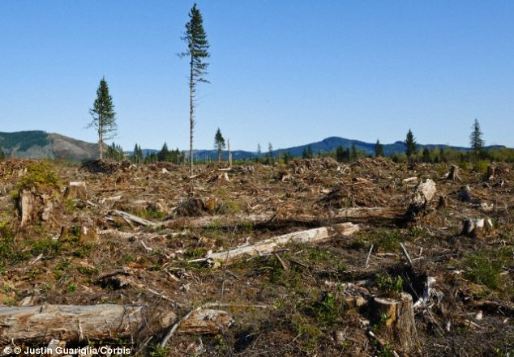
So… why haven’t we TOTALLY exhausted the earth?
Not everyone lives like us…yet –
But the population is growing and more and more countries are also consuming…

Slide 6
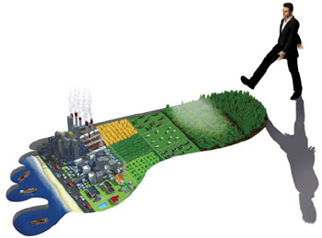
How does this relate to the idea of your ‘ecological footprint’?

Slide 7
The ecological footprint is a measure of human ______________ on the Earth's ecosystems.
It represents the amount of biologically_________________ land and sea area necessary to supply the __________________a human population consumes
If the Earths resources were equally _____________between EVERYONE on the planet, we would each get __________ per person.
1.9 hectares (4 acres) productive demand spread resources
What is your footprint?

Slide 8
StP Website:
Under title ‘Ecological Footprint and Sustainability’
Take Quiz “Your Ecological Footprint”
At the end of the quiz, record:
“If everyone lived like me, we’d need ________ earths and _______ global hectares to support the population.”
2. Explain the three major reasons for your footprint
(ie: grazing land – land for animals)
3. Click on ‘Explore Scenarios” – record three things you can do to reduce your ecological footprint.

