Slide 1
What are we watching? HANS ROSLING’s “The Joy Of Stats: 200 countries, 200 years, 4 minutes” What do Health and Wealth have to do with today’s subject: changing Sectors and Economic development? Think. Pair. Share.
https://www.youtube.com/watch?v=jbkSRLYSojo

Slide 2
The Development Pathway: Sectoral Shifts (P/S/T/Q)
There are three phases to this process;
Pre-Industrial, Industrial, and Post-Industrial
What do you think are the characteristics?
As countries ____________ their _________ sectors change.
Which sectors are the most prominent in each?
Rank them in importance for each time period

Slide 3
Phases of development; Sector importance over time.
Pre-industrial: Primary Sector Leads the Economy (employs more than 2/3 of the labour base; agriculture most important activity
Industrial: Secondary and Tertiary increase in productivity; secondary peaks during this phase. Primary declines in relative importance.
Post-industrial: Tertiary Sector most important sectors; primary and secondary continue the decline. Quaternary begins to appear.

Slide 4
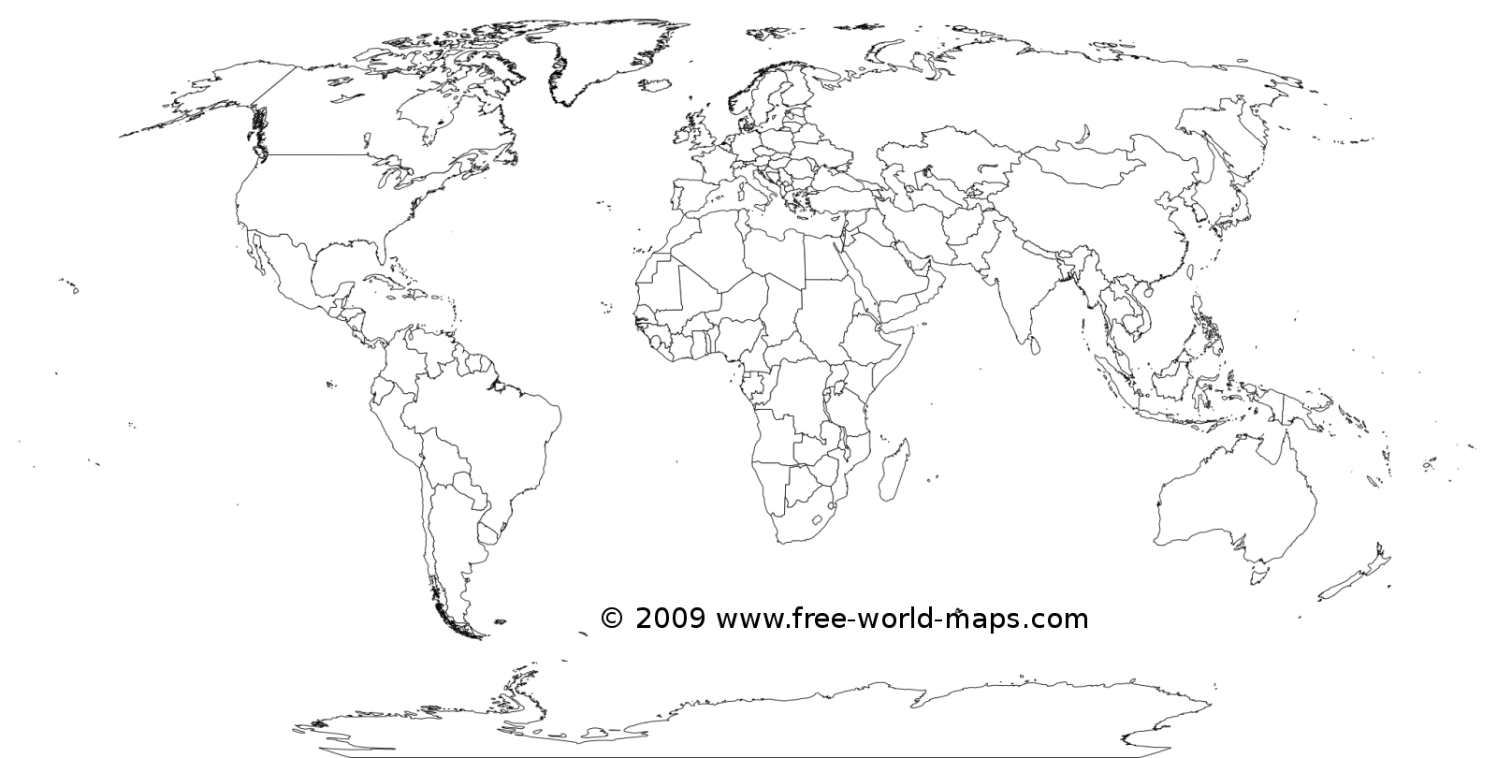
HIC – High Income country MIC – Middle income country LIC – low income country What stages?

Slide 5
Textbook pages 95 - 97 (read text, answer questions, discuss quietly)
Ethiopia
In general, which type of industry employs most people? Does it make the most money (GDP)? Why is this the case?
Why is there a limited need for services in Ethiopia?
China
Which sector has the highest percentage of GDP? Why?
In which industry do much of the labour force still work?
United Kingdom
What is a name for the UK economy?
What is the largest and smallest sectors?
Why do we often have to guess at the quaternary sector?

