Slide 1
Sovereignty: the authority of a state to govern its people and land
What determines sovereignty????

Slide 2
The geopolitics of oceans:
- ‘murkiness’ of sovereignty concept is a problem…. In particular oceanic sovereignty has become a hotspot of controversy and political debate

Slide 3
Laws that apply to oceans
1982 – UN Law of the Sea established
Exclusive Economic zones (EEZ’s)
Recognize the rights of coastal states to “exploit , develop, manage and conserve all resources, fish or oil, gas or gravel, nodules or sulphur – to be found in the waters, on the ocean floor and in the subsoil of an area, extending almost 200 nautical miles form its shore.”

Slide 4
EEZ’s are important because:
Almost 90% of all known oil reserves fall under a countries EEZ
98% of the worlds rich fishing areas fall within an EEZ

Slide 5
Fight over the Arctic………………
Who are the ‘Arctic Five’??
Russia
Canada
USA
Denmark
Sweden
All have EEZ’s in the Arctic… all want more

Slide 6
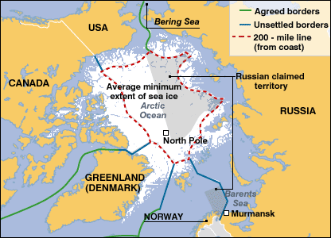
Map to show current borders in the Arctic Ocean:
how can they argue for more??

Slide 7
Under UNCLOS:
A country can secure control beyond the 200 nautical mile limit IF it can demonstrate the seabed is an extension of its continental shelf…
“The Lomonosov Ridge”

Slide 8
Two Articles on Website: Read and Answer questions
“Arctic Resources: The Fight For the Coldest Place on Earth Heats Up”
“ Race to Claim High Arctic’s Oil Resources May Be a Fool’s Mission”

