Slide 1
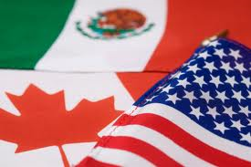
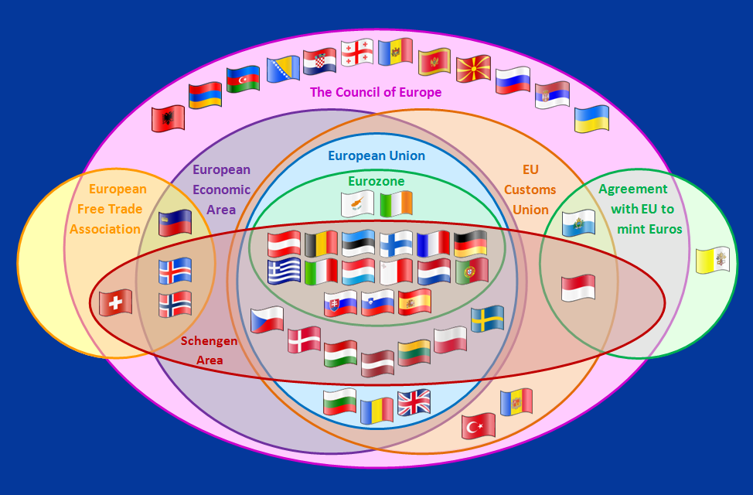
Is the nation state still important?

Slide 2
Discuss the links between the diminishing effectiveness of political borders and the flow of goods, capital, labour and ideas. Case study of One multi-governmental organization: NAFTA

Slide 3
What is sovereignty?
Right of rule over land within national borders
The authority of a state to govern itself
Political expression of independence
From ‘reign’ – to rule or hold royal office
(kings and queens) “Queen Elizabeth reigned”

Slide 4
International interactions are all contributing to loss of sovereignty. Global interactions (see below) flow more freely; nations have less control….
Flow of migration
Flow of capital
Flow of goods
Flow of ideas and culture
The national borders are becoming less important than international organizations because of:
Trade blocs
TNC’s

Slide 5
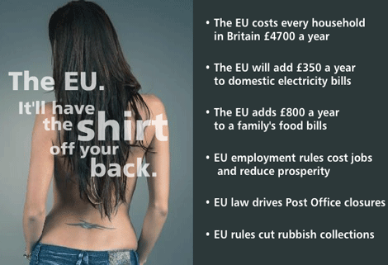

Slide 6
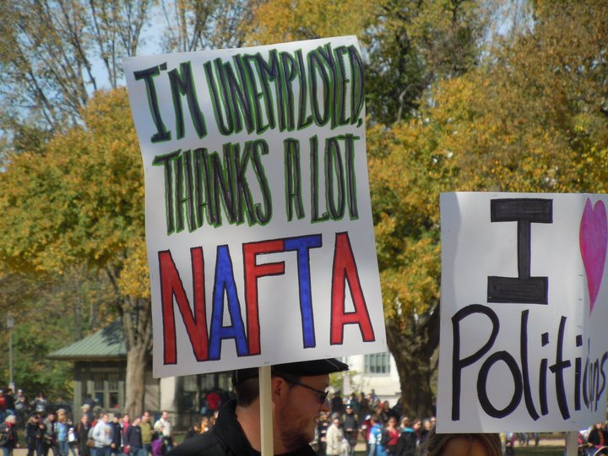

Slide 7
Trade blocs
Arrangement among a group of nations to allow free trade between themselves but impose charges on other countries that may want to trade with them. Eg. EU, nafta, asean, caricom
Benefits
You have access to many other markets – in the EU that is 470 million wealthy customers!
Disadvantages
Developing countries don’t get access to rich markets of EU and NAFTA. WTO is trying to promote free trade and limit ‘protectionism’
https://www.youtube.com/watch?v=DGeTZ4u2jbg

Slide 8
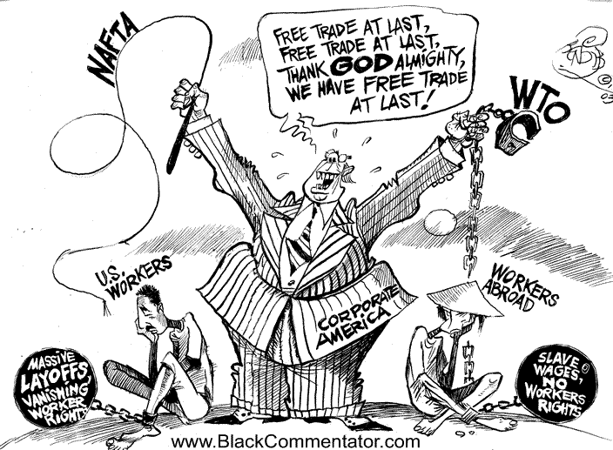
Case study example…
Nafta pg. 376
http://www.ustr.gov/trade-agreements/free-trade-agreements/north-american-free-trade-agreement-nafta
When did it form?
Who is in it?
What are its aims?
How many people are in this market?
Value in trade in dollars
Positives of this trade bloc
Negatives of this trade bloc
Include information on
migration, capital, goods and culture
Complete tasks a and b on 377

Slide 9
