Slide 1
Can you define tourism and tourist?

Slide 2
Tourism: all the activities tourists take part in and the services that support them
Tourist: a person who travels to a new place and stays there for at least one night before leaving (can be for business or holiday or other)

Slide 3
Are all these people tourists? Why or why not?

Slide 4
Tourism needs three things: an attraction, accommodation, & transport
For each photo, give it a title and number (ie: 1. camping)
Identify the accommodation & transport in each photo…
Then identify whether the attraction is NATURAL or HUMAN

Slide 5
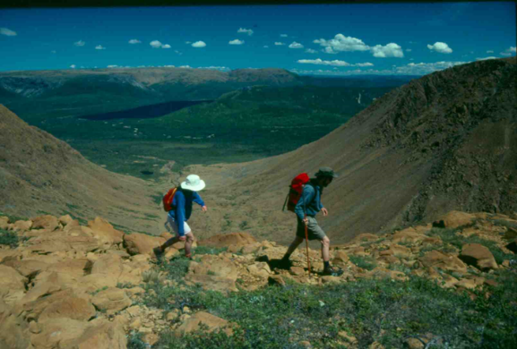
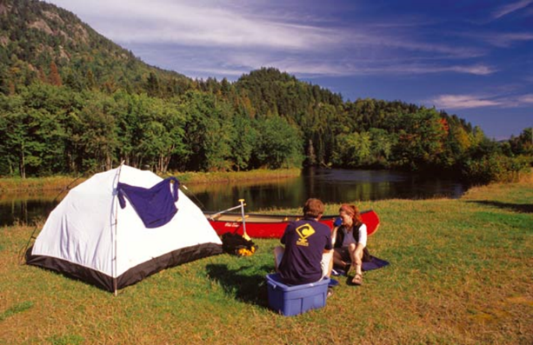

Slide 6
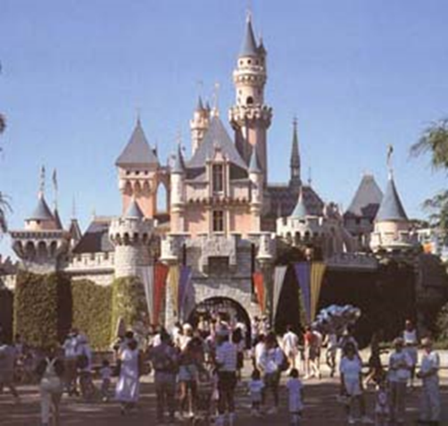
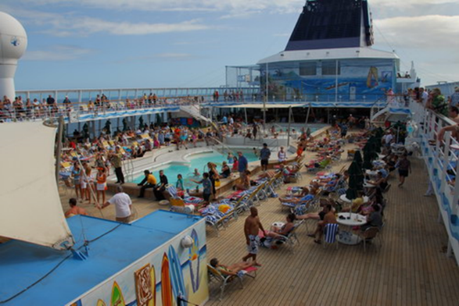

Slide 7
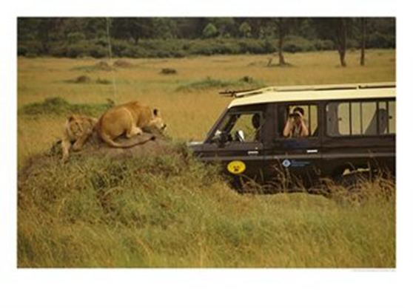
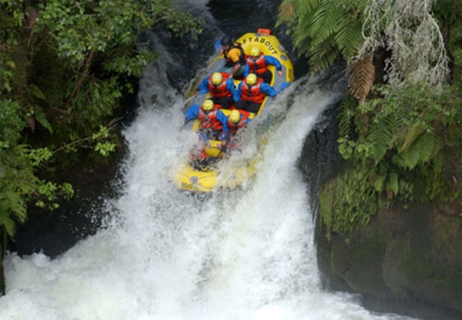

Slide 8
Where do you predict the top 10 most visited countries in the world are?
Ideas
Pg. 103 Geog 3
Look at Graph B:
1. Draw a bar chart to show which areas of the world have the most tourist arrivals.
Does it match your predictions?
2. For each country in your chart, write down one natural and one human attraction

