Slide 1
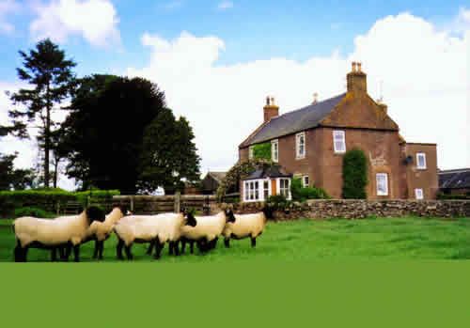
What is Agro-Industrialization?

Slide 2
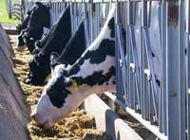
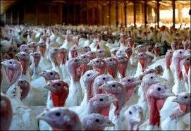

Slide 3
Agriculture has changed by:
Change from small scale family owned farms serving a local population
To
Large scale, global companies, high input, high output, intensive methods serving the global community. This is agro industrialization
This has happened because of:
Advances in farming technology such as GM foods
Fertilizers and pesticide use
Improved transport and communication to export products

Slide 4
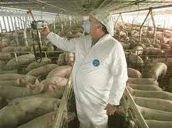
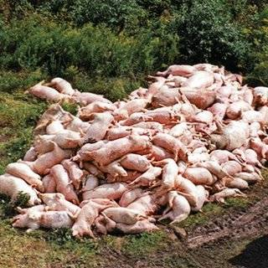

Slide 5
Agro-industrialisation causes negative impacts on the environment. How?
It has increased food production but is a major consumer of energy, a major contributor of greenhouses gases, air pollution, water pollution, spread of disease, land erosion and loss of biodiversity.
Find one example of agro-industrialization for each environmental concern – share w/ peers
(ie; country/company/scenario/news story)

