Slide 1
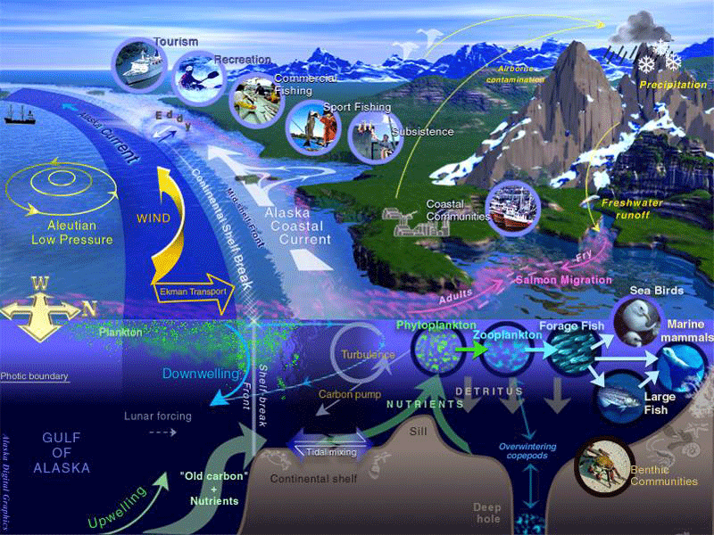
Fragile Environments

Slide 2
An ecosystem has specific characteristics that make it unique.
These are:
The Atmosphere, climate
Rocks, Soil
Vegetation (flora), Animals (fauna)
Water
Use by people
Any change in one of these characteristics can affect all the others. This is why an ecosystem is a FRAGILE ENVIRONMENT.

Slide 3
Draw a quick brainstorm of all the ways humans can affect their ecosystems:
Human actions can affect the environment in many ways…..

Slide 4
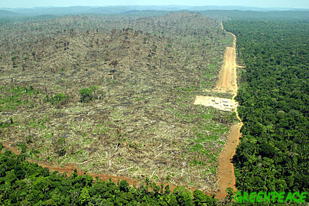
Add Below Your Brainstorm in BOLD… Deforestation

Slide 5
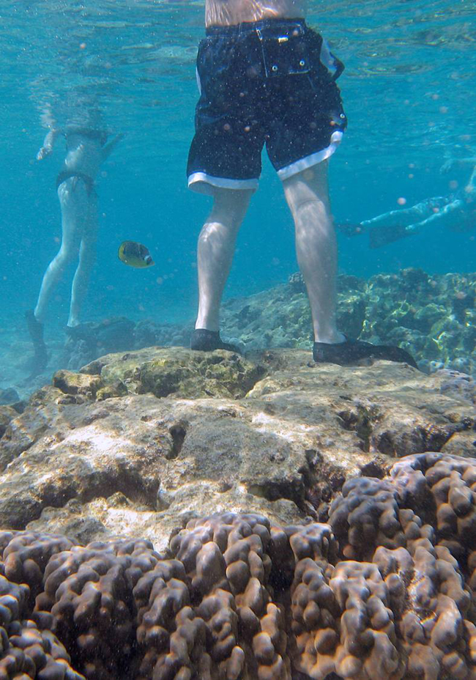
Tourists destroy the environment they have come to see!

Slide 6
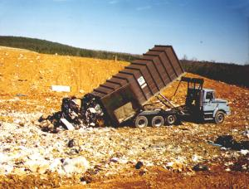
Producing too much waste

Slide 7
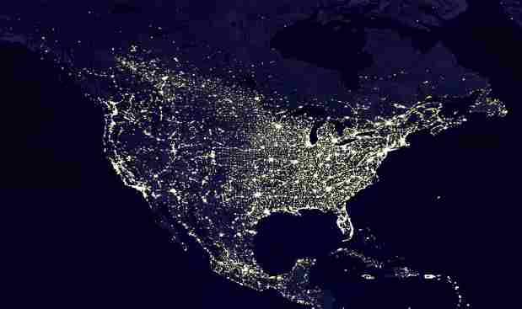
Light pollution - energy is wasted

Slide 8
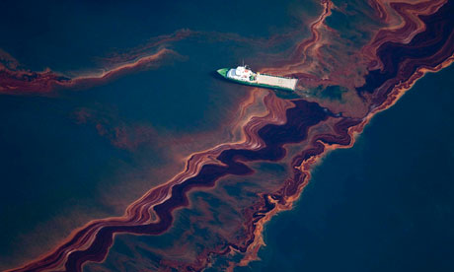
Oil spills cause water pollution

Slide 9
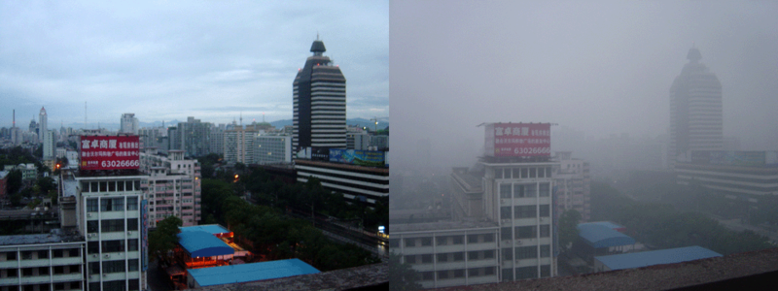
Factories and cars cause air pollution

Slide 10
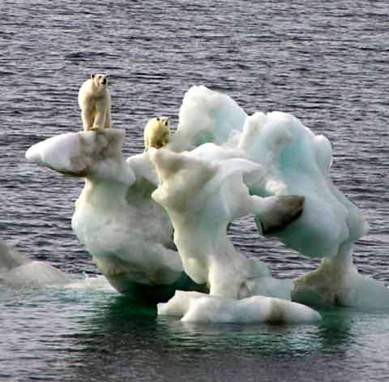
Global warming- Ice caps melting

Slide 11
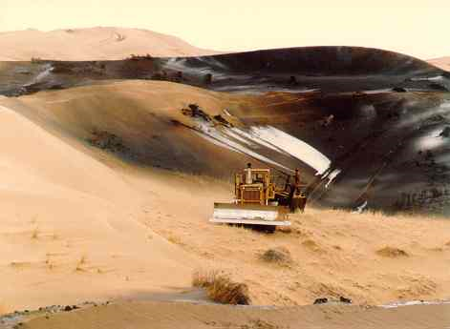
Desertification – Overfarming, land becomes a desert

Slide 12
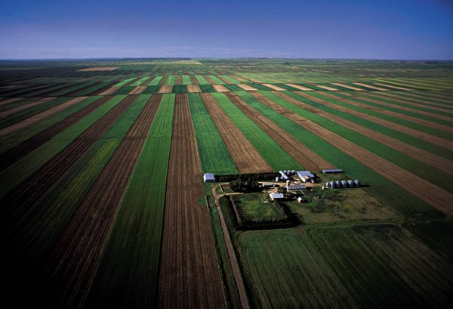
No bio diversity - Only one crop means no other animals or plants can live in the area

Slide 13
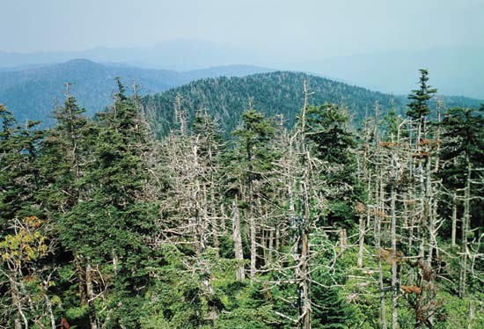
Chemicals from factories travel in the atmosphere to fall as acid rain on forests many miles away.

Slide 14
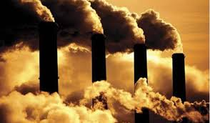
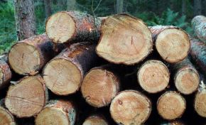
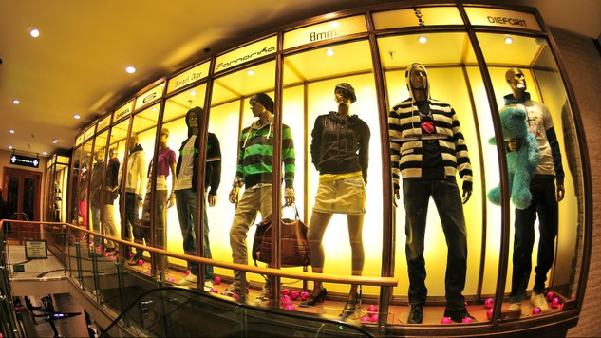
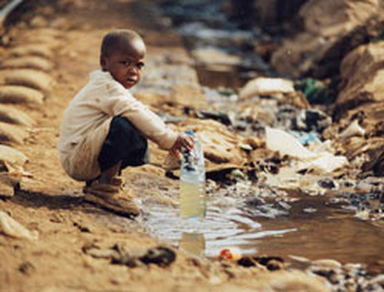
ALL of these effects are the result of two phenomenon:
Resource Consumption - what are resources?

Slide 15
Population Growth: more people means more of these processes!!

Slide 16
Fragile Environments:
Are biomes or ecoregions under threat from change, damage or unsustainable use.
Environments are fragile for two reasons:
They are very sensitive to the basic presence of people (ie: in semi-arid regions)
They are made fragile by large-scale exploitation (ie: rainforests)

Slide 17
From the website:
Click on the link “ WWF’s Terrestrial Ecoregions”
Browser through the regions and choose two
For each, in your notebook provide:
A short description of ecoregion (4-5 sentences)
(climate, temperature, flora and fauna, one example)
b) A description of the “sensitivity to disturbance”
(2-5 sentences, depending on the region)

Slide 18
1

Slide 19
2

Slide 20
3

Slide 21
4

Slide 24
5

Slide 25
6

Slide 26
7

Slide 27
8

