Slide 1
Aim: To Describe and explain the variations in health as reflected by changes in life expectancy at national and global scales since 1950.
This unit is about……..
The ways that food availability and the susceptibility of a person to disease determines the health of a population

Slide 2
In your notes, write a sentence about the importance of food.

Slide 3
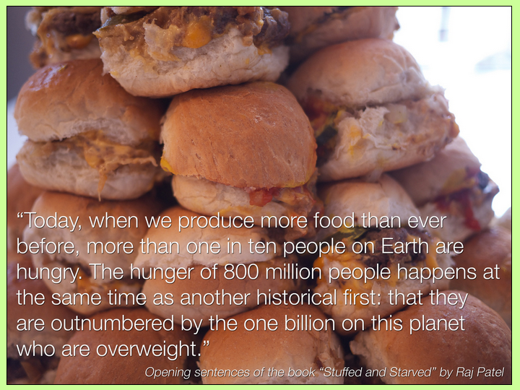

Slide 4
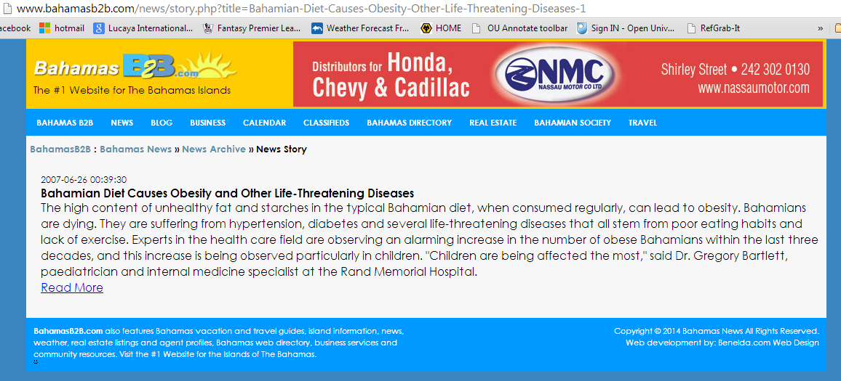
http://www.allcountries.org/ranks/diabetes_prevalence_country_ranks.html

Slide 5
Issues with food and health in the Bahamas

Slide 6
Poor soil so most fresh produce has to be imported
High prices of food
Traditional diet (culture) is high in fats
Culturally, women with a fuller figure celebrated?
High incidence of diabetes and heart disease – diseases of affluence

Slide 7
Define life expectancy…….
Average number of years a person can expect to live if demographic factors remain unchanged

Slide 8
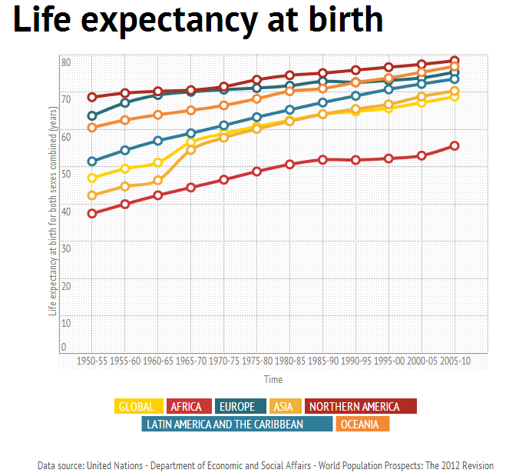
Describe the global trend in health (as indicated by life expectancy). [Has it increased or decreased?]
Describe the global patterns in health (as indicated by life expectancy). [Do some regions of the World have higher level of health than others]
Describe the global trends income since 1950.
4. Make a statement that links the global trends in health and income.

Slide 9
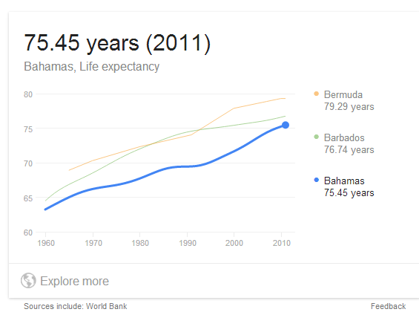
National trend in life expectancy: Bahamas
Describe the regional trend in health (as indicated by life expectancy)
Describe the regional patterns in health (as indicated by life expectancy).
Describe the global trends income since 1950.
4.Make a statement that links the regional trends in health and income.

Slide 10
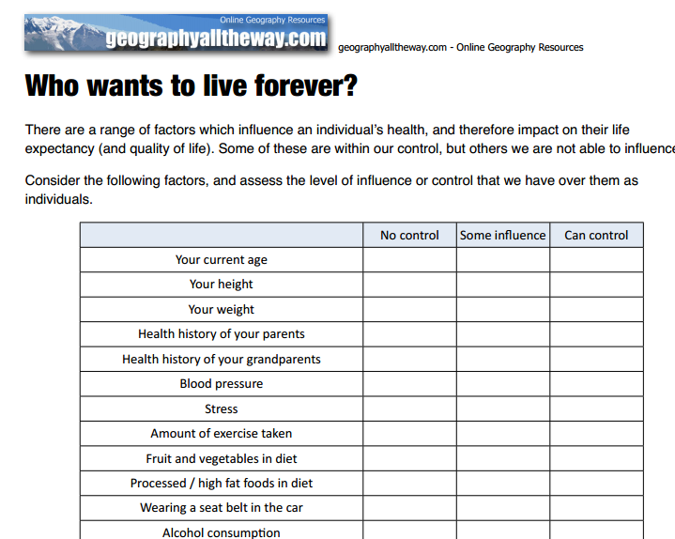
What factors determine my life expectancy?
‘Who wants to live forever’ extension sheet

