Slide 1
Coastal Management: defense against flooding and erosion
Hard Engineering and Soft Engineering Measures

Slide 2
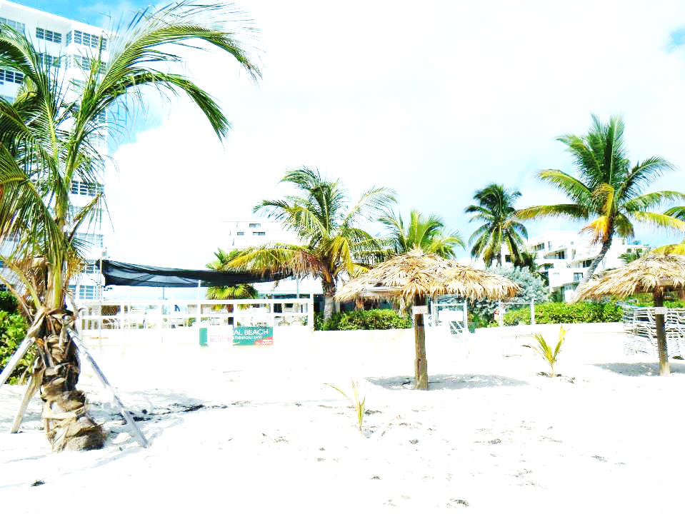
Evaluate the effectiveness of coastal protection methods
We are going on a virtual field trip to investigate the features of coastal protection in different islands of the Bahamas.
What are the advantages and disadvantages of different types of protection?
As we visit each site, you will need to fill in a field scorecard to rate the protection in different categories.

Slide 3
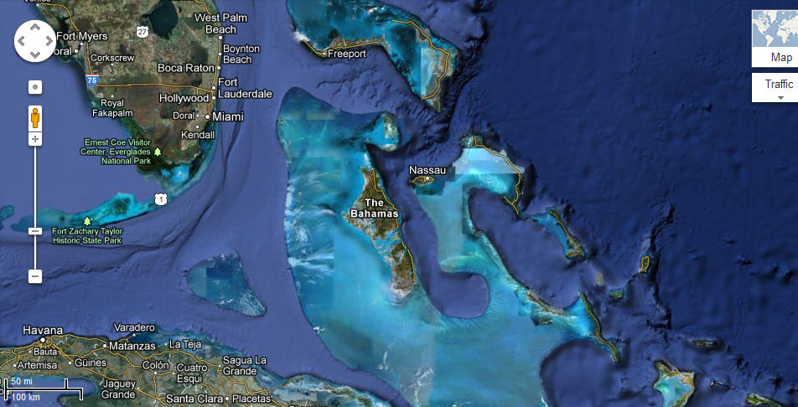
Grand Bahama
Abaco
New Providence – capital city Nassau
Map of the Bahamas
Issues
700 different islands and Cays
Very low lying – highest point 63 meters above sea level
Hurricane risk area
Many settlements and roadways are on the coast
Tourism makes up more than than 50% of GDP
https://maps.google.com/maps?q=bahamas&hl=en&ll=24.647017,-77.55249&spn=5.081055,10.821533&t=h&hnear=The+Bahamas&z=7

Slide 4
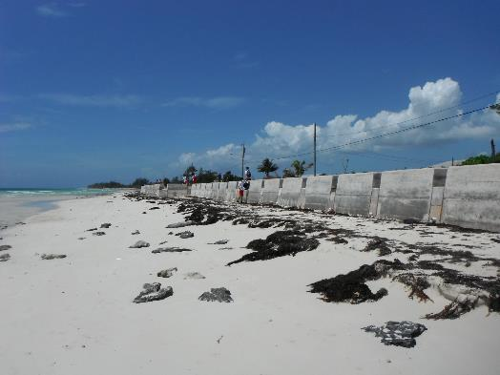
Sea Wall at Williams Town, Grand Bahama
Looking East

Slide 5
Looking West
Notes:
Williams Town is a settlement on Grand Bahama badly affected by the 2004 Hurricanes Frances and Jeanne. This wall was built in response to hurricane damage. When it rains, all the flood water runs off the road behind and onto the beach through the drain pipes.

Slide 6
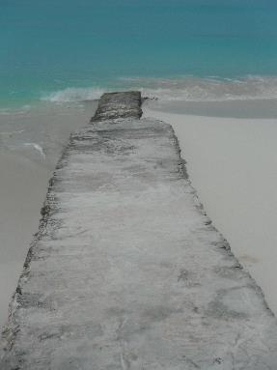
Groynes on Treasure Cay in Abaco
Notes:
Treasure cay is found on ‘most beautiful beaches in the world’ lists. A very exclusive resort including private homes and rented villas lies behind the beach.

Slide 7
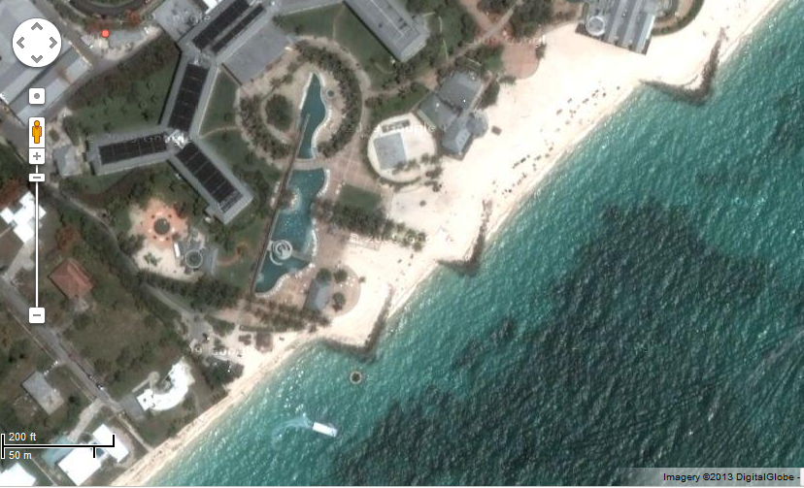
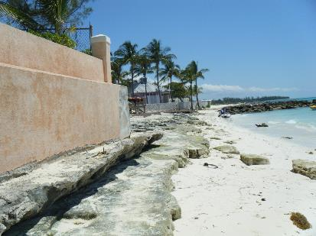
https://maps.google.com/maps?q=grand+lucayan&hl=en&ll=26.509501,-78.641676&spn=0.002443,0.005284&sll=25.085269,-77.358373&sspn=0.004946,0.010568&t=h&hq=grand+lucayan&radius=15000&z=18
Groyne/rock armour at Grand Lucayan Hotel, Grand Bahama

Slide 8
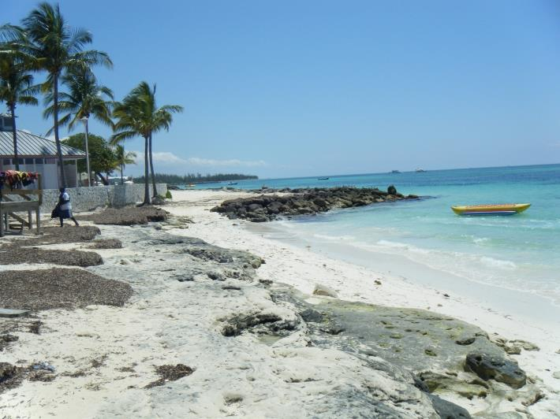
Looking towards the hotel – you can see the last groyne/rock armour
Notes:
The Grand Lucayan is the most important hotel on Grand Bahama. It lost all of its sand after the hurricanes in 2004 and these groynes were built at the same time as beach replenishment took place, to restore this beach to its former glory. Rapid erosion has taken place after the last groyne affecting local residents.

Slide 9
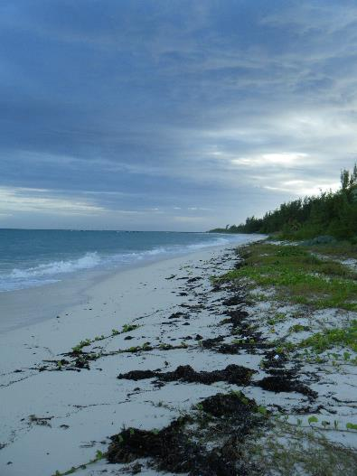
Habitat restoration, Elbow Cay, Abaco
Notes:
After seeing erosion during the hurricane of 2004, a natural approach was taken to try and restore the dunes by planting vegetation. Few people live in this area.

Slide 10
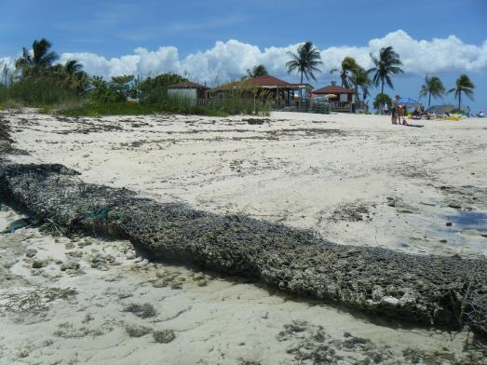
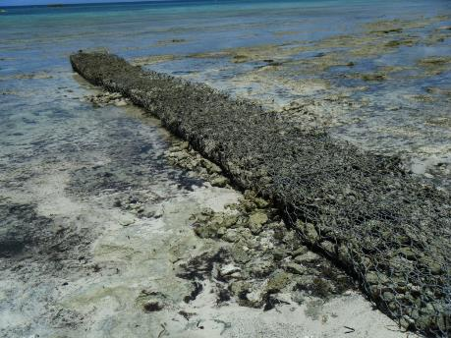
Gabions at Paradise Cove - snorkeling destination, Grand Bahama

Slide 11
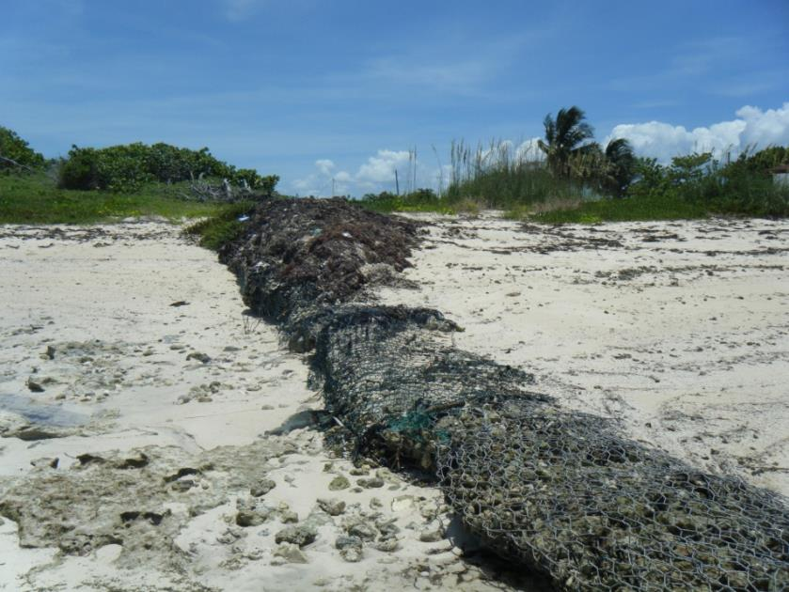
Notes:
Gabions are used as a cheap alternative to groynes in this tourist spot that is a little off the beaten track.

Slide 12
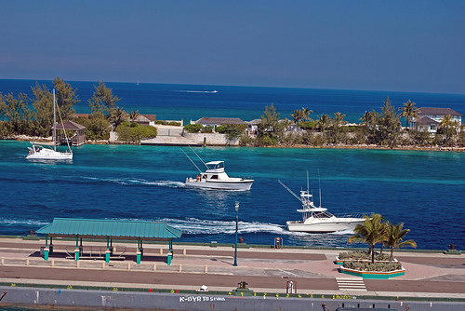
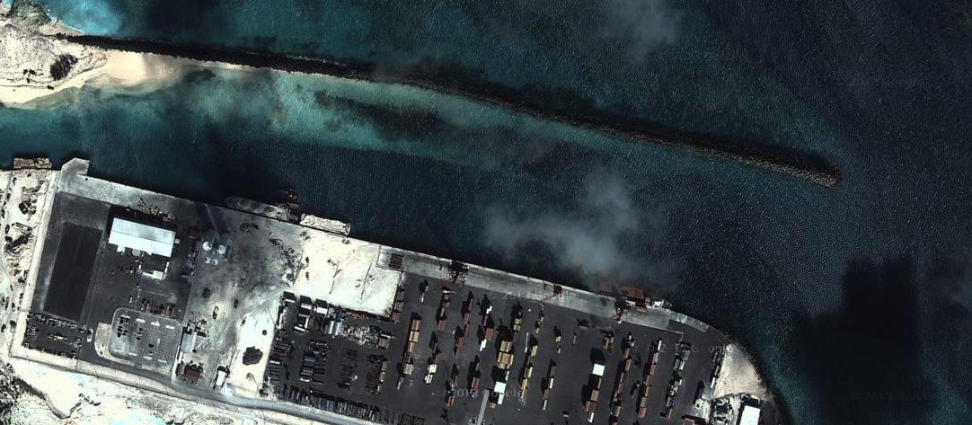
Breakwater to protect Nassau harbor, New Providence
http://www.flickr.com/photos/31021914@N02/3286977158/
https://maps.google.com/maps?q=paradise+island&hl=en&ll=25.085269,-77.358373&spn=0.004946,0.010568&sll=25.079526,-77.339995&sspn=0.00997,0.029311&t=h&hnear=Paradise+Island&z=17
Notes:
Nassua is the capital city of the Bahamas and has a thriving cruise ship industry. Photo credit - http://www.flickr.com/photos/31021914@N02/3286977158/

Slide 13
Revetment in Marsh Harbour, Abaco

Slide 14
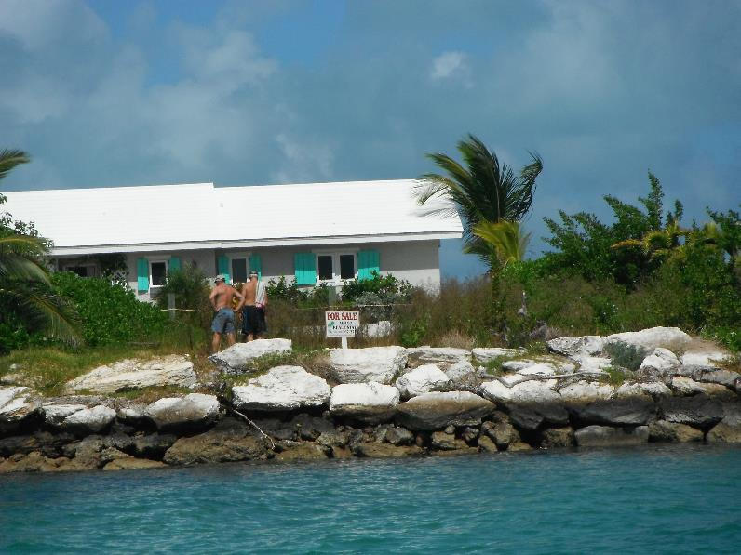
Notes:
Marsh harbor is the largest settlement on Abaco

Slide 15
Managed retreat, Gold Rock National Park, Grand Bahama
Damage from Hurricane Sandy 2012

Slide 16
Notes:
Erosion is allowed to take place in the National Park – large sand dunes and mangroves behind them.

Slide 17
Student tasks
Add up your scores
Which is the most successful type of coast protection in the Bahamas? Justify your opinion.

Slide 18
Approximate coasts of defences - taken from http://www.geography.learnontheinternet.co.uk/topics/coastal_management.html
Groyne | 7000 pounds each
Gabion | 100 pounds per meter
Revetment | 2000 pounds per meter
Sea wall | 3-4000 pounds per meter
Rock armour | 3000 pounds per meter
Habitat restoration | Very cheap – $1.50 per plant in Abaco
Managed retreat | Cost in lost land
Breakwater | Very expensive

Slide 19
All photographs taken by the author apart from google map pictures (https://maps.google.com/maps?q=grand+lucayan&hl=en&ll=26.509501,-78.641676&spn=0.002443,0.005284&sll=25.085269,-77.358373&sspn=0.004946,0.010568&t=h&hq=grand+lucayan&radius=15000&z=18
https://maps.google.com/maps?q=paradise+island&hl=en&ll=25.085269,-77.358373&spn=0.004946,0.010568&sll=25.079526,-77.339995&sspn=0.00997,0.029311&t=h&hnear=Paradise+Island&z=17
https://maps.google.com/maps?q=bahamas&hl=en&ll=24.647017,-77.55249&spn=5.081055,10.821533&t=h&hnear=The+Bahamas&z=7
and Nassau breakwater taken by http://www.flickr.com/photos/31021914@N02/3286977158 arnett 117

Slide 20
Summary – mind map
Conflicts on coastline – urbanization, transport, aquaculture, tourism and recreation, fishing, industry
Problems caused by conflicts
Managing coastline – hard or soft engineering
Advantages and disadvantages of defence types.
Grand Bahama examples of all the above

