Slide 1
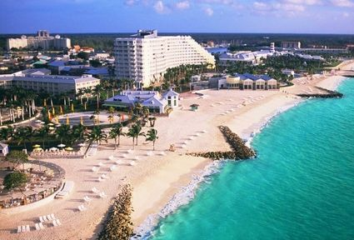
Aim: To know how the coast can be managed
Method sort sheet
Match
Rank by cost

Slide 2
Aim: To know how the coast can be managed
Types of defence
Hard engineering
Built to control natural process
Soft engineering
Work with natural processes
Task
Classify your sheet by hard or soft engineering
Download sheet

Slide 3
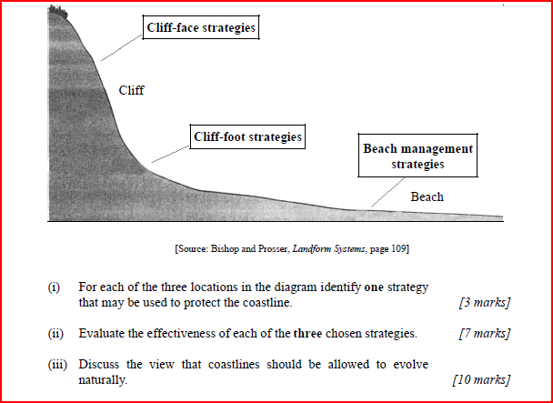

Slide 4
(b) Structured question
[3 marks]
(i) For each of the three locations in the diagram identify one
strategy that may be used to protect the coastline.
For each of the three locations shown in the diagram, responses should identify
one appropriate technique, hard or soft, to reduce the impact of erosion. Cliff face
strategies – cliff pinning, cliff modification, drainage, gabions, vegetation cover.
Cliff foot strategies – sea walls, gabions, baffles, boulders, tetrapods. Beach
management strategies – rip-rap, groynes, beach recycling, nourishment. Marks
should be allocated on the basis of [3 % 1 mark].
(ii) Evaluate the effectiveness of each of the three chosen strategies. [7 marks]
Good responses should look at the effectiveness of hard management techniques
and soft management techniques. Techniques like sea walls allow little
movement, whereas boulders or tetrapods and baffles are more absorbent of wave
energy. Beach nourishment is more aesthetic but it is very expensive to maintain.
Stronger responses may look at the failures that have occurred with management
strategies. In many areas the impact of many of the protection methods is felt
elsewhere along the coastline. It is an open system and changes to one component
may affect others. The question is open ended and strong responses will look at
the positive and negative impacts and should focus on appropriate examples.
Marks should be awarded on the basis of [3 % 2 marks] plus [1 mark] for
additional insight or comment.
[10 marks]
(iii) Discuss the view that coastlines should be allowed to evolve
naturally.
It would be expected that good responses would mention the coastal system and
any change in one component leads to change elsewhere. Examples may be
chosen which illustrate that inappropriate management has resulted in impacts
elsewhere. These impacts may include coastal recession, erosion of dune
ecosystems, loss of settlements etc.. Examples from any appropriate coastal
locations may be given, such as the east coast of the UK, Presque Isle on Lake
Erie, the Bight of Benin, south-east Singapore.
Strong responses will discuss the view that a coastline, which is untouched by
humans will achieve its own equilibrium (dynamic equilibrium), through the process
of negative feedback. They may argue that coastlines should be left to adjust in
this way, as they do in areas which are uninhabited or have sparse populations.
The reality is that people are attracted to littoral zones and to protect property or
landscape, which has an economic value, and so it becomes necessary to employ
appropriate techniques.
It would be expected that good responses adopt an approach which looks at both
sides of the argument, citing examples. Alternatively, convincing discussions can
adopt either viewpoint.
The marks should be allocated according to the markbands.

Slide 5
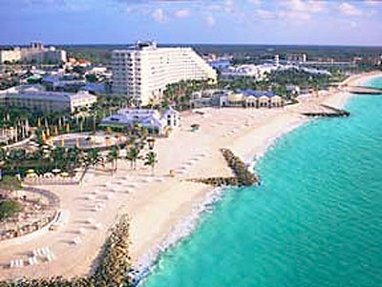
Aim: To evaluate coastal management in Grand Bahama
What types of defence are used? Are they hard or soft?
How do they work?
Why is this area protected?
What may be some advantages and disadvantages of these defences – who might be against them?
http://www.cavehill.uwi.edu/BNCCde/bahamas/conference/papers/sealey.html

Slide 6
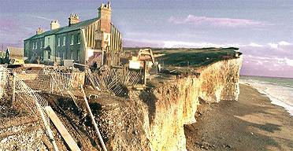
How do we decide if should defend the coast or not?
Clipbank – human intervention

Slide 7
What questions do we need to ask to decide if money should be spent on defences?
Natural
What is the environmental significance of the area - nature reserve?
Will environmentally sensitive areas further down the coastline be affected?
Economic
What will the defences cost to build and maintain?
How valuable is the area we want to protect – major highway, industry, housing, farmland etc?
Social
Will homes be lost – will home owners be compensated?
Is the area densely populated?
What is the history of the area? Archaeological interest?
Political
What is council tax like in the area? Can residents afford additional tax to pay for defences?
Is there funding from central government?

Slide 8
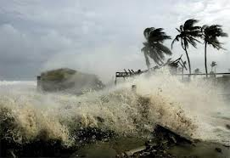
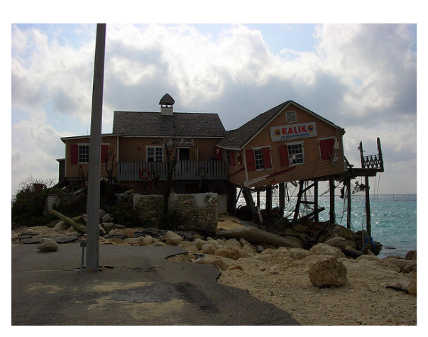
Problem in Grand Bahama
Coastal erosion and sea level rise
Marinas, coastal roads, houses, beaches and hotels are all subject to wave erosion and storm surge damage on Grand Bahama

Slide 9
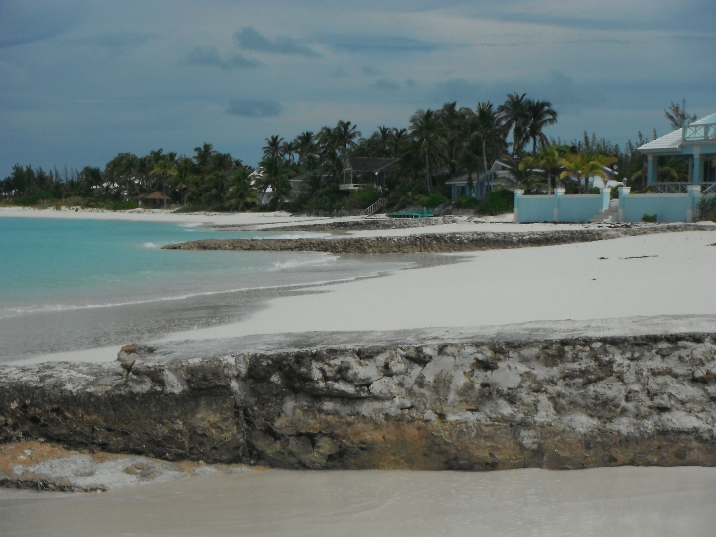
Solution - Groynes on Treasure Cay in Abaco

Slide 10
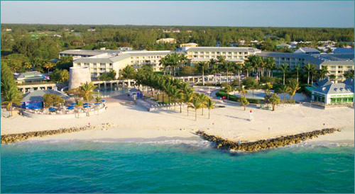
Solutions – Build Groynes
View clipbank
Build groynes to trap sand and build up beach in front of hotel.
Use beach replenishment to replace sand lost in storms

Slide 11
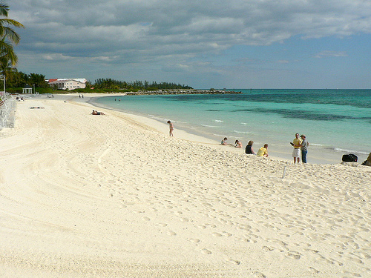
Large beach for tourists to enjoy in front of Our Lucaya

Slide 12
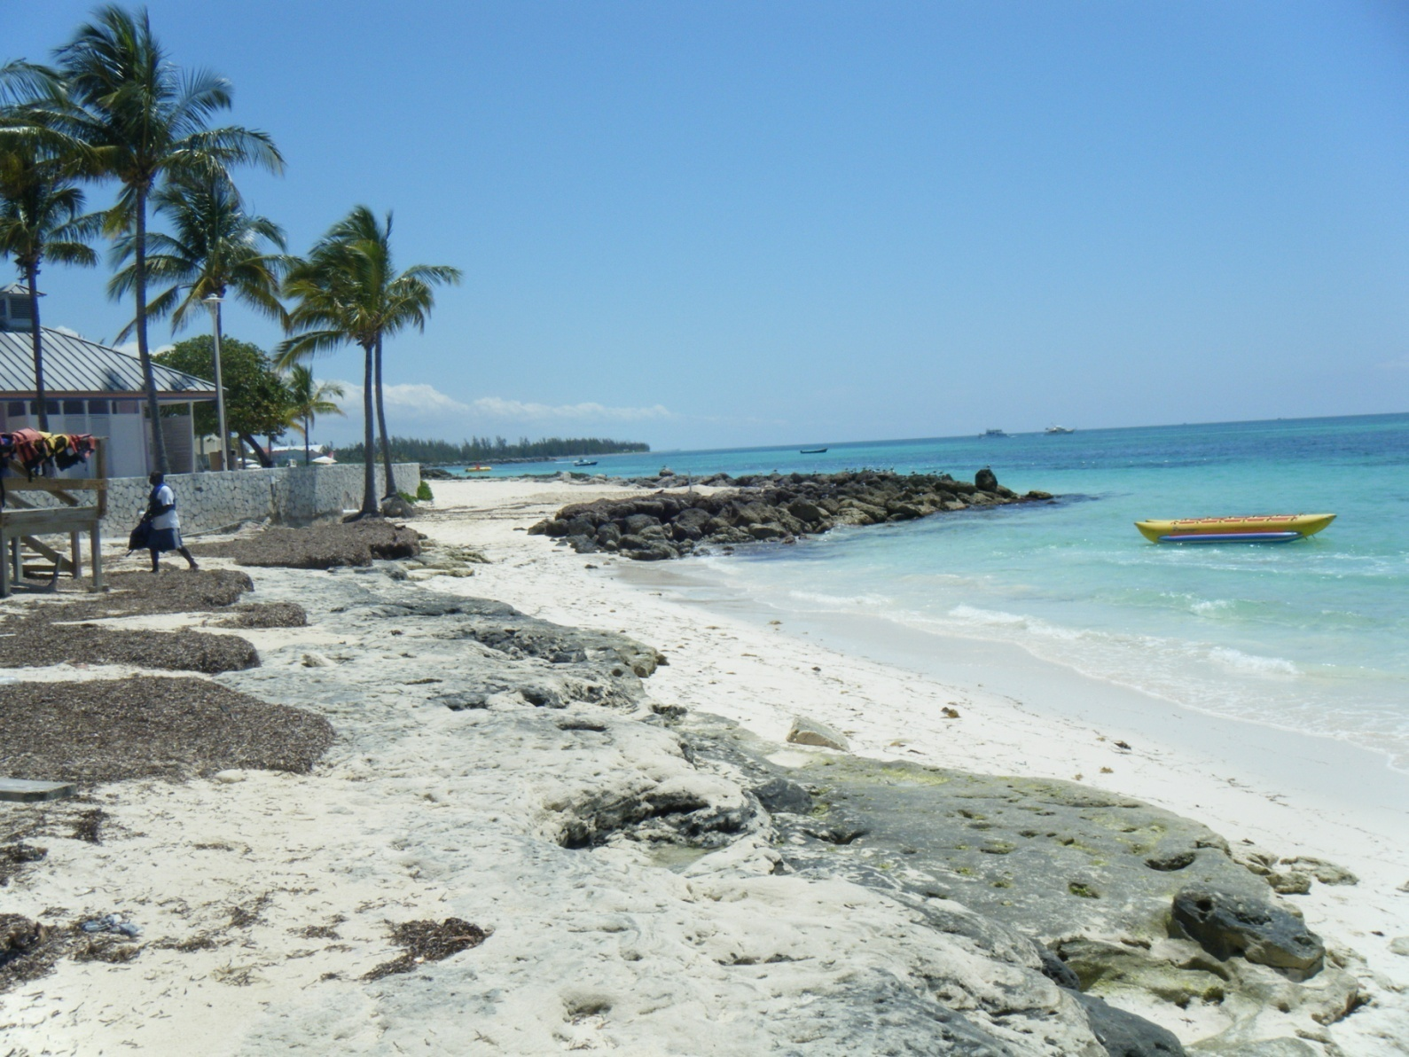
BUT!!!!!!

Slide 13
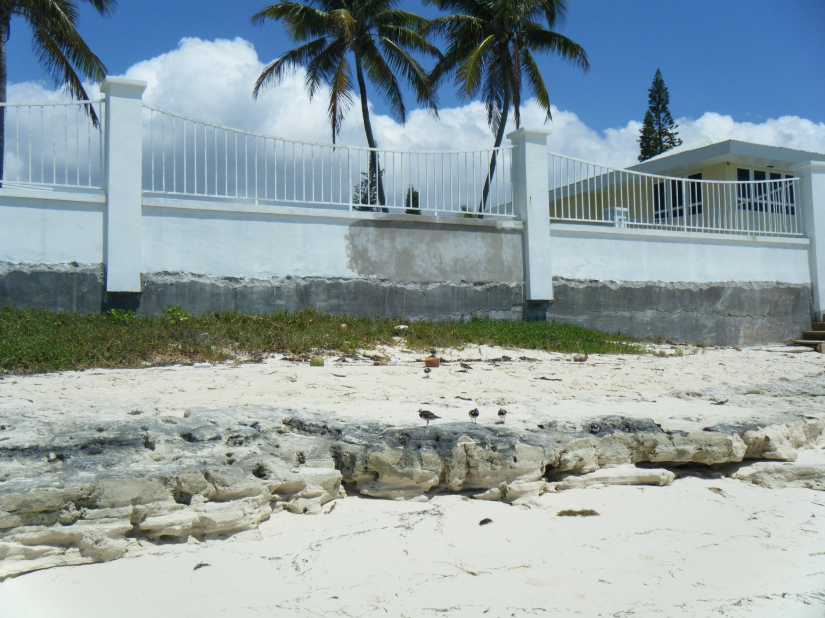

Slide 14
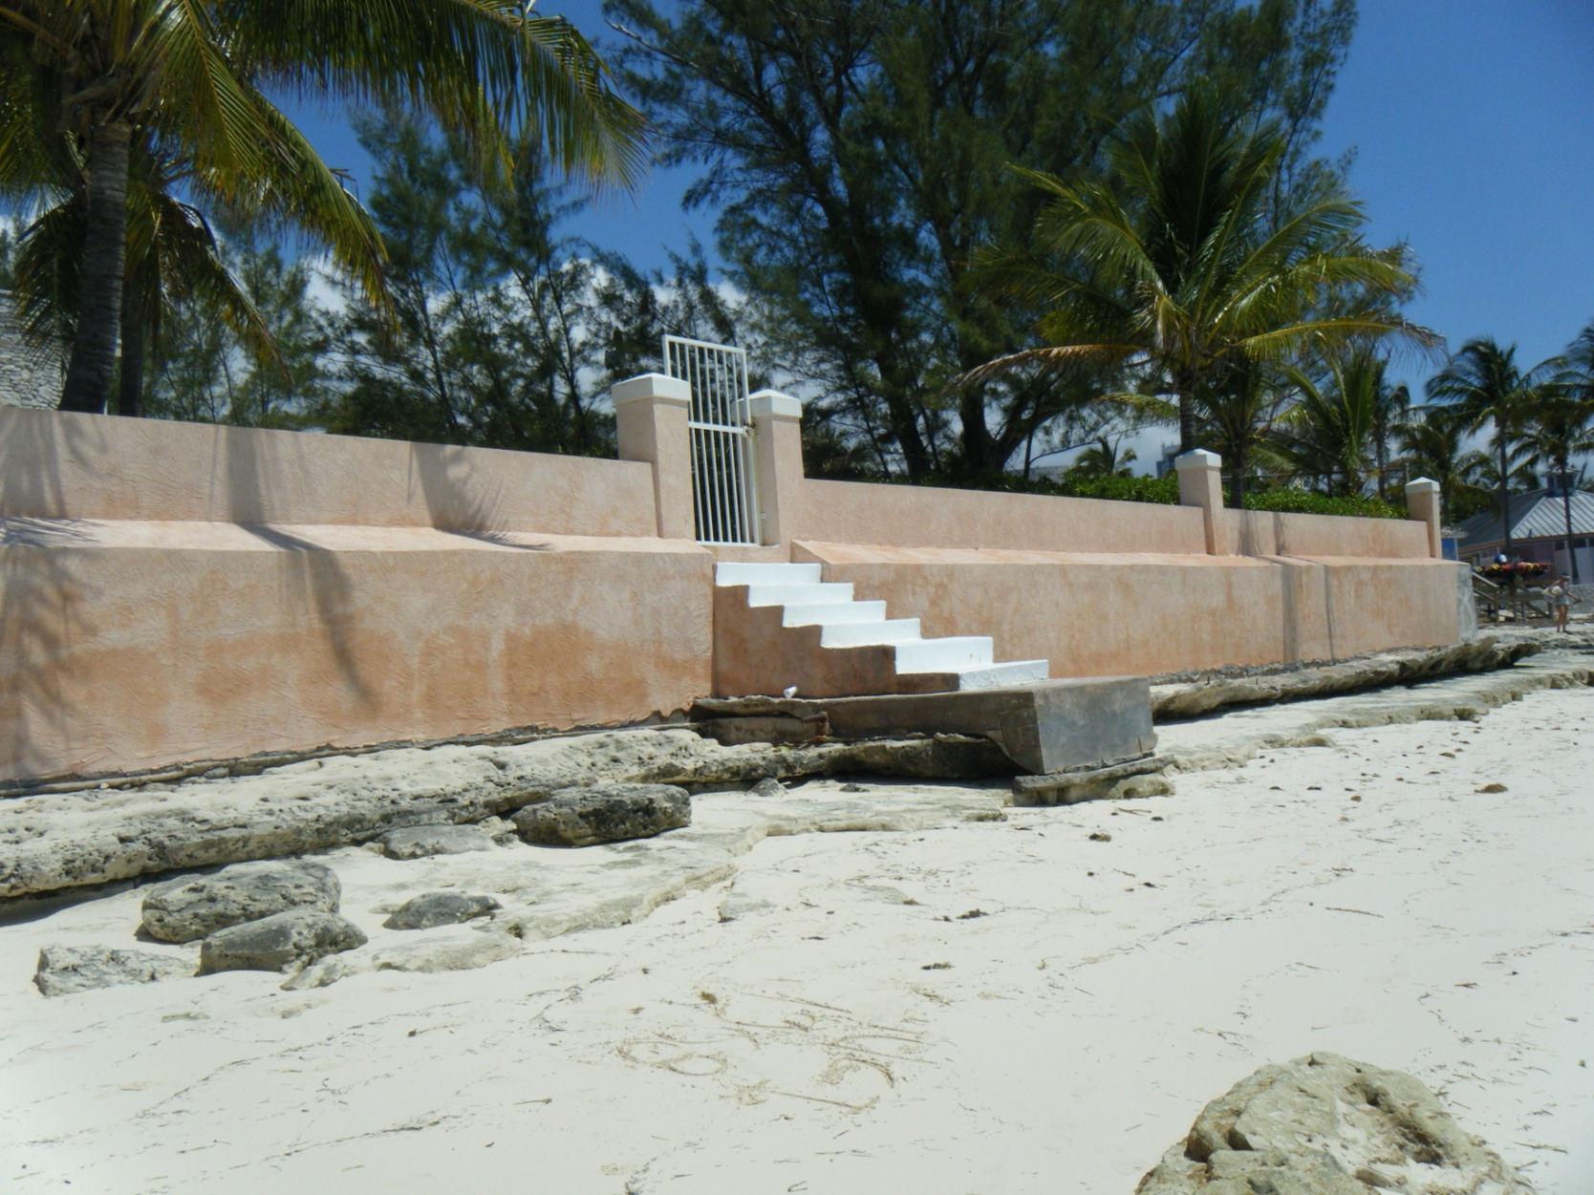

Slide 15
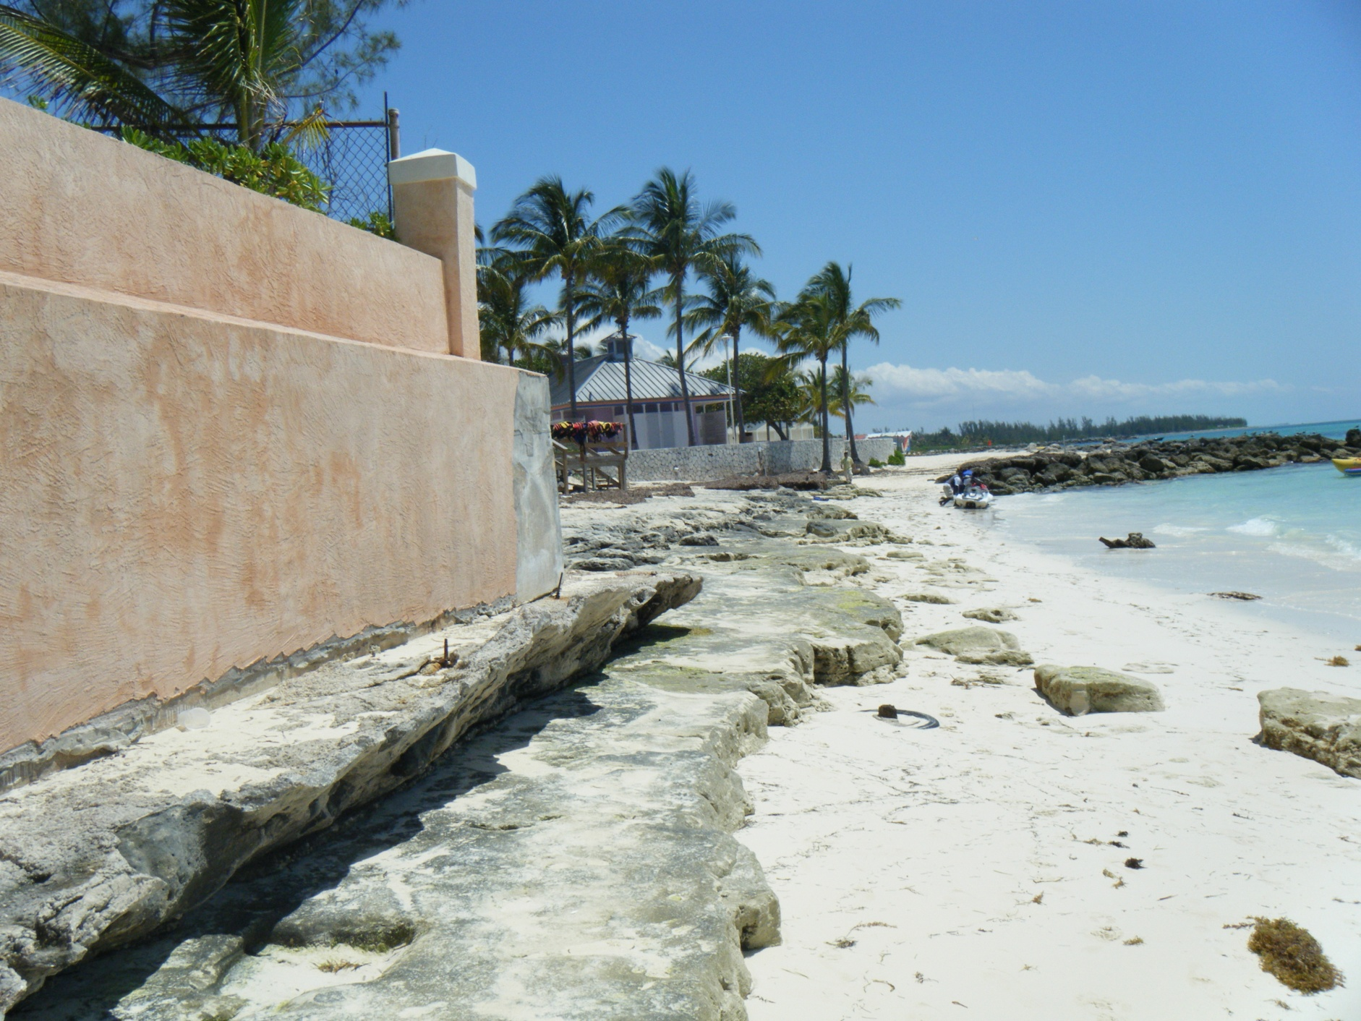

Slide 16
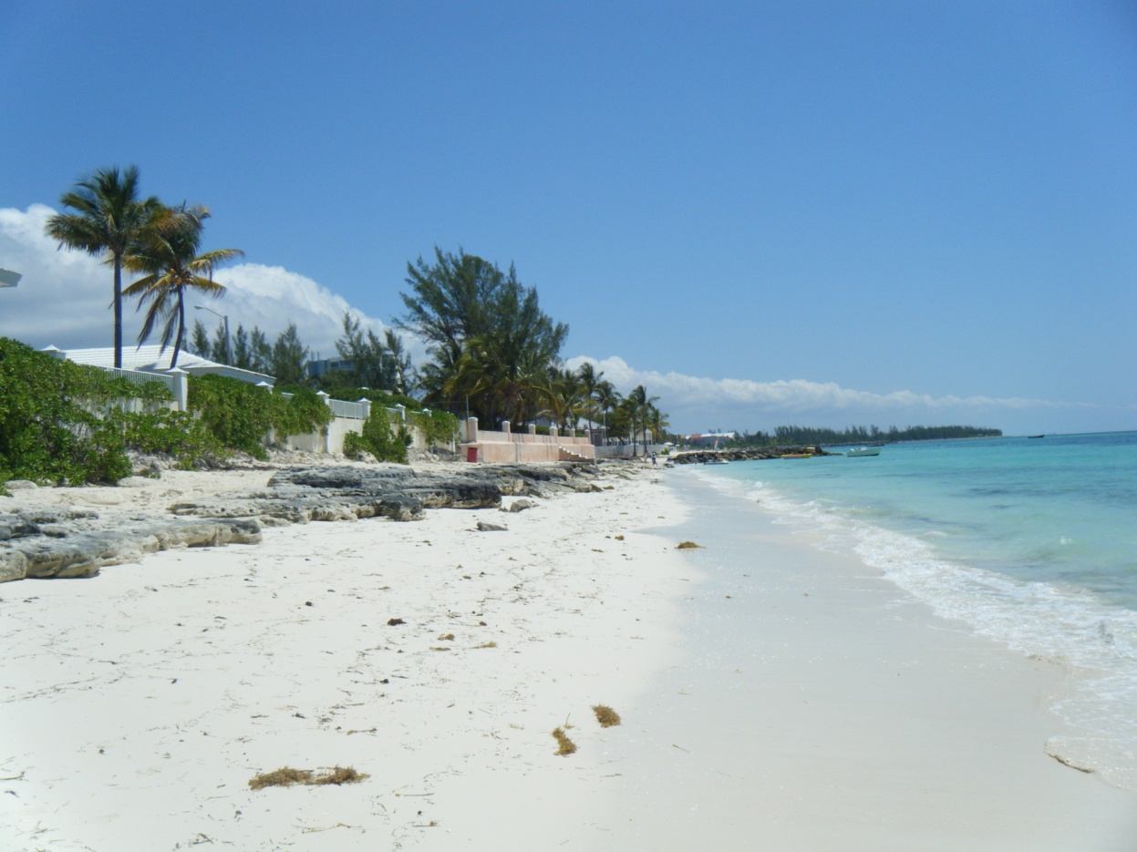
Sand is trapped by groynes in front of the hotel.
Longshore drift continues after the groynes which leads to rapid erosion as sand removed is not replaced.
Smaller beach so less natural protection from storm waves
Undercutting of sea walls for local residents
Uneven beach for walking

Slide 17
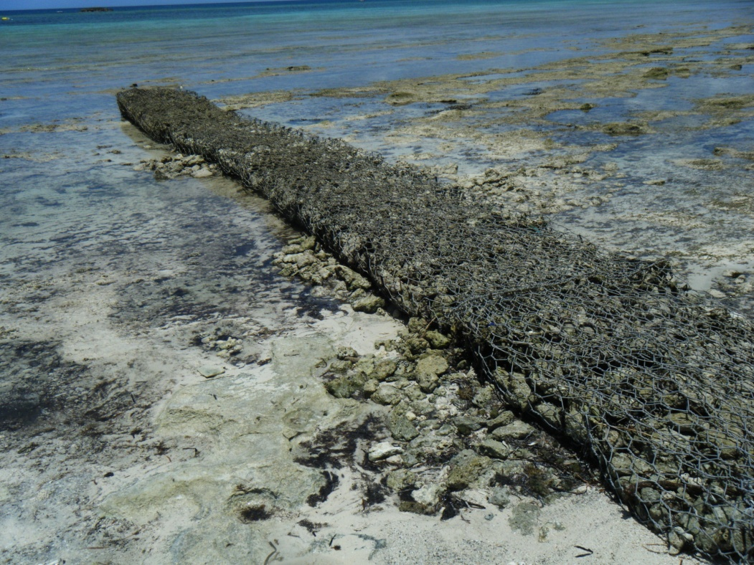
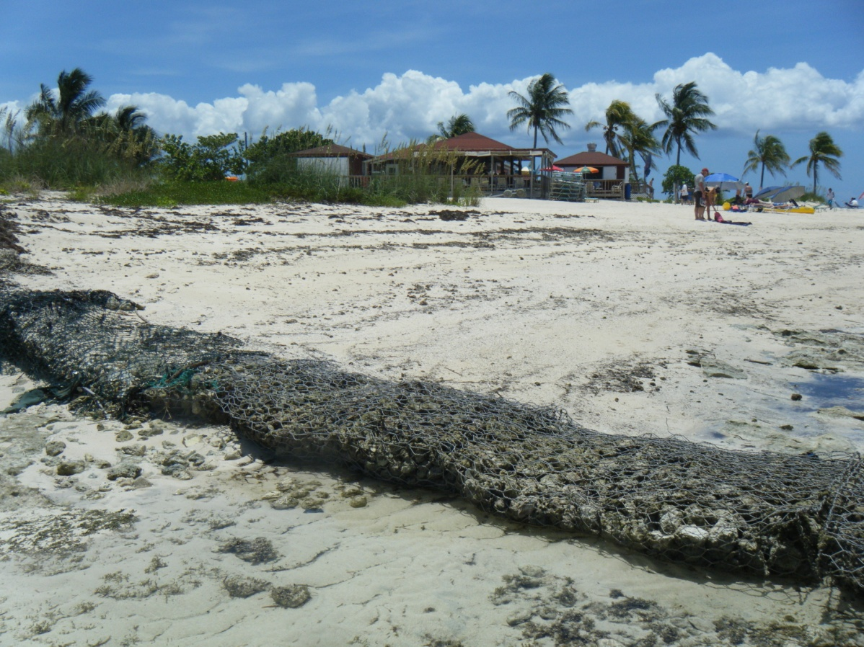
Solutions - Gabions
Paradise Cove – tourist destination for snorkelling
A gabion is cheaper than a groyne, it prevents longshore drift and absorbs wave energy.
Builds up beach in front of tourist location

Slide 18
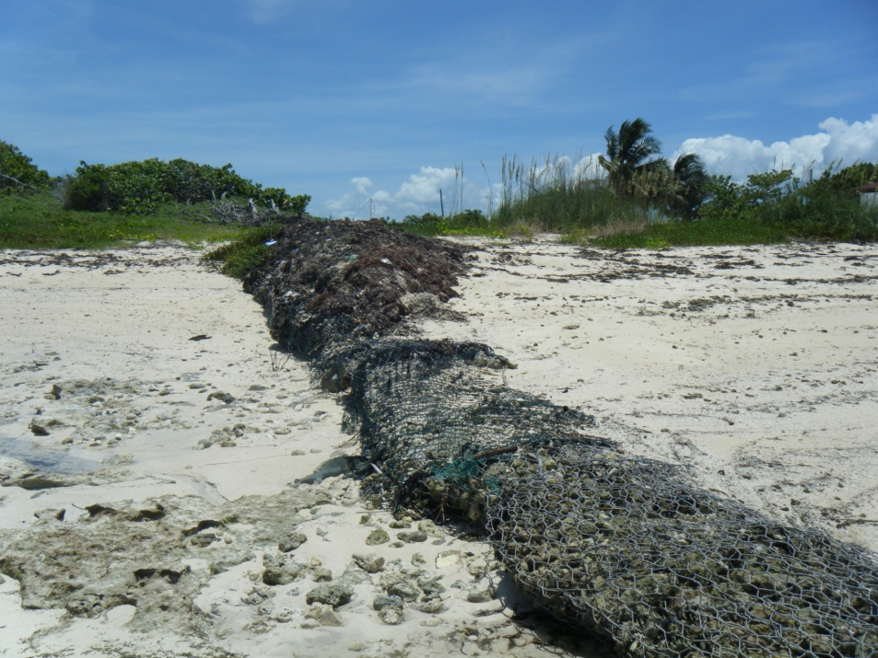
But!!!!
They are not visually attractive for tourists!
They break down and need repair

Slide 19
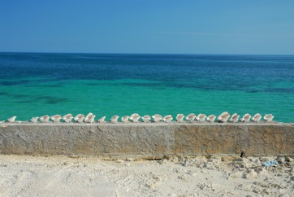
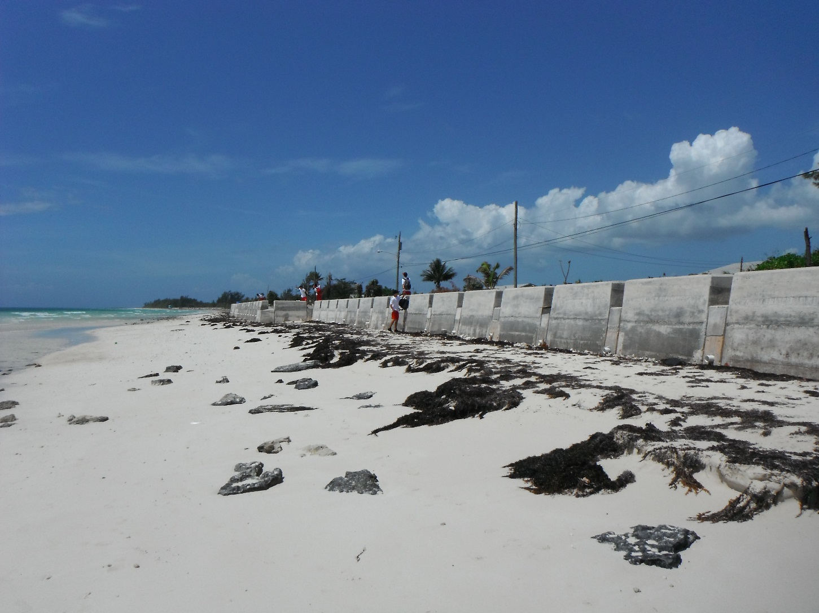
Solutions – sea walls
Williams Town - sea wall
Protects Williams Town properties and main road from erosion

Slide 20
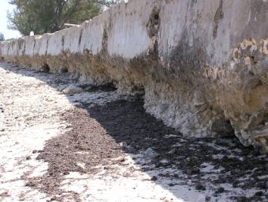
If a sea wall is not curved it is prone to erosion and needs constant repair.
It can sometimes make a beach steeper

Slide 21
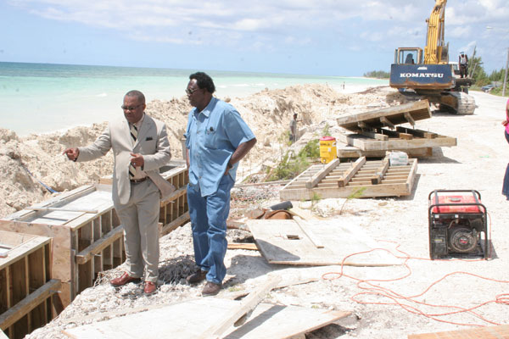
Also…….
Visual pollution during construction
Reduces access to the beach

Slide 22
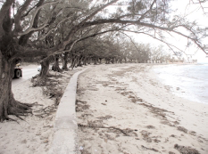
Planting Casuarina trees (non native species) to stabilise dunes and prevent erosion
BUT !!!!!!!!
Casuarina trees increase beach erosion due to its thick shallow roots
Wave action removes the sand from around the roots reducing the beach width.
Casuarina trees are prone to wind damage during heavy storms increasing risk to nearby properties.
Fast growing and tall so they crowd out other native species

Slide 23
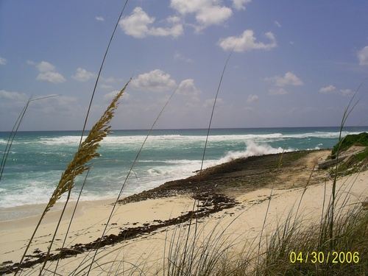
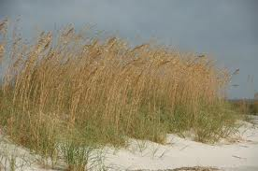
Dune replanting - Abaco
Sand removed after hurricane Frances
Planted 200,000 sea oats along Elbow Cay's dunes. Inexpensive
Stabilized primary sand dunes against wind erosion.
BUT
Will another large storm remove sand again??
Can you use this method everywhere?

Slide 24
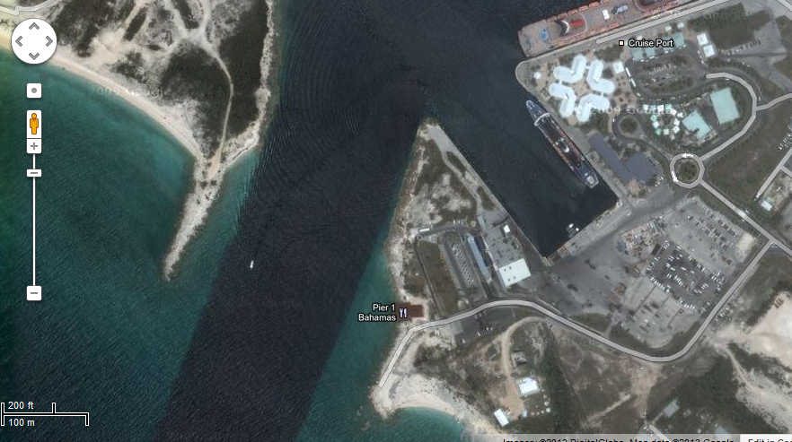
Breakwater to protect Freeport harbour

Slide 25
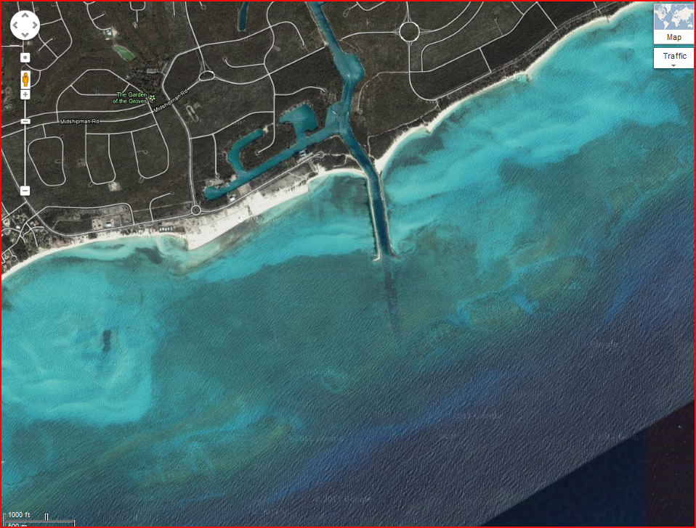
And canal access
Vital to the economy but trap sand and change sediment flow

Slide 26


Task 1
Add information to the table above that gives specific information about location and use in Grand Bahama.

Slide 27
Complete the essay!
Highlight information specific to grand Bahama
Areas of positive evaluation
Areas of negative evaluation
Write a conclusion at the bottom!

Slide 28
Evaluate the methods of coastal management for a named area. (10)
Sea level rise and risk of storm surges in hurricanes means that coastal erosion and protection from coastal flooding are priorities in Grand Bahama. Many tourist resorts and residential properties are built along the coast. Most of the main roads run along the coast. Tourism makes up 60-70% of the Bahamian economy.
Sea walls protect major coastal settlements and roads such as High Rock and Williams Town.
The Sea wall at Williams Town is not curved so whilst it is a barrier, it will need to be more frequently maintained as it does not deflect the wave energy but rather absorbs it all. Sea walls have been shown to be ineffective as it makes the beach profile steeper over time and therefore increases wave height and worsening erosion of sand. This means that during a storm, the wall is in danger of collapse as it will have lost its protective sand.
Rock groynes build up and protect the beaches for the larger resorts such as Our Lucaya resort – these are important to the economy and tourists will not come if the beach is not wide. Groynes trap sand and the sand attracts tourists as well as protecting the coast. Our Lucaya hotel beach was replenished after the last period of hurricanes
Beach replenishment has created a different sand texture that is different to typical Bahamian sand – much coarser. Gabions used in some tourist areas like Paradise Cove but they are visually unattractive and only used where tourists can’t directly see them.
Groynes visually unattractive for tourists and prevent full access to the beach. Erosion after the last groyne can be seen in Port Lucaya where there is a large beach in front of the hotel but the beach shrinks where the residential area begins and the sea is undercutting the residents wall at high tide.
The groynes are more natural than a sea wall. Sea walls used where there are fewer tourists such as Williams Town, as sea walls prevent beach access.
Breakwaters protect the port area and entrances to the canals – very important to the island economy – largest deepwater port in Western hemisphere.
The Bahamian government is moving towards using vegetation and revetments to stabilise beaches rather than sea walls as this has fewer impacts a further down the coastline. Casaurina trees were planted but they were not native and its roots increased erosion. Sea Oats were planted on dunes in Abaco but dunes don’t offer protection from storms and homes may be at risk.
Conclusion……………………………………..

