Slide 1
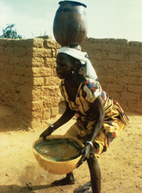
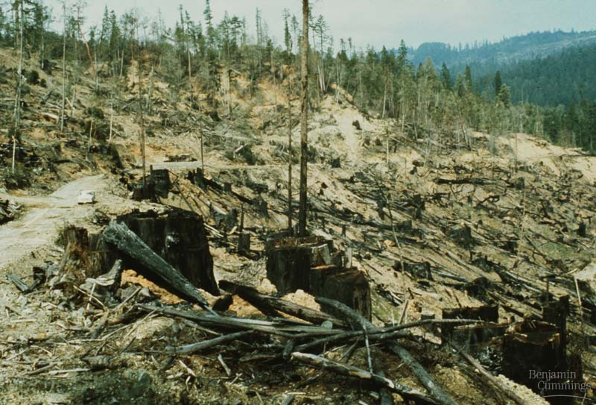
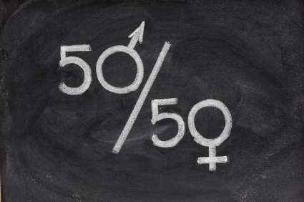
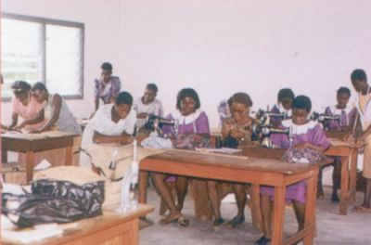
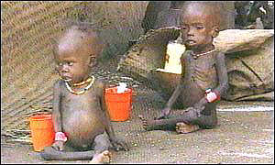
Aim: To know the UN Millennium Development goals
What are the worlds biggest problems?

Slide 2
What Do You Think Are the World’s Biggest Problems?
Of everything we’ve discussed this year so far, what would you rank the most important to tackle in the world, on a global scale?
With your partner, come up with 10 and rank them from most to least important

Slide 3
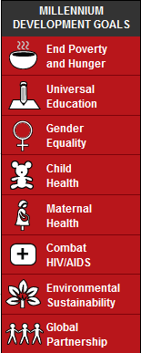
http://www.un.org/millenniumgoals/
What are the Millennium development goals?
When were the goals made?
What is the target date to reach the goals?
Who decided on the goals?
Find one fact that supports the fact that the MDG’s are not working
Find one fact that supports the fact that the MDG’s are working
What is your opinion?
Laptop next lesson
http://www.youtube.com/watch?v=JztmHP1tz3c

Slide 4
MDG Speed date task
http://www.un.org/millenniumgoals/
You need to thoroughly research your goal and to practise
your timed dating speech. You must cover the following: a. Name and number of goal b. Two Quick Facts c. The target d. Where do we stand –will the target be reached? e. Two named places and examples of where progress is being made.
The Speed Dating Process Goal teams 1, 2, 3, 4 will present to Goal teams 5, 6, 7, 8 and will work their way down the line. You will have 90 seconds to get through your speech and impress the other side. Each group must record their date information on a sheet and then give their opposite partner a grade out of 10 - where 1 = No hope to 10 = Love at first sight!

Slide 5
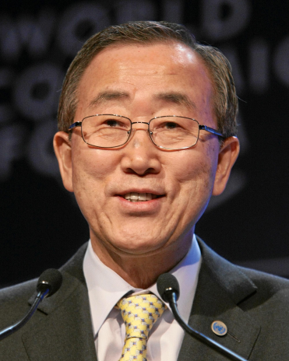
Millennium development goals task
You are now in the position to be able to have an overview of seven of the eight MDG's, where we are in 2014 and the progress with each. Your task is now to draft a letter to Ban Ki-Moon (Head of the United Nations) outlining three of the MDG's that you are most interested in and providing a summary of where we are in 2013 in terms of meeting it. Use your recording sheet from the speed dating exercise and the fact sheets above to improve your knowledge. After all, you are writing a letter to the number one expert in the world!

Slide 6
Planning sheet and mark scheme
Task: Your task is now to draft a letter to Ban Ki-Moon (Head of the United Nations) outlining three of the MDG's that you are most interested in and providing a summary of where we are in 2013 in terms of meeting it.
Introduce yourself to Mr. Ban Ki Moon
Describe your first goal and whether you think it will be met
Describe your second goal and whether you think it will be met
Describe your third goal and whether you think it will be met
Overall conclusion – Explain to Mr. Ban Ki Moon what you think needs to be done to achieve the goals by 2015
 | Description
A | You have written in clear paragraphs. You describe three goals using specific facts and figures. You give reasons to explain your ideas. You explain your own view
B | You have written in clear paragraphs. You describe three goals. You try to give reasons to explain your ideas. You describe your own view
C | You describe three goals. You describe your own view
D | You give some information about the goals and attempt to give your won view.

Slide 7
Aim: To create a campaign to raise awareness
Come up with a campaign to raise awareness of a particular goal you are interested in.
Think about how the 'Make Poverty History' campaign got their message over http://www.youtube.com/watch?v=gFfIIW_xQq4
Could you put together your own video to be sent to all schools in Europe and North America?

