Slide 1
How Do We Measure Hurricanes?

Slide 2
What scale measures hurricanes?
The Saffir Simpson scales measures hurricanes.
It looks at:
Wind speed
Storm surge level
Damage

Slide 3
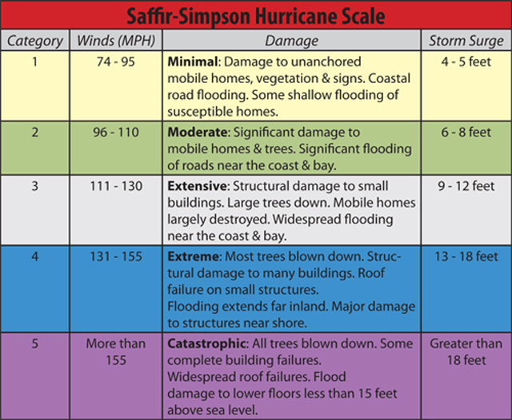
How do we measure a hurricane?

Slide 4
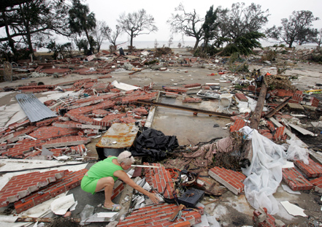
Guess the saffir simpson measurement? 1

Slide 5
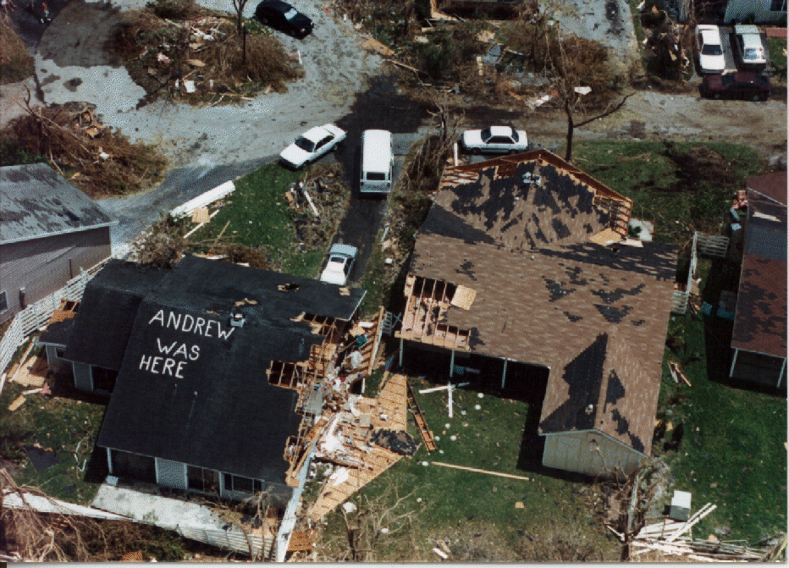
2

Slide 6
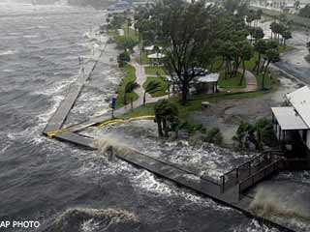
3

Slide 7
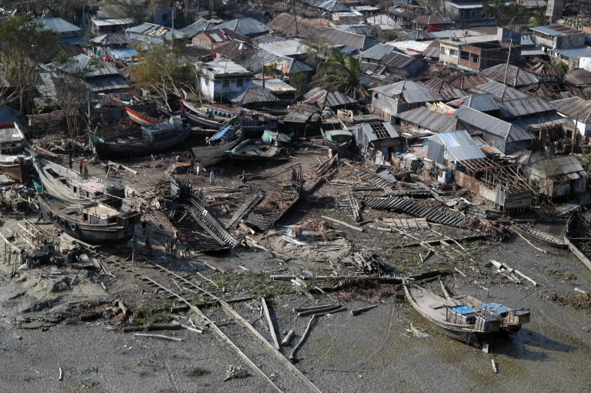
4

Slide 8
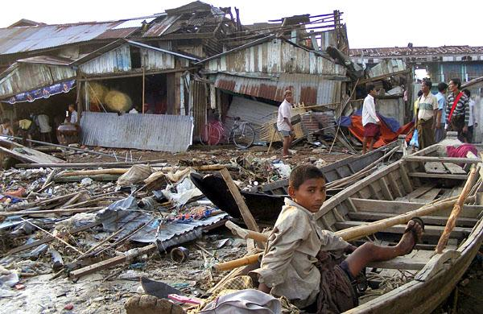
5

Slide 9
answers

Slide 10
Hurricane Katrina - 4

Slide 11
Hurricane Andrew 5

Slide 12
Frances - 3

Slide 13
Cyclone sidr 5

Slide 14
Cyclone Nargis – 3/4

Slide 15
What is the problem with the Saffir-Simpson Scale?
It is difficult to use damage to measure hurricane intensity as different places have different risk factors such as poverty or poor housing which increases damage
There are different scales used in different regions of the world

Slide 16
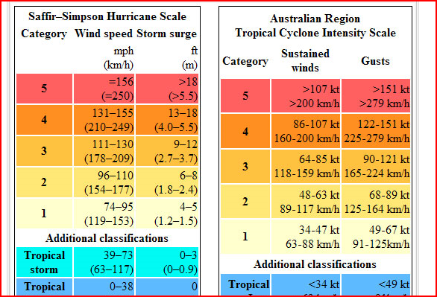

Slide 17
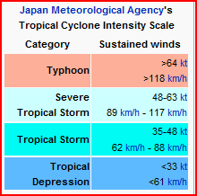

Slide 18
We can measure weather using:
Rainfall –
Windspeed –
Pressure -

Slide 19
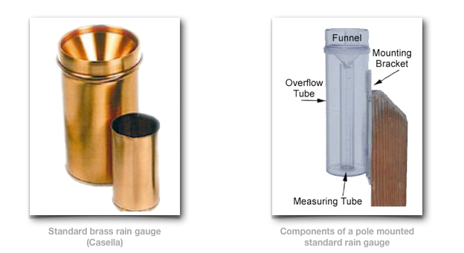
Rain Gauage
Measures the amount of liquid precipitation over a set period of time.

Slide 20
Good and bad points………
Easy and cheap to do BUT
Attempting to collect rain data in a hurricane can be nearly impossible and unreliable (even if the equipment survives) due to wind extremes.
Only indicate rainfall in a localized area.
Drops will stick to the sides or funnel of the collecting device
Cannot use when its freezing
Must be placed correctly - no obstructions, such as building or trees, to block the rain

Slide 21
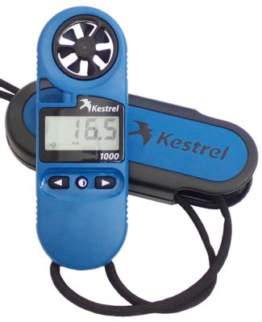
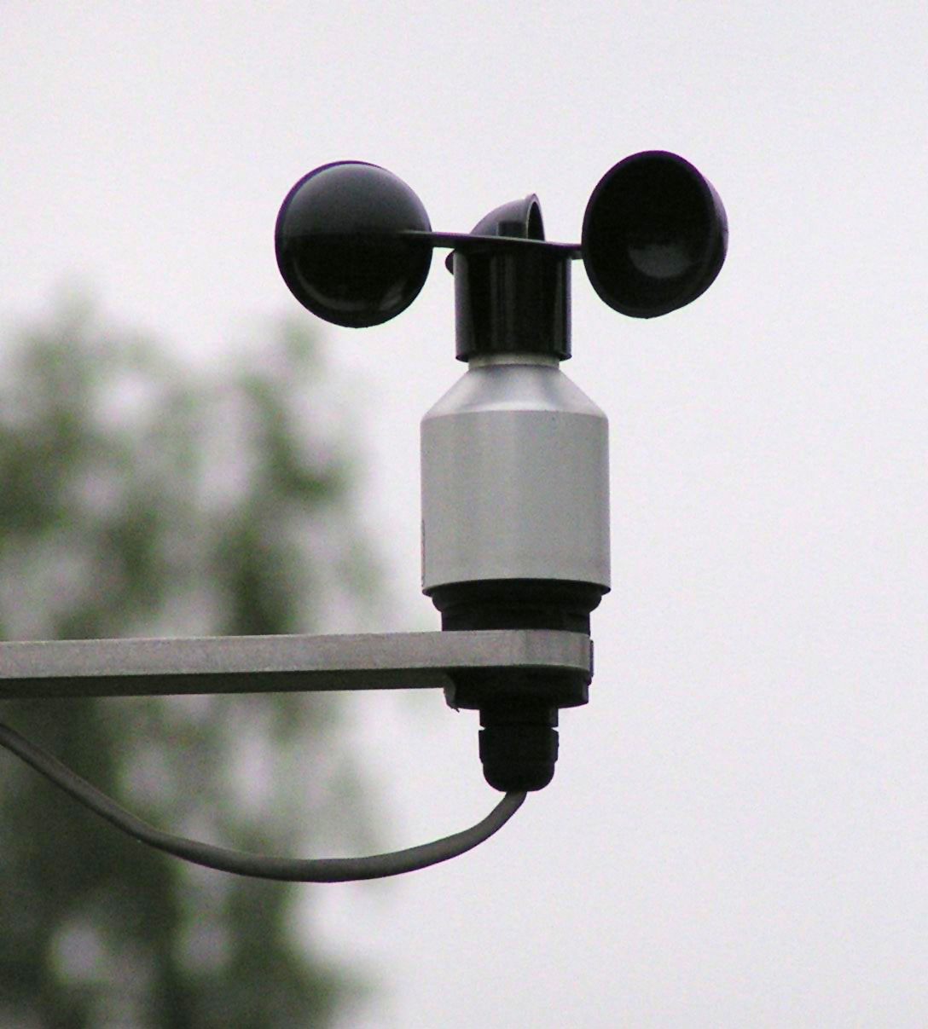
Anemometer
Measures windspeeds

Slide 22
Good and bad points………
Easy and cheap BUT
Wind does not blow continuously
You often need a lot of wind to move the meter – especially in cheaper devices
Local environment can block winds

Slide 23
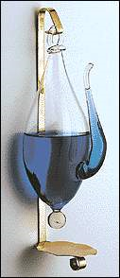
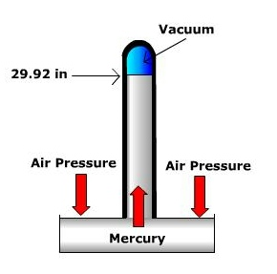
Barometer – measure air pressure
(mercury is a dangerous metal to spill!)

Slide 24
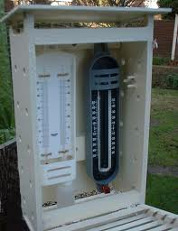
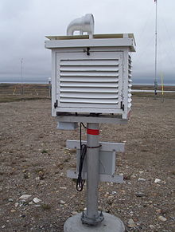
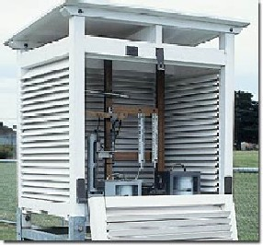
Glue in your sheet on the Stevenson screen and answer the questions in your book

Slide 25
Aim: To record weather data
http://www.wunderground.com/weather-forecast/BS/Freeport.html
Design a table you can use to record weather data on temperature, pressure, rainfall and wind speed.
We will compare your measurements to the real measurements so make two tables!

Slide 26
Measuring the weather at LIS on Grand Bahama? What is our average monthly rainfall, wind speed and pressure? Make your own weather measuring equipment.
Think about:
How you will actually collect data reading from your equipment?
Where should the equipment be placed?
Why is your design effective?
Ideas……..
http://www.ehow.com/how_2321604_make-homemade-barometer.html
http://www.savvyhomemade.com/make-your-own-barometer.html
http://www.k12science.org/curriculum/weatherproj2/en/docs/raingauge.shtml
http://www.wikihow.com/Build-a-Rain-Gauge
http://www.sercc.com/education_files/anemometer.pdf
http://www.rcn27.dial.pipex.com/cloudsrus/protanemom.html

