Slide 1
A beach is a……
geological landform along the shoreline of a body of water.
It consists of loose particles which are often composed of rock,
such as sand, shingle, pebbles, or have biological origins, such as
shell fragments or coral fragments.

Slide 2
What conditions are needed for deposition to occur?
#1 - A large supply of beach material eg. Beach deposits, river sediments, material from eroded cliffs and headlands
#2 - Low energy coastline –
Sediment usually builds up in bays because the waves there have less energy (due to wave refraction), while sediment is carried away from the exposed headlands leaving them vulnerable to more erosion
#3 - Longshore or littoral drift
#4 - An irregular or indented coastline eg. A river mouth
#5 - Bioconstruction – plants stabilising sediments

Slide 3
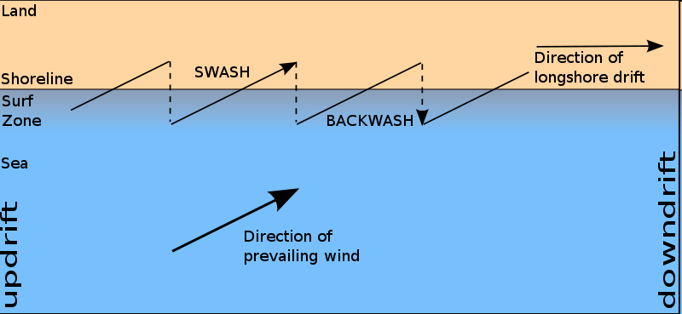
Longshore drift is where sediment is carried along the coastline
by the waves in the direction of the prevailing winds.
Generally, the largest particles of beach sediment are
found updrift, closer to the sediment source.
The smallest sediment particles are transported further
downdrift before being deposited.
Why……..?
Wave lose energy so larger materials are deposited first.

Slide 4
Influence of season
The lower energy waves deposit sediment on the beach berm adding to the beach profile in Summer.
The beach profile is lower in the Winter due to the increased wave energy associated with storms.

Slide 5
Beach profile:
Particle size
Particles get larger and more angular towards the back of the beach. Due to the ability of bigger storm waves which have more energy to transport greater loads, depositing large material at the back of the beach.
Storm beach
A noticeable semi permanent ridge found at the level of the highest spring tides
Berms
Small scale beach ridges built up by successive levels of tides or storms
Cusps
Semi circular embayments found in the shingle or sand sand-shingle interface. Larger particles found at ‘horn’ or cusp
Ripples
Formed by wave action or currents

