Slide 1
Revitalization Can Lead to Re-Imaging

Slide 2
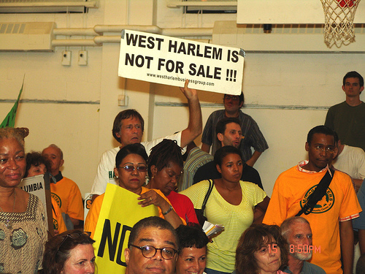
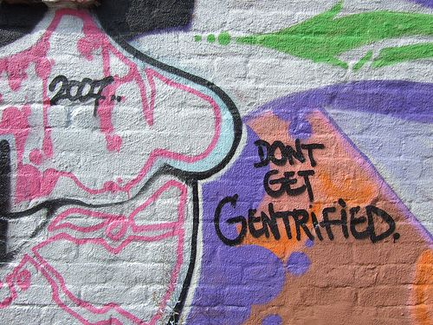
Re-Imaging
How did this take place in Harlem?

Slide 3
Re-urbanization/ Re-Imaging: What about MIC and LIC cities?

Slide 4
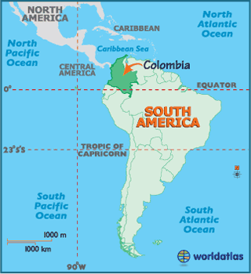
Location has made Colombia a center of drug trade and illicit activities. How?
Vast mountain ranges make it difficult for any government to control trade in drugs/arms
Four major neighbours to south provide market for drugs/arms
Central America to north only overland access point to North America (another market)
Access to two oceans for transport to rest of the world….

Slide 5
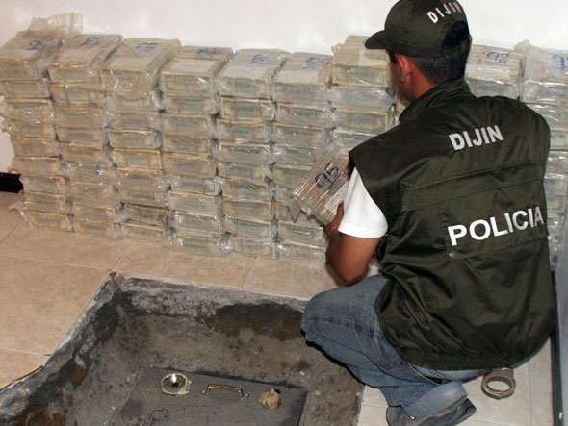
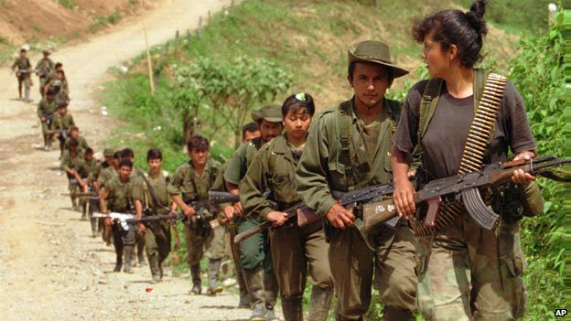
Colombia & Drug Trafficking:
Drug trafficking began in 1940s, during period of violence over fight to control of coffee trade
Small groups hid from violence and began arming themselves to survive in jungles – became guerilla fighters
Grew marijuana and then cocaine to make money
By 1980, the drug trafficking industry made up 6% of the GDP of Colombia; 90% of all cocaine in the USA came from Colombia

Slide 6
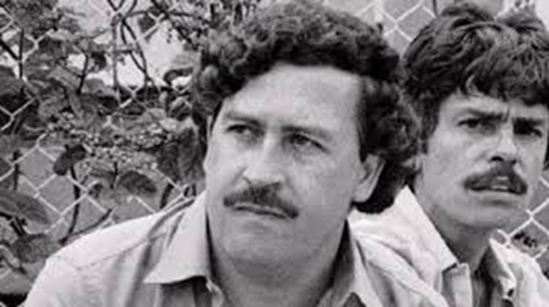
Escobar and Medellin
Medellin city of 2 million, 2nd largest in Colombia
‘Home base’ of biggest, most dangerous gang; Pablo Escobar
‘Murder Capital of the World:’ 6 500 murders a year in 1991
Entire neighbourhoods off-limits to law enforcement
Students afraid to go to school in low-income neighbourhoods

Slide 7
Re-Imaging and Rebranding:
Change the reputation of a whole city by focusing on a new identity AND changing the quality or appearance of a built up area

Slide 8
Read the article and answer questions below
Why was Medellin in decline in 1930’s-1990’s?
Name 5 Major redevelopment projects in Medellin?
Explain the importance of improving transport to urban renewal in Medellin.
What was the most important ‘marketing move’ to change Medellin?
What is the purpose of building the most beautiful spaces in the poorest areas?

